Slide 1
Educational laboratory demonstration unit
MPS® PA COMPACT WORKSTATION for measurement and automatic control of level, flow rate, temperature and pressure
Responsabile: Prof. Michele Miccio
Purchased on the FunzLab2015 Fund of the Teaching Council of Chemical Engineering
PROVIDES FROM FESTO CTE SRL AND tested May 6th 2016
Usable for students in the Process Instrumentation and Control course
Presentazione redatta da Mariagrazia Forte;
Rev. 2.6 of May 23, 2019 by Rocco Pierri
and Michele Miccio

Slide 2
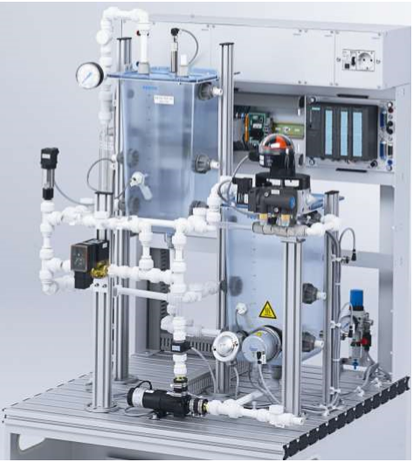
MPS® PA COMPACT WORKSTATION
OUTLINE OF THIS PRESENTATION:
Process Instrumentation
Feedback control loop components
P&ID
Software supplied

Slide 3
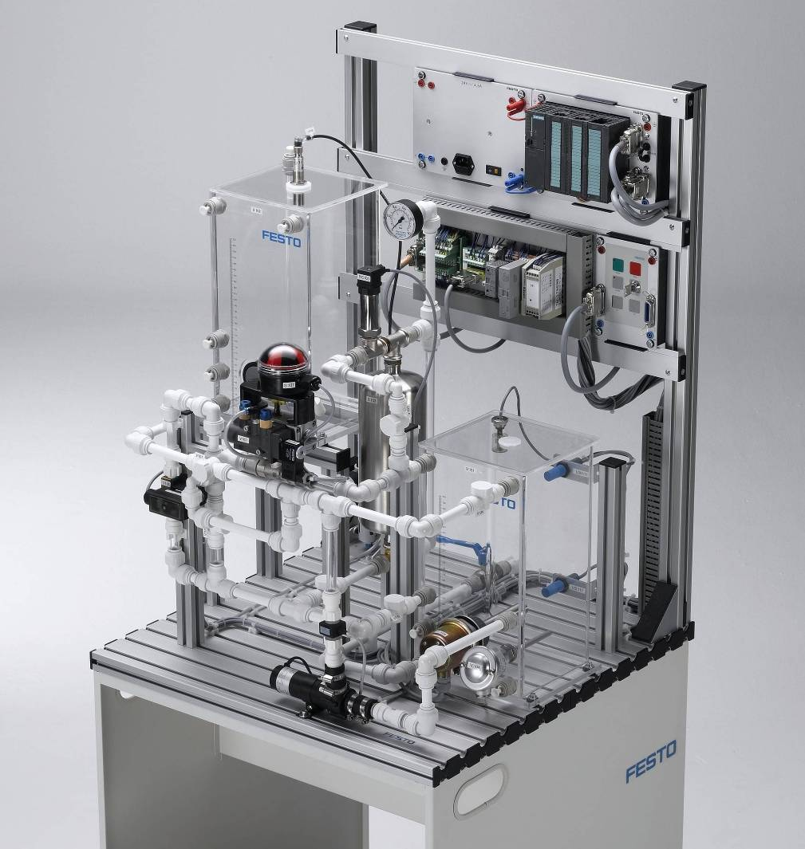

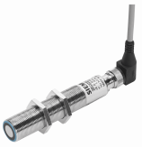
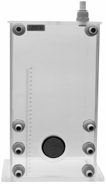
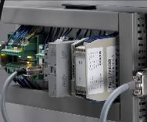
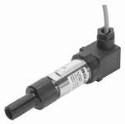
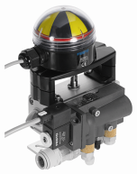
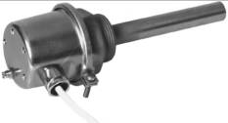
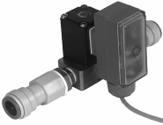

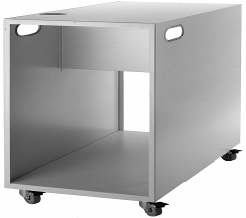
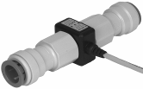
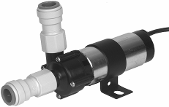

MPS® PA COMPACT WORKSTATION
Components
Controller
Ultrasonic sensor
I/O board
Tank
Pressure sensor
2-way
ball valve
Heater
Proportional
valve
Temperature sensor
Flow rate sensor
Trolley
Pump
Profile plate

Slide 4
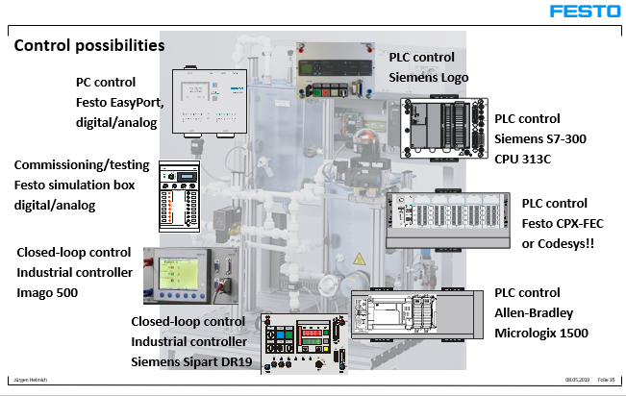
MPS® PA COMPACT WORKSTATION AUTOMATIC CONTROL
Among the various control possibilities shown in the figure, our workstation has the Festo EasyPort interface card.

Slide 5
process INStrumentaTion
installED

Slide 6
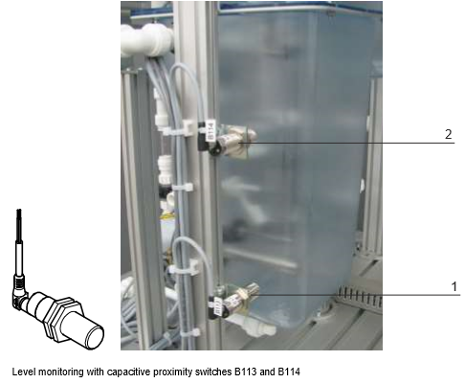
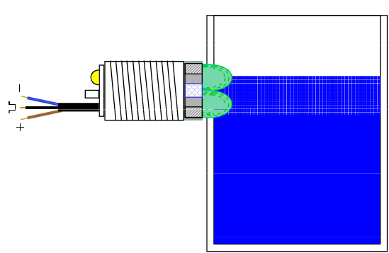
CAPACITIVE LEVEL SWITCH
Two capacitive switches B113 (1) e B114(2) are located in the lower part of the B101 tank.
The minimum tank level is indicated by the B113 switch. The maximum level is indicated by the B114.
The 24V output signal of the switches is wired as input to the I/O board.
PRINCIPLE OF OPERATION
It is based on the evaluation of a change in the capacitance of a capacitor in an RC circuit.
If the substance approaches the switch it increases the capacitance of the capacitor.
The capacity variation depends mainly on the distance, the dimensions and the constants of the fluid.

Slide 7
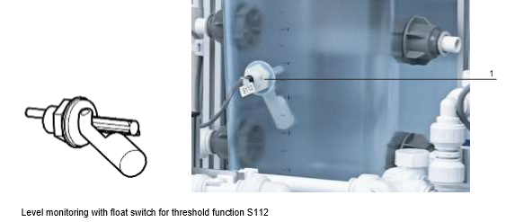
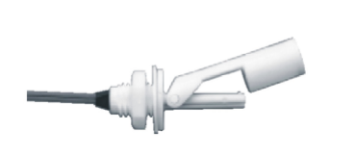
FLOAT LEVEL SWITCH threshold function
The increase in the liquid level in the B102 tank is monitored with the S112 float switch.
Likewise in the tank B101 there is the float switch S117.
It can be used to detect overflow or too much vacuum, just change the mounting position.
The digital signal is connected to the I/O card.
PRINCIPLE OF OPERATION
It is based on the variation of the liquid level.
The magnet integrated in the float activates the hermetically sealed tape switch in the housing.

Slide 8
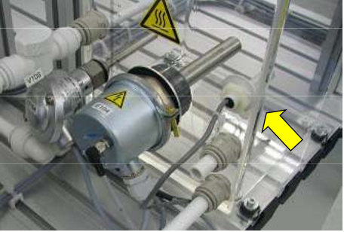
FLOAT LEVEL SWITCH threshold function
The S117 float switch is also used as a heater protection in the B101 tank.
It controls the reduction of the tank filling level.
Heating is switched off if the level drops below the heater.
The latter can be switched on only if the resistance is completely surrounded by water.
The resistance is connected in series with the digital output to activate heating.

Slide 9
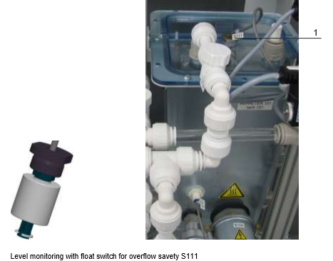
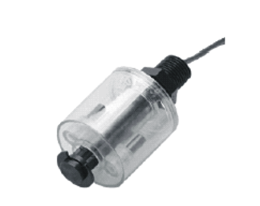
FLOAT LEVEL SWITCH overflow safety
The S111 float switch controls the B101 tank overflow.
It is designed exclusively for vertical installation.
PRINCIPLE OF OPERATION
If the level in the tank exceeds the maximum level, the floating transparent cylinder is pushed upwards.
Magnets inside this cylinder activate the alarm.
The 24V signal is connected to the I/O board.

Slide 10
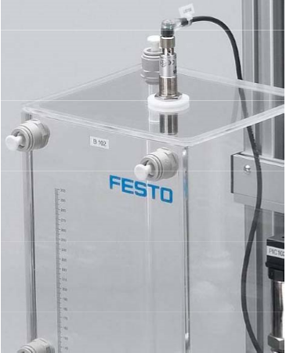
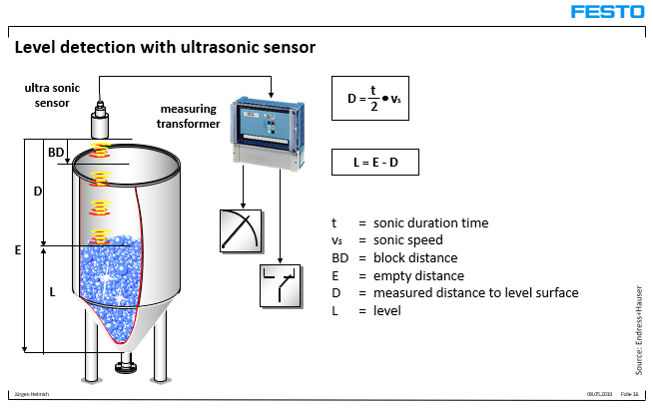
LEVEL SENSOR
The ultrasonic sensor B101 monitors the liquid level in the B102 tank.
It cannot give reliable measurements when the liquid level distance lower than 50 mm.
The current signal of the ultrasonic sensor is transformed into a voltage signal via a transducer: 4-20 mA → 0-10 V
PRINCIPLE OF OPERATION:
It is based on the generation of acoustic waves and their detection after the reflection of an object. A sound generator is operated for a short period of time by emitting an ultrasonic pulse. After emission, the ultrasonic pulse is reflected from the water surface and returned to the receiver. The duration of the ultrasonic pulse is electronically evaluated.

Slide 11
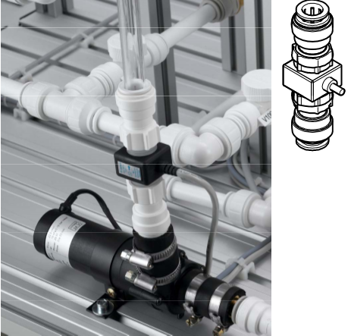
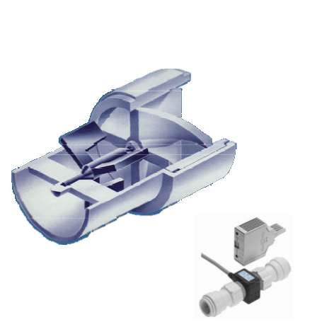
FLOWRATE SENSOR
The volumetric flow rate is detected by the axial vane flowmeter B102 equipped with an optoelectric infrared system (diode and photo transistor).
PRINCIPLE OF OPERATION
The fluid flowing through the rotating body transfer momentum to the turbine rotor blades.
The angular speed or the number of revolutions per minute of the turbine is proportional to the flow rate of the liquid and is detected by the built-in optoelectronic infrared system.
The minimum flow rate depends on the viscosity factor of the fluid.
The cavitation phenomenon in a turbine flow meter occurs when the local pressure drops near or under the vapor pressure of the liquid.

Slide 12
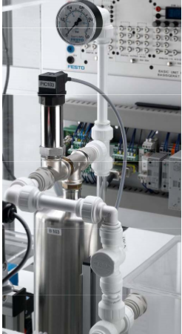
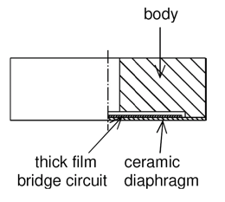
PRESSURE SENSOR
The pressure sensor B103 is a device based on the deformation measurement of an elastic element: ceramic measuring cell.
measurement range : 0 – 400 mbar
Output signal: 0 -10 V DC / 3-wire
Electrical supply 14-36 V DC
PRINCIPLE OF OPERATION
Ceramic cells are used in the pressure transduction of fluids in electrical signals. The deformation of the cell's ceramic membrane caused by the pressure of the fluid varies the distance between two metal plates that make up the plates of a condenser. As a result the capacitance of the condenser varies.

Slide 13
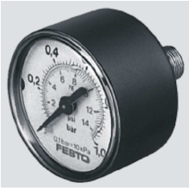
PRESSure INDICATOR
(Pressure gauge)
Range: 0 -1 bar
Operating pressure: 0 - 0.7 bar gauge
Type: Bourdon tube pressure manometer
Indicated with PI 105 on P&ID
PRINCIPLE OF OPERATION
It is perhaps the most used device for local pressure measurement.
It consists of an elastic tube with an elliptical section in the shape of an arc of circumference, having a fixed end. The free end deforms due to the forces generated by the pressure of the internal (measuring) fluid. The deformation is detected and transduced in a displacement of the indicator on a dial with a simple lever mechanism.

Slide 14
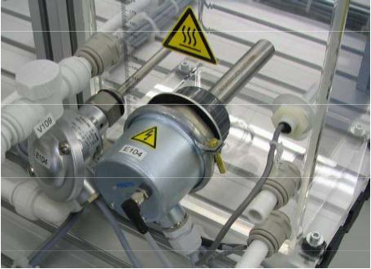
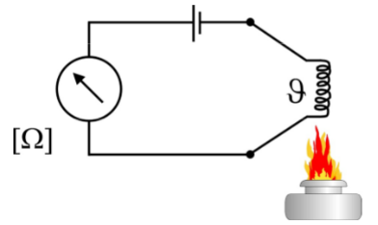
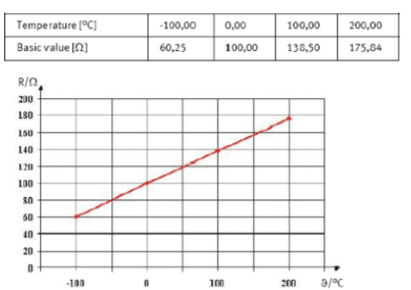

TEMPERATURE SENSOR
The B104 temperature measuring device is a platinum PT100 sensor, the resistance of which changes if the temperature is varied.
PRINCIPLE OF OPERATION
Pt100 is a PTC or rather a resistance with “Positive Temperature Coefficient”. The thermoresistance exploits the dependence of the electrical resistance of a conductor on temperature :
The calibration curve of the thermoresistance is a straight line

Slide 15
Final control elements
installED

Slide 16
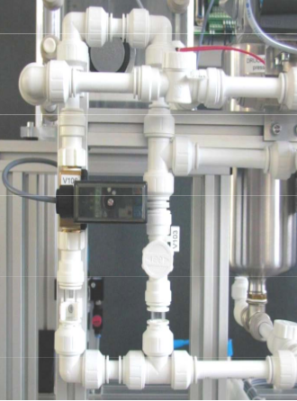
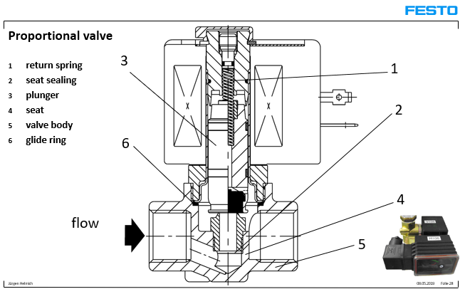
PROPORTIONAL VALVE
The proportional valve V106 is a 2/2 proportional globe-like valve for fluid flow control.
It can be used as a final control element.
The valve piston shutter is lifted from its seat according to the coil current of the M106 solenoid actuator.
The control signal, which is transformed into a PWM (pulse-with modulation) signal, lifts the piston from its seat.
PRINCIPLE OF OPERATION
The regulation of the opening and closing of the valve is obtained by adjusting the coil current.
In normal position the piston plug, with sealing rings, is pressed by the spring on the valve seat. When the coil current increases, the tensile force of the coil at some point will exceed the elastic reaction force of the spring. The piston rises. The fluid flows.

Slide 17
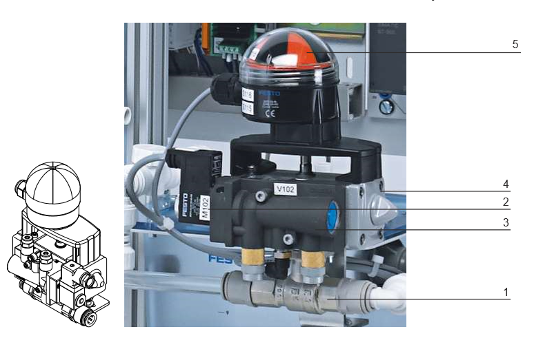
BALL VALVE
The ON/OFF ball valve V102 with a 2-position pneumatic actuator has the task of switching the liquid flow from the upper tank B102 to the lower tank B101.
PRINCIPLE OF OPERATION
The V102 is opened and closed by a quarter-turn pneumatic drive.
It consists of a brass ball valve (1) with rotary drive (4) using the "scotch yoke" principle. According to this principle a linear motion is transformed into a rotary motion.
A solenoid M102 (2), the pneumatic valve 5/2 (3) and the box for electrical signals (5) are mounted on the rotary actuator.

Slide 18
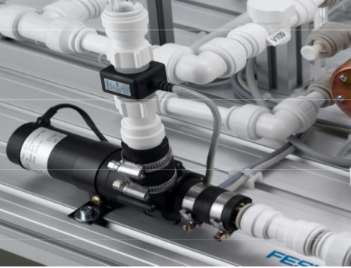
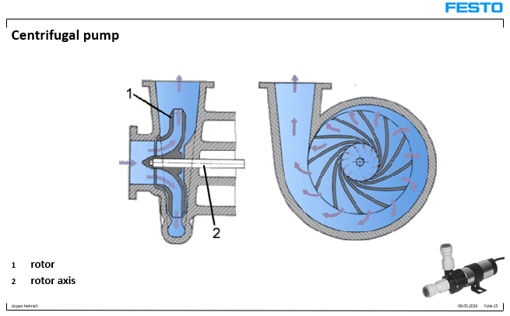
PUMP
The P101 centrifugal pump delivers the liquid from the B101 tank through the piping system.
It is operated by the M101 electric motor as an actuator.
It can be used as a final control element.
The centrifugal pump with a flow rate of about 5 L/min guarantees a continuous flow of liquid.
 The pump must not run dry, in which case noise will be heard. However, a short period of dry running will not damage the pump (max 15 minutes).
PRINCIPLE OF OPERATION
A rotor with blades rotates at high speed in a spiral-shaped casing of the pump. The rotor is driven by an electric motor.
Fluid enters the pump body through the suction nozzle, which is aligned with the rotary axis.
The fluid is radially accelerated by the rotor and is discharged from the pump body tangentially through the discharge nozzle.

Slide 19
PUMP
PUMP CHARACTERISTICS

Slide 20
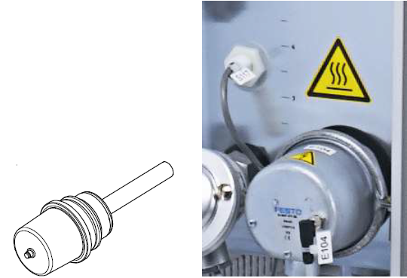
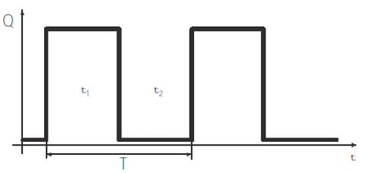
heating element
The E104 ohmic heater uses an electric resistance via a 230 V AC power supply.
It can be used as a final control element.
It is screwed into a 50 mm diameter hole in the tank B101. It must be operated only when it is immersed in the liquid. Two operating modes facilitate strictly digital or analog operation. If the digital operating mode is used, the heater is switched on and off via a 24 V input signal.
In the case of analog operation, the heating power can be continuously adjusted via an input signal from 0 to 10 V.
Heater control
The control is performed only through the activation of a binary output. To use the heating element as a continuous output, a pulse width modulation (PWM) must be used. Basically this modulation consists in sending a sequence of pulses which has a constant period T (time period ≤ 20 s) as shown in the figure, where Q represents the thermal power.
In manual, the switch-on time t₁ is taken as the integer greater than the% (pulse width) of T inserted as a value by the user.
In automatic control, the controller establishes the values of the switch-on time t₁ and the switch-off time t₂.

Slide 21
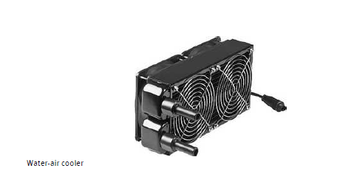
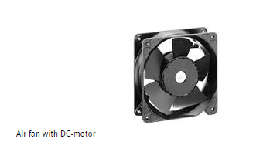
REFRIGERANT
(WATER-AIR COOLER)
The water-air cooler is a water-to-air heat exchanger (heat exchanger made of a pipe coil with aluminum fins) driven by two axial fans with a DC motor. Speed control is operated with an analog voltage signal 0-10 V.
A motor encoder feedback signal provides the motor rotation speed: only one motor encoder is connected for use.
The encoder square wave signal is converted with a frequency transducer into a 0-10 V voltage signal for processing with the controller.

Slide 22
P&ID

Slide 23
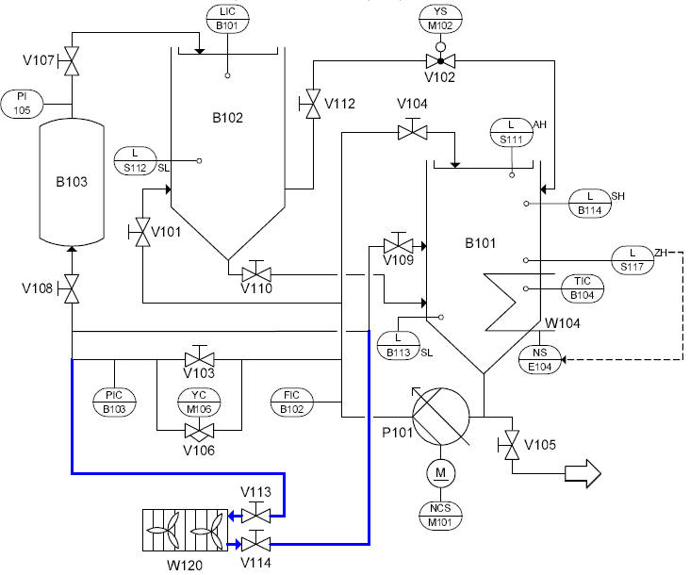
MPS PA® COMPACT WORKSTATION
SIMPLIFIED P&ID
Tanks
Heating element
Water-Air cooler
Pump

Slide 24
SUPPLIED Software

Slide 25
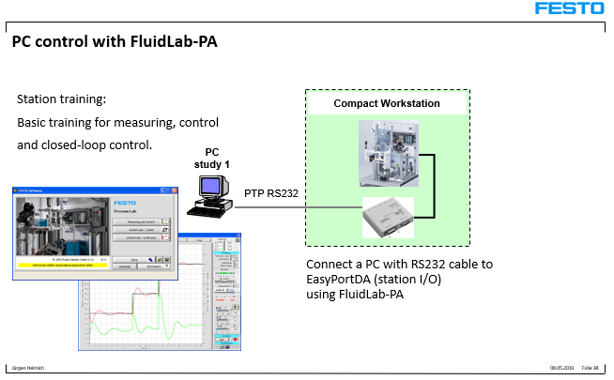
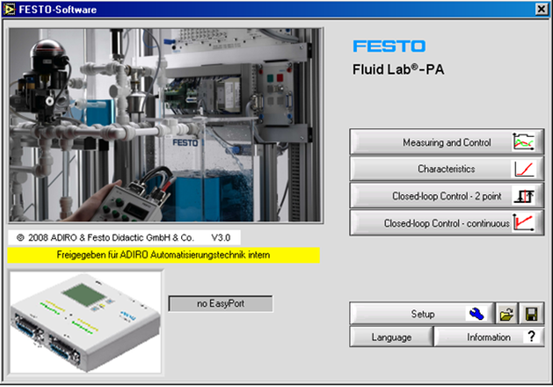
THE SW FluidLab-PA closed-loop
 Operating system MS Windows®
The “FluidLab®-PA closed loop” software, in combination with the "EasyPort digital / analog" card connected to a PC, offers the possibility of measuring, analyzing and managing signals.
Three main functions are integrated:
Measuring and control: for the detection, display and analysis of input signals: 8 digital/4 analog
Characteristics: for continuous or binary handling of output signals: 8 digital/2 analog
Closed loop control: to adjust a closed loop system with 2 modes: "2 point" (relay) or "continuous" (PID type controllers: P, I, PI, PD)

Slide 26
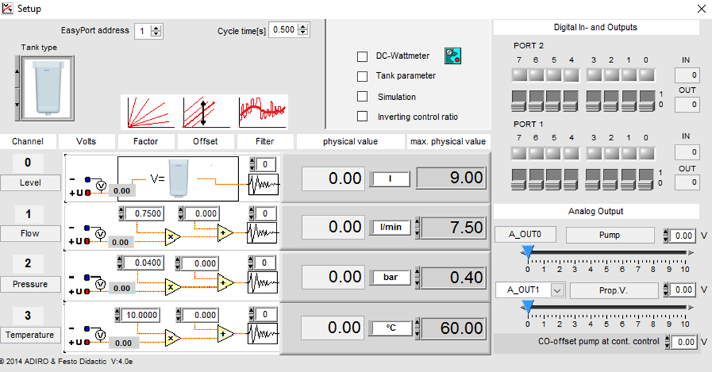
THE SW FluidLab-PA closed-loop
 Operating system MS Windows®
With the set-up window it is possible to test the process, i.e., activate the various elements (actuator, pump, etc.) and check the reaction of the system on the analog channel (Channel).
On each channel, which corresponds to a process variable, the value is detected for each variable (voltage, factor, offset, filter, etc.) and, finally, the maximum value that it can assume.

Slide 27
THE SW FluidLab-PA closed-loop
 Operating system MS Windows®
the Fluid-Lab PA software displays (see Figure 4) and logs SP(t) and PV(t) as non-dimensional values, i.e., normalized with respect to the maximum allowed level value

Slide 28
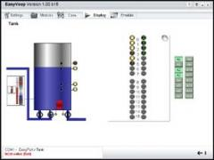
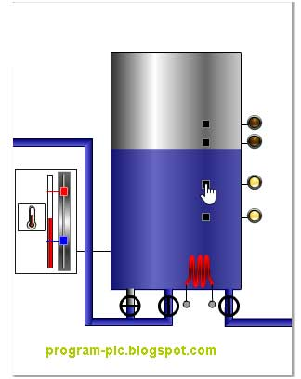
THE SW EasyVEEP
EasyVEEP is the new, free graphic 2D process simulation program with numerous attractive examples for PLC training.
PLC training has to be fun. This includes realistic exercises and processes.
The EasyVEEP process simulation program supplies the exercise description. Trainees develop the STEP 7 program. And the connections between the PC, EasyPort and the S7 are quickly and easily made with the cables supplied.

