Slide 1
UNIVERSITÀ DEGLI STUDI DI SALERNO
Bachelor Degree in Chemical Engineering
Course: Process Instrumentation and Control
(Strumentazione e Controllo dei Processi Chimici)
TUTOR’s SESSION No. 4
WRITTEN TEST No.2 of June 25, 2020 EXAM
by GIOVANNI Cascone
Rev. 1.0 – July 23, 2020

Slide 2
Section 3: DYNAMIC REFERENCE MODELS 3.1. Properties of the 1st order dynamic response (ex. n°1)
A first-order dynamic system, with unknown parameters, is disturbed by
i. a step input with amplitude 3.5 and
ii. a unit impulse input.
The dynamic response in both cases is y(t)=8 at the dimensionless time t/τ=1.5.
By using the generalized diagrams attached here, please calculate:
a. static gain;
b. time constant;
c. the value y(0) of the dynamic response to unit impulse input at the origin (t/τ=0).
NB: i parametri del sistema di primo ordine: K_{p} , τ_{p} e NON CAMBIANO se cambia la forzante (non si deve cercare un K_{p} , τ_{p} del primo e del secondo caso!!!)

Slide 3
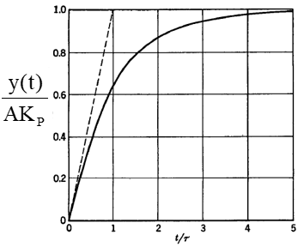
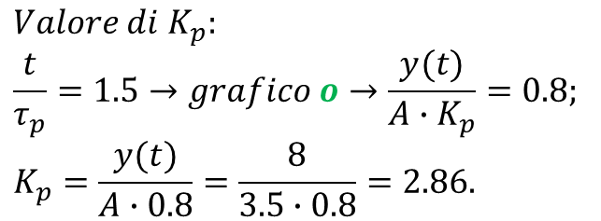
a. Static gain
A=3.5;
y(t)=8 @ t/τ=1.5;
Grafico generalizzato per la risposta ad una forzante a gradino (K_{p} unica incognita).
NB: con soli questi dati non può essere utilizzato il grafico generalizzato per la risposta ad una forzante a impulso (K_{p} e τ_{p} incognite!!!).
$$Valore di K_{p}:$$
$$\frac{t}{τ_{p}}=1.5→grafico o→\frac{y(t)}{A∙K_{p}}=0.8;$$
$$K_{p}=\frac{y(t)}{A∙0.8}=\frac{8}{3.5∙0.8}=2.86.$$

Slide 4
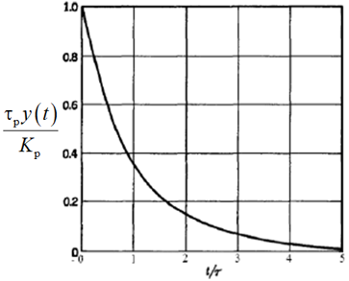
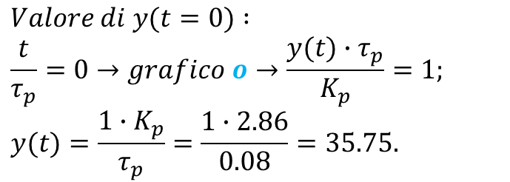
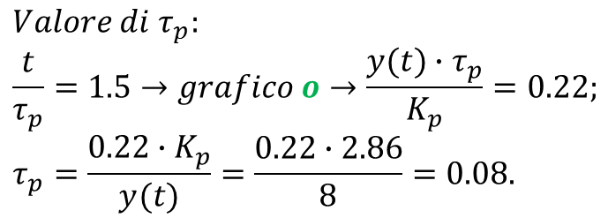
b. Time constant
K_{p}=2.86;
y(t)=8 @ t/τ=1.5;
Grafico generalizzato per la risposta ad una forzante a impulso (K_{p} ora è nota e τ_{p} è l’unica incognita).
$$Valore di τ_{p}:$$
$$\frac{t}{τ_{p}}=1.5→grafico o→\frac{y(t)∙τ_{p}}{K_{p}}=0.22;$$
$$τ_{p}=\frac{0.22∙K_{p}}{y(t)}=\frac{0.22∙2.86}{8}=0.08.$$
c. Y(0) to unit impulse input @ t/τ=0
K_{p}=2.86;
τ_{p}=0.08;
Origine→t=0→t/τ=0.
Grafico generalizzato per la risposta ad
una forzante a impulso.
$$Valore di y(t=0) :$$
$$\frac{t}{τ_{p}}=0→grafico o→\frac{y(t)∙τ_{p}}{K_{p}}=1;$$
$$y(t)=\frac{1∙K_{p}}{τ_{p}}=\frac{1∙2.86}{0.08}=35.75.$$

Slide 5
3.2. Parametric model (ex. n°2)
$$G_{P}(s)=\frac{ks+2}{s^{2}+5s+6}$$
The dynamics of a process is described by the following transfer function:
where k is a parameter.
a. What order is this dynamic system?
$${Sistema dinamico del secondo ordine perchè s}^{2}\underset{→}{ℒ^{−1}}\frac{d^{2}y}{dt^{2}}nel dominio di t$$
b. How much is the static gain K_{p} parametrically expressed as a function of k ?
$$Per valutare K_{P} bisogna esprimere numeratore e denominatore in forma canonica$$
$$\left(termine noto unitario\right):$$
$$G_{P}\left(s\right)=\frac{2\left(\frac{ks}{2}+\frac{2}{2}\right)}{6\left(\frac{s^{2}}{6}+\frac{5s}{6}+\frac{6}{6}\right)}=\frac{1}{3}\frac{\left(\frac{1}{2}ks+1\right)}{\left(\frac{1}{6}s^{2}+\frac{5}{6}s+1\right)}=\frac{1/3\left(\frac{1}{2}ks+1\right)}{\left(\frac{1}{6}s^{2}+\frac{5}{6}s+1\right)}$$
$$Ricordando:G_{P}\left(s\right)=\frac{K_{P}\left(τ_{d}s+1\right)}{{τ_{P}^{2}s}^{2}+2ζτ_{P}s+1} allora K_{P}=\frac{1}{3} e NON é PARAMETRICO in k$$
$$\left(potendo anche pensare a K_{P}=\lim_{s→0}{G_{P}(s) }\right)$$
c. How much is the time constant in the denominator?
$$τ_{P}^{2}=\frac{1}{6}→τ_{P}=\sqrt{\frac{1}{6}}=0.41$$
Notes:
Tau_d=Tau_lead

Slide 6
d. Assign a suitable value to the parameter k so that the numerator has a zero equal to a pole
$$G_{P}\left(s\right)=\frac{ks+2}{s^{2}+5s+6} Poli:s^{2}+5s+6=0;s=\frac{−5∓\sqrt{5^{2}−4∙6∙1}}{2∙1}=\frac{−5∓1}{2}=−2;−3.$$
$$Lo zero \left(parametrico in k\right) è: ks+2=0→s=−\frac{2}{k}.$$
$$Valori di k affinchè lo zero sia uguale ad un polo:$$
$$\left\{\begin{aligned}−\frac{2}{k}=−2 \\ −\frac{2}{k}=−3 \end{aligned}→\right.\left\{\begin{aligned}−\frac{2}{−2}=k \\ −\frac{2}{−3}=k \end{aligned}→\right.\left\{\begin{aligned}k=1 \\ k=\frac{2}{3} NON \frac{3}{2}‼!\end{aligned}\right.$$
$$NB:se si verificano i valori di k nel numeratore della G_{P}\left(s\right) si individuano$$
$$immediatamente eventuali errori di calcolo‼!$$

Slide 7
3.3. Poles and zeros of a transfer function (ex. n°3)
Not all transfer function have poles!
a. How is a transfer function called if it contains poles and zeros only?
Funzione di trasferimento razionale
For the following Transfer Function:
$$G(s)=\frac{s+\frac{1}{2}}{\left(s^{2}+2s\right)\left(3s^{2}+s+3\right)}$$
b. Calculate the poles and, for each pole or pair of poles, provide the type of stability that characterizes its dynamic response in the time domain
$$\left(s^{2}+2s\right)\left(3s^{2}+s+3\right)=0; \left\{\begin{aligned}s=0 \\ s+2=0 \\ 3s^{2}+s+3=0\end{aligned}\right.; \left\{\begin{aligned}s=0 \\ s=−2 \\ s=\frac{−1∓\sqrt{1^{2}−4∙3∙3}}{2∙3}=\frac{−1∓j\sqrt{35}}{6}\end{aligned}\right.$$
$$\left\{\begin{aligned}p_{1}=0→marginalmente stabile \\ p_{2}=−2→stabile \\ p_{3}=−\frac{1}{6}+j\frac{\sqrt{35}}{6};p_{4}=−\frac{1}{6}−j\frac{\sqrt{35}}{6}→stabili\end{aligned}\right.$$
Notes:
Tau_d=Tau_lead

Slide 8
c. Calculate the poles and, for each pole or pair of poles, provide the type of stability that characterizes its dynamic response in the time domain
$$\left\{\begin{aligned}p_{1}=0 \\ p_{2}=−2 \\ \begin{aligned}p_{3}=−\frac{1}{6}+j\frac{\sqrt{35}}{6}\sim −0.16+j \\ p_{4}=−\frac{1}{6}−j\frac{\sqrt{35}}{6}\sim −0.16−j\end{aligned}\end{aligned}\right.$$
No!!! Riconoscere che l’ascissa è <|0.5| e l’ordinata circa |1|
X
p₃
X
X
p₂
X
p₁
X
p₄
X
X
X
Notes:
Tau_d=Tau_lead

Slide 9
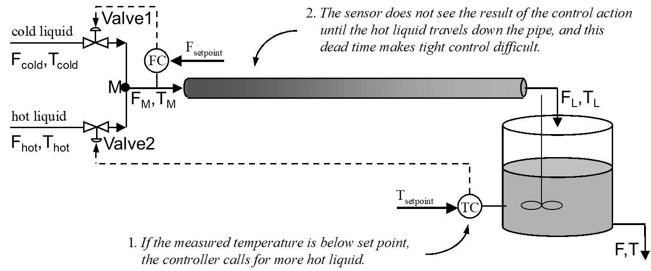
Section 4: PROCESS CONTROL 4.1. Feedback control (ex. n°4)
The figure shows a simplified PI&D of a continuous process with feedback control.
With ref. to the control loop dedicated to temperature in the mixer, among the various variables (flow rate, temperature, etc.), please
a. Select the controlled variable
T (variabile catturata dall’elemento di misura)
b. Select the manipulated variable
F_{hot} o F_{M} (la valvola=elem. finale di controllo agisce su una portata. NO T_{M}!!!)
c. Select the disturbance variable (if any)
F_{cold},T_{cold} o F_{hot},T_{hot} (cercare i disturbi tra gli ingress all’intero sistema. NO T_{L}!!!)
e. What kind of signals is used for communication in this case of feedback control?
Segnale elettrico standard: 4÷20 mA
/controlled
y_{sp}(t)
comparator
ε(t)
o(t)
m(t)
y(t)
d(t)
y_{m}(t)
Notes:
Il segnale pneumatico non è descritto in maniera esplicita

Slide 10
d. Define the role that each control block component has in the Feedback Block Diagram, and that is specific to the case in question
Liquid tank→Process
Mixer M→Process
Control Valve1→No role
Control Valve2→Final control element
FC→No role (nel controllo di T)
TC→Controller (non solo sensore!!!)
/controlled
y_{sp}(t)
comparator
ε(t)
o(t)
m(t)
y(t)
d(t)
y_{m}(t)

