Slide 1
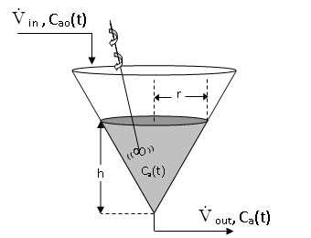
Written Test No.2 – Section 6: Development of a mathematical model of a lumped parameter system (Compito d'esame del 27.07.2005 / Examination text of July 27, 2005)
An inverted cone CSTR with the axis perpendicular to the ground has a base radius equal to R while the height is equal to H. It is normally filled with a liquid solution of density ρ for a height h < H.
A flow of liquid V'_{in} is introduced from the top, while a port is at the bottom, corresponding to the vertex of the cone, from which a flow rate V’_{out} exits.
A simple chemical reaction A → P occurs.
The variable that we intend to predict with the model is the concentration of unreacted A C_{a}(t).
The following assumptions hold:
The density of the liquid ρ is constant;
The system is isothermal;
The volume and the height h are constant, therefore the volumetric flow rate V’_{in}=V’_{out} =V'=constant;
The reaction kinetics is linear, i.e., (-r_{A})=kC_{a}(t).

Slide 2
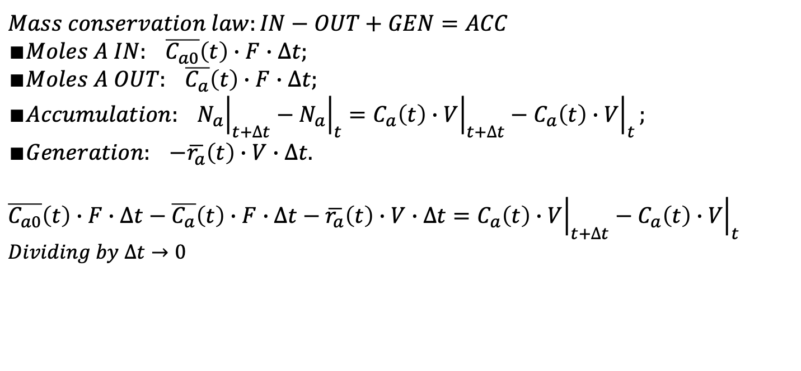
Dynamic mathematical model
Assumptions:
Constant physical properties;
Constant volume;
Perfect cone tank;
Well mixed;
No shaft work;
No heat of reaction;
Constant temperature;
k not a f(t);
No evaporation.
Units:
C_{ao}, C_{a} [=] moles/L;
V’ = F [=] L/s;
V [=] L;
h, r [=] dm;
t [=] s;
k [=] 1/s;
r_{A}(t) [=] mol/(s*L).
Initial Condition: C_{a0}(0)=C_{as}
𝐵a𝑙𝑎𝑛𝑐e on the 𝑐𝑜𝑚𝑝𝑜𝑛𝑒𝑛𝑡 𝐴
$$Mass conservation law:IN−OUT+GEN=ACC$$
$$∎Moles A IN: \overline{C_{a0}}\left(t\right)∙F∙∆t;$$
$$∎Moles A OUT: \overline{C_{a}}\left(t\right)∙F∙∆t;$$
$$∎Accumulation: {\left.N_{a}\right|}_{t+∆t}−{\left.N_{a}\right|}_{t}={\left.C_{a}\left(t\right)∙V\right|}_{t+∆t}−{\left.C_{a}\left(t\right)∙V\right|}_{t};$$
$$∎Generation: −\overline{r_{a}}\left(t\right)∙V∙∆t.$$
$$\overline{C_{a0}}\left(t\right)∙F∙∆t−\overline{C_{a}}\left(t\right)∙F∙∆t−\overline{r_{a}}\left(t\right)∙V∙∆t={\left.C_{a}\left(t\right)∙V\right|}_{t+∆t}−{\left.C_{a}\left(t\right)∙V\right|}_{t}$$
$$Dividing by ∆t→0$$
Notes:
Vige la proporzionalità tra i cateti di un triangolo rettangolo per cui r/R=h/H.

Slide 3
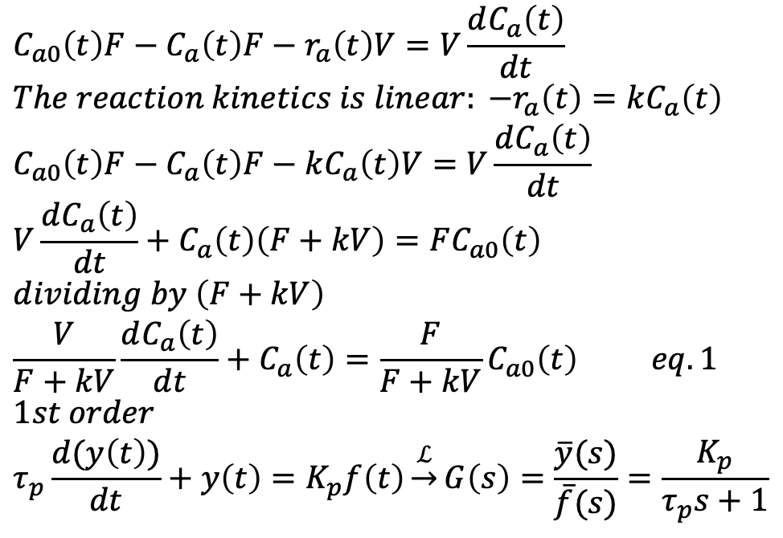
$$C_{a0}\left(t\right)F−C_{a}\left(t\right)F−r_{a}\left(t\right)V=V\frac{dC_{a}\left(t\right)}{dt}$$
$${The reaction kinetics is linear: −r}_{a}\left(t\right)=kC_{a}\left(t\right)$$
$$C_{a0}\left(t\right)F−C_{a}\left(t\right)F−kC_{a}\left(t\right)V=V\frac{dC_{a}\left(t\right)}{dt}$$
$$V\frac{dC_{a}\left(t\right)}{dt}+C_{a}\left(t\right)\left(F+kV\right)=FC_{a0}\left(t\right)$$
$$dividing by \left(F+kV\right)$$
$$\frac{V}{F+kV}\frac{dC_{a}\left(t\right)}{dt}+C_{a}\left(t\right)=\frac{F}{F+kV}C_{a0}\left(t\right) eq. 1$$
$$1st order$$
$$τ_{p}\frac{d(y\left(t\right))}{dt}+y\left(t\right)=K_{p}f\left(t\right)\underset{→}{ℒ}G\left(s\right)=\frac{\overline{y}(s)}{\overline{f}(s)}=\frac{K_{p}}{τ_{p}s+1}$$
It can be said that the system corresponds to a first-order, linear, non-homogeneous model with constant coefficients. Clearly C_{a}(t) represents the dynamic response y(t) and C_{a0}(t) represents the forcing function f(t) that can be, for example, a step.
The system parameters are:
$$K_{p}=\frac{F}{F+kV}\left[=\right]adim.\left(\frac{ΔC_{a}}{ΔC_{a0}} eq. 1\right), τ_{p}=\frac{V}{F+kV}\left[=\right]s$$
$$Transfer Function :G\left(s\right)=\frac{\overline{y}(s)}{\overline{f}(s)}=\frac{K_{p}}{τ_{p}s+1}=\frac{\left(\frac{F}{F+kV}\right)}{\left(\frac{V}{F+kV}\right)s+1}$$
Notes:
Vige la proporzionalità tra i cateti di un triangolo rettangolo per cui r/R=h/H.

