Slide 1
Mathematical Modeling
Prof. Ing. Michele MICCIO
Dept. of Industrial Engineering
(Università di Salerno)
Prodal Scarl (Fisciano)
Rev. 7.01 of December 10, 2014
Notes:
1

Slide 2
TYPES OF MODELS
Models are used not only in the natural sciences (such as physics, biology, life sciences, earth science, meteorology) and engineering-architecture disciplines, but also in the social sciences (such as economics, psychology, sociology and political science).
Here is a list:
• Physical Models
• Analogic Models
• Provisional Theories
(e.g., molecular and atomic models)
• Maps and Drawings
(e.g., PI&D, geographycal maps, etc.)
• Mathematical and symbolic models
 § 1.4 in Himmelblau D.M. e Bischoff K.B., “Process Analysis and Simulation”, Wiley & Sons Inc., 1967

Slide 3
Why modeling?
Some answers …
Models are usually more accessible to study than the actual system modeled.
Changes in the structure of a model are easier to implement, and changes in the behavior of a model are easier to isolate, understand, and communicate to others.
A model can be used to achieve insight when direct observation/experimentation with the actual system is too dangerous, disruptive, or demanding.
A model can be used to answer questions about a system that has not yet been observed or built, or even one that cannot be observed or built with present technologies.

Slide 4

MATHEMATICAL MODELING
A mathematical model is a description of a system using mathematical concepts and language.
The process of developing a mathematical model is termed mathematical modeling.
Mathematical models are used not only in the NATURAL SCIENCES (such as physics, biology, earth science, meteorology) and ENGINEERING DISCIPLINES (e.g. computer science, artificial intelligence), but also in the SOCIAL SCIENCES (such as economics, psychology, sociology and political science);
physicists, engineers, statisticians, operations research analysts and economists use mathematical models most extensively.
A model may help to explain a system and to study the effects of different components, and to make predictions about behavior.

Slide 5
MATHEMATICAL MODELING
General statements
A mathematical model usually describes a system by a set of variables and a set of equations that establish relationships between the variables.
Relationships can be described by operators, such as algebraic operators, functions, differential operators, etc.
Anonymous
A mathematical model is a representation, in mathematical terms, of certain aspects of a non-mathematical system
Aris, 1999
A model may be prescriptive or illustrative, but, above all, it must be useful !
Wilson, 1991

Slide 6
Why Math Modeling ?
Is it:
  to design a controller?
  to analyze the performance of the process?
  to understand the process/system better?
  to simplify the complexity of a system?
Introduction to Process Control Romagnoli & Palazoglu

Slide 7
Mathematical model development strategy
The development of a model and its structure are intimately related to the goals of modeling.
In other words, the complexity of a model should be commensurate with the ultimate application in which it will be used.
In model development, always start by trying the simplest model and then only add complexity to the extent needed
Keep things as simple as possible, but not simpler
A. Einstein
Introduction to Process Control Romagnoli & Palazoglu

Slide 8
Mathematical model development:
Complexity vs. Simplicity
Ratio of costs to benefits
Introduction to Process Control Romagnoli & Palazoglu

Slide 9
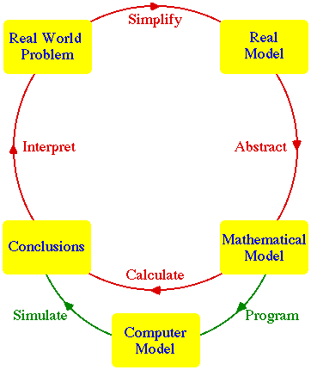
Mathematical model development strategy: cycling

Slide 10
Mathematical model development strategy: cycling (2)
Problem description
Mathematical representation
Data
collection
Parameter tuning
ko
Validation
ko
ok
Model use
From
Prof. Giorgio Guariso slides

Slide 11
Validation
In modeling and simulation, the process of determining the degree to which a model or simulation is an accurate representation of the real world from the perspective of the intended uses of the model or simulation.
From ✓
http://www.thefreedictionary.com

Slide 12
VARIABLES
Definition
A variable represents a relevant property of the system, being modeled.
A variable can be, for example, physical or chemical quantities, measured system outputs often in the form of signals, timing data, counters, and event occurrence (yes/no).
Mathematically, a variable can be an unknown appearing in equations and disequations or a function of one or more independent variables.
 The actual model is the set of functions that describe the relations between the different variables.
Notes:
NEW

Slide 13
VARIABLES
Examples
The most common variables in chemical and process engineering are:
1. composition/concentration
2. temperature
3. pressure
4. rate
5. repetition variable
Variables 1 to 3 are referred to as “intensive” as they do not depend on mass or size of the system being considered.
A rate can be related to matter (mass, mole, volume) or energy (heat) or momentum (force).
Rate is an “extensive” variable.
A repetition variable is used to account for realization of a given operation through a number of stages or units, being all equal in their working principle.
Generally, each variable is defined in a given interval.
N_{V} = No. of variables in the model being considered.

Slide 14
COMPOSITION VARIABLES
Notes:
NEW

Slide 15
VARIABLES
1st Classification
(on the base of the mathematical set membership)
A variable can be, depending on its value:
  real
  natural
  integer
  boolean
  strings
 A variable can be “continuous” or “discrete”.
Notes:
NEW

Slide 16
VARIABLES
2nd Classification
(on the base of the role in engineering calculations)
Specified variables
or Specifications
They are those variables that represent physical-chemical properties or that are fixed by designers, regulations, environmental considerations, etc. prior to the design phase.
Design variables
They are variables selected by designers.
Generally, their values are chosen in order to satisfy an optimum condition for a given “objective function”.
Unknown variables
They are those variables that are calculated by the available system of equations once values for Design Variables have been fixed.

Slide 17
Mathematical Models
1st classification
(on the base of the approach
adopted for model development)
Deterministic Models
  “First principles Models”
    Basic models
    Models involving transport phenomena
    Models based on the “population balance approach”
  Empirical or “fitting” models
  Dynamic models
    dynamic models with “input-output representation”
    state-space dynamic models
    black box dynamic models
  Time Series
  Statistical models
 rielaborated from § 1.4 in Himmelblau D.M. e Bischoff K.B., “Process Analysis and Simulation”, Wiley & Sons Inc., 1967
Notes:
new

Slide 18
Mathematical Models
1st classification
(on the base of the approach
adopted for model development)
  First principles Models
  or
  Fundamental Models
  ( Palazoglu & Romagnoli, 2005)
  or
  Mechanistic or White Box Models
  ( Roffel & Betlem, 2006)
    Modelli basati sui “fenomeni di trasporto”
  Modelli basati sul “bilancio di popolazione”
  Modelli empirici o di “fitting”
  Modelli dinamici
    Modelli dinamici “con rappresentazione ingresso-uscita”
    Modelli dinamici “con rappresentazione nello spazio di stato”
    Modelli dinamici a scatola nera (black box)
  Serie temporali
  Modelli statistici

Slide 19
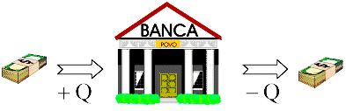
FUNDAMENTAL LAW
GENERAL CONSERVATION PRINCIPLE
[IN] – [OUT] + [GEN] = [ACC]
NB: GEN > 0 → formation
GEN < 0 → disappearance
SIMPLER CASES
For a chemical element:
IN - OUT = ACC
At steady-state:
IN - OUT + GEN = 0
At steady-state and without chemical/biochemical reactions:
IN - OUT = 0
Notes:
new

Slide 20
First principles models
(including population balance models)
NB:
The description of such a system and the development of such a model require the concept of:
control volume
or
system boundary

Slide 21
Mathematical Models
1st classification
(on the base of the approach
adopted for model development)
  “First principles Models”
    Basic models
    Models involving transport phenomena
    Models based on the “population balance approach”
  Empirical or “fitting” models
  Dynamic models
    dynamic models with “input-output representation”
    state-space dynamic models
    black box dynamic models
  Time Series
  Statistical models
 rielaborated from § 1.4 in Himmelblau D.M. e Bischoff K.B., “Process Analysis and Simulation”, Wiley & Sons Inc., 1967
Notes:
NEW

Slide 22
First principles mathematical models.
Malthusian Growth Model
An Early and Very Famous Population Model
In 1798 the Englishman Thomas R. Malthus posited a mathematical model of population growth. He model, though simple, has become a basis for most future modeling of biological populations. His essay, "An Essay on the Principle of Population," contains an excellent discussion of the caveats of mathematical modeling and should be required reading for all serious students of the discipline. Malthus's observation was that, unchecked by environmental or social constraints, it appeared that human populations doubled every twenty-five years, regardless of the initial population size. Said another way, he posited that populations increased by a fixed proportion over a given period of time and that, absent constraints, this proportion was not affected by the size of the population.
By way of example, according to Malthus, if a population of 100 individuals increased to a population 135 individuals over the course of, say, five years, then a population of 1000 individuals would increase to 1350 individuals over the same period of time.
Malthus's model is an example of a model with one variable and one parameter. A variable is the quantity we are interested in observing. They usually change over time. Parameters are quantities which are known to the modeler before the model is constructed. Often they are constants, although it is possible for a parameter to change over time. In the Malthusian model the variable is the population and the parameter is the population growth rate.

Slide 23
Example No. 1
Malthusian Growth Model
GENERAL CONSERVATION LAW
applied to No. of individuals in a “closed system”: ACC = GEN
GEN = birth - death
INITIAL CONDITION:
STATE VARIABLES
PARAMETERS
CLASSIFICATION
DYNAMIC AUTONOMOUS MATHEMATICAL MODEL
made by 1 ODE (Order =1) ,
LINEAR, CONSTANT COEFFICIENT MODEL

Slide 24
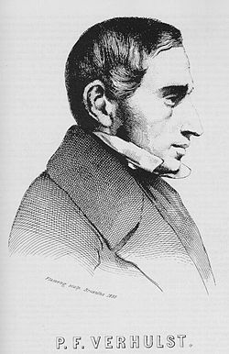
Example No. 2
Logistic Model
Differently from the Malthusian model …
developed by Belgian mathematician Pierre Verhulst (1838)
HYPOTHESES
resources are limited for growth: N(t)≤N_{sat}
GENERAL CONSERVATION LAW
applied to No. of individuals in a “closed system”: ACC = GEN GEN = birth - death
STATE VARIABLES
PARAMETERS
CLASSIFICATION
Dynamic autonomous mathematical model
made by 1 ODE (Order =1) ,
non linear, constant coefficient model
Notes:
NEW

Slide 25


First principles mathematical models.
The prey-predator model
BIBLIO REF.
Lotka A.J. (1925) Elements of Physical Biology. Baltimore: Williams & Wilkens.
Volterra V. (1926) "Variazioni e fluttuazioni del numero d’individui in specie animali conviventi", Mem.R.Accad.Naz.dei Lincei, Ser.VI, 2
1st president of National Research Council (CNR) of Italy
The idea is that, if left to themselves with an infinite food supply, the rabbits or zebras would live happily and experience exponential population growth.
On the other hand, if the foxes or lions were left with no prey to eat, they would die faster than they could reproduce, and would experience exponential population decline.

Slide 26
First principles mathematical models.
The prey-predator model
ASSUMPTIONS
In words, the model states that:
Each prey gives rise to a constant number of offspring per year;
In other words, there are no other factors limiting prey population growth apart from predation.
Each predator eats a constant proportion of the prey population per year;
In other words, doubling the prey population will double the number eaten per predator, regardless of how big the prey population is.
Predator reproduction is directly proportional to prey consumed;
Another way of expressing this is that a certain number of prey consumed results in one new predator; or that one prey consumed produces some fraction of a new predator.
A constant proportion of the predator population dies per year.
In other words, the predator death rate is independent of the amount of food available.

Slide 27
Example No. 3
The prey-predator model
GENERAL CONSERVATION LAW
applied to No. of individuals in a “closed system”: ACC = GEN
GEN = birth - death
“maltusian” term
interaction term
STATE VARIABLE
VECTOR
VECTOR OF
PARAMETERS
INITIAL CONDITION
CLASSIFICATION
DYNAMIC AUTONOMOUS MATHEMATICAL MODEL
made by 2 ODEs (Order = 2) ,
NON LINEAR, CONSTANT COEFFICIENT MODEL

Slide 28


First principles mathematical models.
The prey-predator model with 2 parameters
carrying capacity
INITIAL CONDITION
STEADY-STATE or EQUILIBRIUM POINTS
☞ Cleve Moler, Experiments with MATLAB, 2009
http://www.mathworks.com/moler/exm/chapters.html
Notes:
28

Slide 29
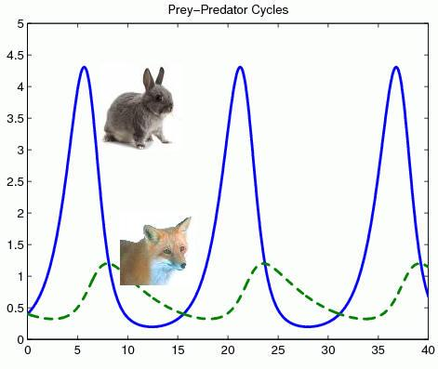
First principles mathematical models.
The prey-predator model
Issues related to mathematical solution
TYPES OF SOLUTION
  Steady-state solutions
  Periodic solutions
STABILITY OF SOLUTIONS
Time profile
or
Time series
http://www.scholarpedia.org/article/Predator-prey_model

Slide 30

First principles mathematical models.
The prey-predator model with 2 parameters
MatLab SOLUTION (1)
run file LOTKADEMO.M
calling function LOTKA.M
function yp = lotka(t,y)
%LOTKA Lotka-Volterra predator-prey model.
% Copyright 1984-2002 The MathWorks, Inc.
% Revision: 5.9 by Michele MICCIO: May 8, 2008
% suggested parameters in the original file by MatLab:
% ALPHA=0.01
% BETA=0.02
yp = diag([1 - ALPHA*y(2), -1 + BETA*y(1)])*y;
Notes:
30

Slide 31

First principles mathematical models.
The prey-predator model with 2 parameters
MatLab SOLUTION (2)
run file PREDPREY.M
Use of graphycal interface
function predprey(action)
% PREDPREY Predator-prey GUI.
% Drag the red dot to change equilibrium point.
% Drag the blue-green dot to change the initial conditions.
% Default parameters.
mu = [300 200]'; % Equilibrium.
eta = [400 100]'; % Initial conditions.
% Predator-prey ode
function ydot = ppode(t,y);
ydot = [(1-y(2)/mu(2))*y(1);
-(1-y(1)/mu(1))*y(2)];
end
Notes:
31
31

Slide 32
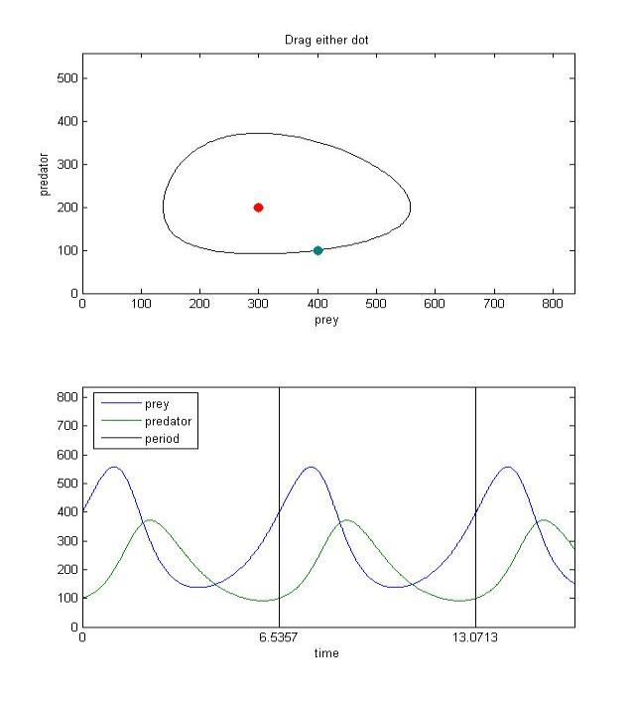
First principles mathematical models.
The prey-predator model with 2 parameters
Phase portrait
predprey.m
Time profile
or
Time series
Notes:
32

Slide 33
Mathematical Models
1st classification
(on the base of the approach
adopted for model development)
  “First principles Models”
    Basic models
    Models involving transport phenomena
    Models based on the “population balance approach”
  Empirical or “fitting” models
  Dynamic models
    dynamic models with “input-output representation”
    state-space dynamic models
    black box dynamic models
  Time Series
  Statistical models
 rielaborated from § 1.4 in Himmelblau D.M. e Bischoff K.B., “Process Analysis and Simulation”, Wiley & Sons Inc., 1967
Notes:
NEW

Slide 34
Transport Phenomena
General Law
Examples:
Newton law of viscosity
Fourier law of heat conduction
1st Fick law of diffusion

Slide 35
Transport and Kinetic Rate Equations
Momentum, Heat and Mass transfers
 | Heat | Mass | Momentum
Flux | q | n_{A} | τ_{xy}
Diffusion transfer (microscopic scale)
Law | Fourier’s law | Fick’s law | Newton’s law
Driving force (gradient) | dT/dx | dC_{A}/dx | dv_{y}/dx
Key parameter (diffusion coefficient) | k_{T} (Thermal conductivity) | D_{AB} (Diffusivity) | µ (Viscosity)
Convection transfer (macroscopic scale)
Driving force | ∆T | ∆C_{A} | ∆P

Slide 36
Mathematical Models
1st classification
(on the base of the approach
adopted for model development)
  “First principle Models”
    Basic models
    Models involving trasport phenomena
    Models based on the “population balance approach”
  Empirical or “fitting” models
  Dynamic models
    dynamic models with “input-output rappresentation”
    state-space dynamic models
    black box dynamic models
  Time Series
  Statistical models
 rielaborated from § 1.4 in Himmelblau D.M. e Bischoff K.B., “Process Analysis and Simulation”, Wiley & Sons Inc., 1967
Notes:
NEW

Slide 37
Mathematical Models
1st classification
(on the base of the approach
adopted for model development)
  “First principle Models”
    Basic models
    Models involving trasport phenomena
    Models based on the “population balance approach”
  Empirical or “fitting” models
  Dynamic models
    input-output dynamic models
    input-state-output dynamic models or state-space models
    dynamic black box models
  Time Series
  Statistical models
 rielaborated from § 1.4 in Himmelblau D.M. e Bischoff K.B., “Process Analysis and Simulation”, Wiley & Sons Inc., 1967

Slide 38
Mathematical Models
2nd classification
(on the base of an approach typical of process engineering)
 Ogunnaike B.A. and Ray W.H., “Process Dynamics, Modeling and Control”, Oxford Univ. Press, 1994
 Romagnoli & Palazoglu, "Introduction to Process Control"
Structured or Theoretical or White Box Models
Unstructured or Empirical or Black Box Models
Hybrid or Gray Box Models

Slide 39
Structured models
Characteristics:
Using mathematical equations describe the system
a) Conservation equations e.g. total mass, mass of individual chemical species, total energy, momentum and number of particles.
b) Rate equations e.g. transport rate and reaction rate equation.
c) Equilibrium equation e.g. reaction and phase equilibrium.
Equations of state e.g. ideal gas law
Other constitutive relationships e.g. Control valve flow equation, PID control law
☺ Advantages:
Being able of understanding the process in a fundamental way from this modeling
☹ Disadvantages:
It requires a good and reliable understanding of the physical and chemical phenomena that underlie the process
Accuracy of model depends on the assumptions and mathematical ability of the person constructing the model.

Slide 40
Unstructured models
Characteristic: constructing (fitting) a mathematical relationship among the variables that can explain the observed data.
a) Vary input variables and then measure the response of the output variables.
b) Enough experiments are required (a historical database of measurements or observations is needed)
c) Such models that rely solely on empirical information are considered as black-box models.
Example: A black-box model simulating the internal combustion engine operation and implemented into the control box of a modern car
☺ Advantages:
a) Good indicator to actual process (no assumption required).
b) Just focus in on the range of conditions under the operating process.
☹ Disadvantages:
a) It requires an actual operating process and may become very time-consuming and costly
b) It doesn’t allow extrapolation, generally
c) It never gives the engineer a fundamental understanding of the process.
y
i
black box
Model

Slide 41
Structured and unStructured Models:
Comparison
Structured Models
theory-rich and data-poor
Unstructured Models
data-rich and theory-poor

Slide 42
“Hybrid” Models
Empirical Model II (Gray-Box) is developed by incorporating empirical knowledge into the fundamental understanding of the process.
Such models blending fundamental and empirical knowledge are referred to as gray-box models.
  Example
  An example can be the use of mass and energy balances to develop a reactor model and the rate of the reaction will be based on expressions obtained from laboratory experiments.
Introduction to Process Control Romagnoli & Palazoglu

Slide 43
Mathematical Models
3rd classification
on the base of
mathematical features of equations and variables,
also affecting type or easiness of solution
 Ch.3 of Himmelblau D.M. and Bischoff K.B., “Process Analysis and Simulation”, Wiley, 1967
deterministic vs stocastic
lumped parameters vs distributed parameters
one dimension vs several dimensions
linear vs non linear
steady state vs time dependent
time-invariant vs time – varying
autonomous vs non – autonomous
  Dynamical models

Slide 44
Example No. 4
Modeling of salami drying
Description of internal moisture profile
X [=] mass of H₂O (liq.) / mass of dry solids
1st approach
lumped parameters
2nd approach
distributed parameters
X [ kg (H₂O/ kg (S.S.) ]
r [mm]
r [mm]
Notes:
---> presentation_MMPIA_2014-15.ppt

Slide 45
Modeling of salami drying:
Other assumptions
Sausage is perfectly cylindrical (R<<L)
Sausage has a homogeneous structure (Imre and Korney, 1990)
Sausage size and shape remain unchanged during drying and ripening
Weight loss is considered as the consequence of H₂O evaporation only
Mass transfer is considered as the result of a H₂O partial pressure difference between the outer surface of the sausage and air
Heat generation by fermentation is negligible
Heat transfer to sausage is under steady-state
All sausages have equal characteristics during drying

Slide 46
SIMPLIFIED MODEL (lumped parameters):
Equations
Mass balance equation
for a single sausage:
m_{ds} is mass of dry solid in kg
A is the sausage outer surface in m²
X is the moisture content of the sausage in kg (H₂O)/kg (dry solid)
β is a mass transfer coefficient in kg/m²s
a_{w} is the water activity corresponding to the equilibrium conditions with a humid solid
RH is the relative humidity of air
 It is a first principles mathematical model.
It is also a dynamical model.
The desorption curve
The Oswin law is used:
Notes:
NEW

Slide 47




SIMPLIFIED MODEL:
Equations
Energy balance
with the corresponding initial condition
[ACC] = IN - [OUT]
lumped parameters Eq.
where:
· N_{R} is the molar moisture flux at the surface [mol/(m² s)]
· h is the convective heat transfer coefficient [kW/m²K]
· T is sausage temperature [K]
· T_{a} is air temperature [K]
· ΔH(T) is the latent heat of water evaporation
· X is the moisture content on a dry basis (kg water/kg dry mass)
Notes:
DA aGGIUSTARE !

Slide 48
SIMPLIFIED MODEL:
Equations
Single sausage evaporation rate
The quantity of water which evaporates from the outer surface of a single sausage is given by:
Single sausage weight loss

Slide 49

SIMPLIFIED MODEL:
Numerical resolution
4th order Runge-Kutta Method to solve the differential equation
Trapezoidal rule to solve the following integral for weight loss
Implementation in Mathcad

Slide 50
SIMPLIFIED MODEL:
Results
Moisture content versus drying time
“Turista Buonpiemonte ” sausage
RH=0.8
T_{a}=20°C
v_{a}=0.6 m/s

Slide 51
SIMPLIFIED MODEL:
Results
Salami temperature versus drying time
“Turista Buonpiemonte” sausage
RH=0.8
T_{a}=20°C
v_{a}=0.6 m/s

Slide 52
SIMPLIFIED MODEL:
Results
Drying rate versus drying time
“Turista Buonpiemonte” sausage
RH=0.8
T_{a}=20°C
v_{a}=0.6 m/s

Slide 53
Example No. 4
Modeling of salami drying
Description of internal moisture profile
X [=] mass of H₂O (liq.) / mass of dry solids
1st approach
lumped parameters
2nd approach
distributed parameters
X [ kg (H₂O/ kg (S.S.) ]
r [mm]
r [mm]
Notes:
---> presentation_MMPIA_2014-15.ppt

Slide 54
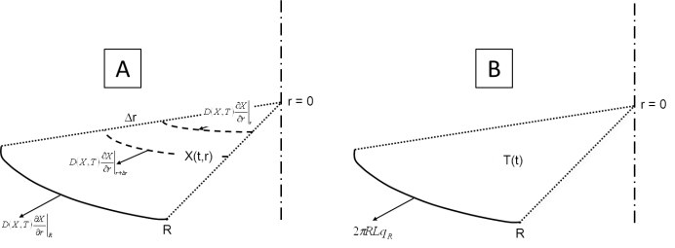
COMPLETE MODEL
(Distributed parameters approach – 1D):
Equations
 Radius is the only spatial coordinate
Water mass balance in a cylindrical shell
[IN] – [OUT] + [GEN] = [ACC]
Lumped
where:
• D(X,T) is the mass diffusion coefficient depending on sausage moisture content and on sausage temperature (m²/s)
• X is the moisture content on a dry basis (kg water/kg dry mass)
Notes:
new

Slide 55


COMPLETE MODEL
(Distributed parameters approach – 1D):
Equations
Water mass balance,
with the corresponding initial and boundary conditions
0 R
where:
• D(X,T) is the mass diffusion coefficient depending on sausage moisture content and on sausage temperature (m²/s)
• ρ_{ds} is the dry mass density (kg/m³)
• β is a mass transfer coefficient

1. parabolic, non-linear PDE
2. Neumann boundary conditions
Notes:
DA Aggiungere energy balance !

Slide 56
Mathematical Models
3rd classification
on the base of
mathematical features of equations and variables,
also affecting type or easiness of solution
 Ch.3 of Himmelblau D.M. and Bischoff K.B., “Process Analysis and Simulation”, Wiley, 1967
deterministic vs stocastic
lumped parameters vs distributed parameters
one dimension vs several dimensions
linear vs non linear
steady state vs time dependent
time-invariant vs time – varying
autonomous vs non – autonomous
  Dynamical models

Slide 57

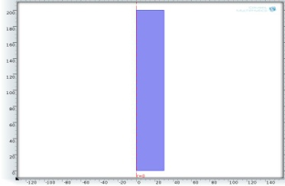

Example No.4 - COMPLETE MODEL
(Distributed parameters approach – 1D):
Geometrical domain
Notes:
DA Aggiungere energy balance !

Slide 58
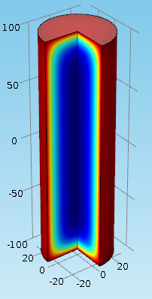

Example No.4 - COMPLETE MODEL
(Distributed parameters approach – 3D):
Geometrical domain
Cylindrical geometry
3D plot of internal moisture content
Notes:
DA Aggiungere energy balance !

Slide 59
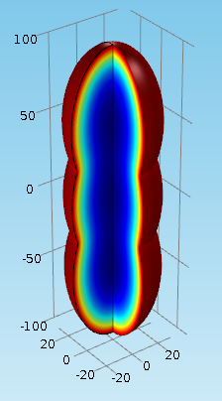
Example No.4 - COMPLETE MODEL
(Distributed parameters approach – 3D):
Geometrical domain
Irregular axial-symmetric geometry
3D plot of internal moisture content
Notes:
DA Aggiungere energy balance !

Slide 60
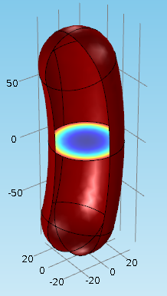
Example No.4 - COMPLETE MODEL
(Distributed parameters approach – 3D):
Geometrical domain
Irregular, non-axial-symmetric geometry
3D plot of internal moisture content
Notes:
DA Aggiungere energy balance !

Slide 61
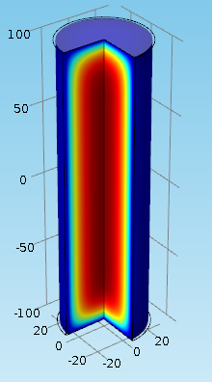
Example No.4 - COMPLETE MODEL
(Distributed parameters approach – 3D):
Geometrical domain
Shrinking cylindrical geometry
3D plot of internal moisture content
Notes:
DA Aggiungere energy balance !

Slide 62

Mathematical Models
3rd classification
Several levels are possible:
Homogeneous vs. Inhomogeneous
Number of variables (e.g. binary and multicomponent systems)
Easy vs. difficult (subjective)
Constant coefficients vs. variable coefficients
Stiff system vs. non-stiff
Linear vs. non-linear system (algebraic and differential).
Order of differential equations (operators)
Ordinary differential equations, partial differential equations, differential-algebraic equations, integrodifferential equations etc.
Hyperbolic, parabolic and elliptic PDE
Initial vs. boundary value problem
  Differential models
Adapted from:
TEKNILLINEN KORKEAKOULU

Slide 63
Mathematical Models
3rd classification
Homogeneous vs. inhomogeneous
  If f(λx)= λ^{n}f(x) for every λ, then f(x) is homogeneous to n:th degree.
Number of variables
  One-component system
  Two-component system
  Multi-component system
  More components, more degrees of freedom.
  Often one degree of freedom leads to scalar equations, more degrees to matrices.

Slide 64
Mathematical Models
3rd classification
Easy vs. difficult:
  If this is estimated based on required time to solve the model with certain computational capacities, then this is actually a physical classification
Variable vs. constant coefficients:
Ex.:

Slide 65
Mathematical Models
3rd classification
Stiff vs. non-stiff
  Formally, based on the ratio of eigenvalues
  In practice, if there are simultaneously very fast phenomena dictating step sizes, and very slow phenomena dictating simulation time, system is stiff.
Linear vs. non-linear
  In principle, linear systems are easy. Natural systems are rarely linear, but often numerical solution is based on (local) linearizations

Slide 66
Linear Operator:
Definition and first consequences
Formally, if V and W are vector spaces over the same ground field K, we say that f : V → W is a linear transformation if for any two vectors x and y in V and any scalar a in K, we have
  (additivity)
  (homogeneity).
This is equivalent to saying that f "preserves linear combinations", i.e., for any vectors x₁, ..., x_{m} and scalars a₁, ..., a_{m}, we have (superposition)
1st example (linear)
f : w = a x
2nd example (non linear)
f : z = a² b x y^{1/2}
with a, b scalar constants
66
Notes:
66
NEW

Slide 67
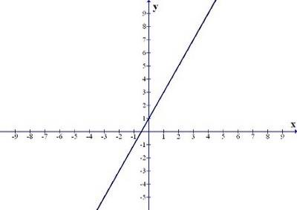
Linear Operator:
Definition and first consequences
3rd example (non linear)
f : y = mx + p
with m, p scalar constants
NB:
It does not obey the principle of superposition
67
Notes:
67
Trasf. Conforme ???

Slide 68
Mathematical Models
3rd classification
Several levels are possible:
Homogeneous vs. Inhomogeneous
Number of variables (e.g. binary and multicomponent systems)
Easy vs. difficult (subjective)
Constant coefficients vs. variable coefficients
Stiff system vs. non-stiff
Linear vs. non-linear system (algebraic and differential).
Order of differential equations (operators)
Ordinary differential equations, partial differential equations, differential-algebraic equations, integrodifferential equations etc.
Hyperbolic, parabolic and elliptic PDE
Initial vs. boundary value problem
  Differential models
Adapted from:
TEKNILLINEN KORKEAKOULU

Slide 69
Mathematical Models
3rd classification
Order of differential equation
  It is defined as the order of the highest derivative in the differenzial eq.
  Ex.: n-th order ODE:
  Can be linear or non-linear, depending on parameters a and function f.
  If parameters a depend on x only (not on y), and function f is at most first order with respect to y, then the equation is linear
Order of a system of differential equation
It is defined as the sum of the orders of the individual eqns.
Notes:
nuova

Slide 70
Mathematical Models
3rd classification
Ordinary vs. partial differential equations
  ordinary: variables are functions of only one independent variable
  Ex.: Variable c is time invariant: ∂ → d
  partial: functions of several independent variables
  Ex.:Variable c depends on time and on position

Slide 71
Mathematical Models
3rd classification
Differential-algebraic equations (DAE)
  In addition to the differential equations there are algebraic constraints.
  Ex.:
for variables x there are both differential and algebraic equations
for variables y there are only algebraic equations

Slide 72
Mathematical Models
3rd classification
Integro-differential equations
  Involve both derivatives and integrals of the unknown variable.
  Ex.:
Distributed systems: x is a density distribution with respect to s, and this distribution depends on t.
K is sometimes called a Kernel function
  A reasonably general form:

Slide 73
Mathematical Models
3rd classification
Initial vs. boundary value problems
Initial value problems usually easier: start from the initial values and ”march” forward in position or time.
Ex.:
the lumped parameters salami drying model
Boundary value problems are usually encountered in partial differential equations.
Ex.:
the distributed parameters salami drying model

Slide 74
Linear-Lumped-Deterministic Models
Nonlinear
Linear
Distributed
Deterministic
Lumped
Stochastic
Simple!! But not necessarily the best…
“The theory of control is well developed for linear, deterministic, lumped-parameter models.”
☞ Introduction to Process Control Romagnoli & Palazoglu

Slide 75
Mathematical Models
1st classification
(on the base of the approach
adopted for model development)
  “First principle Models”
    Basic models
    Models involving trasport phenomena
    Models based on the “population balance approach”
  Empirical or “fitting” models
  Dynamic models
    input-output dynamic models
    input-state-output dynamic models or state-space models
    dynamic black box models
  Time Series
  Statistical models
 rielaborated from § 1.4 in Himmelblau D.M. e Bischoff K.B., “Process Analysis and Simulation”, Wiley & Sons Inc., 1967

Slide 76

    Dynamic Models: definitions
A dynamical system is a state space S , a set of times T and a rule R for evolution, R:S×T→S that gives the consequent(s) to a state s∈S .
  A dynamical system consists of an abstract phase space or state space, whose coordinates describe the state at any instant, and a dynamical rule that specifies the immediate future of all state variables, given only the present values of those same state variables.
  For example the state of a pendulum is its angle and angular velocity, and the evolution rule is Newton's equation F = ma.
A dynamical mathematical model can be considered to be a tool describing the temporal evolution of an actual dynamical system.
  Dynamical systems are deterministic if there is a unique consequent to every state, or stochastic or random if there is a probability distribution of possible consequents (the idealized coin toss has two consequents with equal probability for each initial state).
  A dynamical system can have discrete or continuous time.
Notes:
NEW

Slide 77
    Dynamic Models: input-output representation
MATHEMATICAL MODEL
input output
vectorial scalar
 Giua & Seatzu, “Analisi dei sistemi dinamici”, 2006
An input-output equation reveals the direct relationship between the output variable desired, and the input variable.
This relationship often includes the derivatives of one or both variables.
Even with a higher order equation, the advantage is that the output variable is independent of (uncoupled from) any other variables except the inputs.
 typical of automatic process control
 Roffel & Betlem, 2006

Slide 78
Example No.5 of input-state-output dynamic model:
WATER OPEN TANK
h(t)
IN :
VARIABLES
STATE: h(t)
OUT :
State equation:
Initial Condition: h(0) = h₀

Slide 79
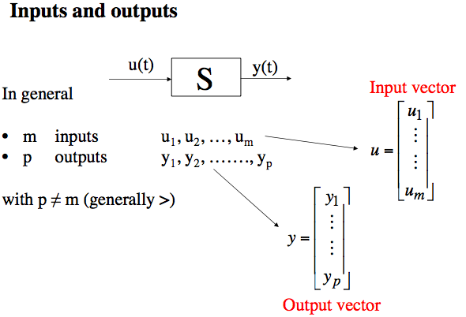
Input-Output representation
Variables
Basic Automatic Control prof. Guariso
Notes:
new

Slide 80
Input-Output Models
General System Representation
(disturbances)
d
1
d
2
…
d
L
(vectorial)
mathematical
model
m
y
1
1
(manipulated
variables)
(output
variables)
m
2
:
Process
:
y
2
m
K
y
J
…
a
1
a
2
a
R
(parameters)
 typical of automatic process control
 Romagnoli & Palazoglu, Introduction to Process Control, 2005

Slide 81

Definition of
Linear dynamic system
From Wikipedia, the free encyclopedia: http://it.wikipedia.org
A linear dynamic system is a model based on some kind of linear operator H. Linear systems typically exhibit features and properties that are much simpler than the general, nonlinear case. By definition, they satisfy the properties of superposition and scaling:
  Given two inputs:
  i₁(t), i₂(t)
  as well as their respective outputs:
  y₁(t) = H(i₁(t))
  y₂(t) = H(i₂(t))
  then a linear system must satisfy:
  αy₁(t) + βy₂(t) = H(α i₁(t) + β i₂(t))
  for any α and β.

Slide 82
Definition of Time-invariant system
Retrieved from Simple Systems by Don Johnson: http://cnx.org/content/m0006/latest/
Systems that don't change their input-output relation with time are said to be time-invariant.
The mathematical way of stating this property is to use the signal delay concept:.
y(t) =S(i(t) ) ⇒ y(t−τ) =S(i(t−τ) )
If you delay (or advance) the input, the output is similarly delayed (advanced). Thus, a time-invariant system responds to an input you may supply tomorrow the same way it responds to the same input applied today; today's output is merely delayed to occur tomorrow.
Retrieved from Wikipedia, the free encyclopedia: http://it.wikipedia.org
A time-invariant system is one whose output does not depend explicitly on time.
Simple examples
To demostrate how to determine if a system is time-invariant then consider the two systems:
System A: y_{A}(t) = t⋅i(t)
System B: y_{B}(t) = 10⋅i(t)
Since system A explicitly depends on t outside of i(t) then it is time-variant. System B, however, does not depend explicitly on t so it is time-invariant.
Notes:
new

Slide 83

Definition of Time-variant system
A time-variant system is one that is not time-invariant. The following things can be said about a time-variant system:
It has explicit dependence on time.
It is not stationary
 It does not have an impulse response (transfer function) in the normal sense. The system can be characterized by an impulse response except the impulse response must be known at each and every time instant.
Examples of time-variant systems
The human vocal tract is a time variant system, with its transfer function at any given time dependent on the shape of the vocal organs. As with any fluid-filled tube, resonances (called formants) change as the vocal organs such as the tongue and velum move. Mathematical models of the vocal tract are therefore time-variant, with transfer functions often linearly interpolated between states over time.
Notes:
NEW

Slide 84
Table of Typical Math Operators
Retrieved from:
http://cnx.rice.edu/content/m0006/latest/
Input-Output Relation | Linear | Time-Invariant
y(t) = d/dt [x(t)] | yes | yes
y(t) = d²/dt² [x(t)] | yes | yes
y(t) = (d/dt [x(t)])² | no | yes
y(t) = d/dt [x(t)]+ x(t) | yes | yes
y(t) = x₁+x₂ | yes | yes
y(t) = x(t−τ) | yes | yes
y(t) = cos(2πft) x(t) | yes | no
y(t) = x²(t) | no | yes
y(t) = |x(t) | | no | yes
y(t) = mx(t) +b | no | yes
y(t) = x(−t) | yes | no

Slide 85


Definition of Autonomous system
(in theory of differential equations)
Retrieved from "http://en.wikipedia.org/wiki/Autonomous_system_%28mathematics%29"
An autonomous system is an ODE equation of the form
where x takes values in n-dimensional Euclidean space and t is usually time. It is distinguished from systems of differential equations of the form
in which the law governing the rate of motion of a particle depends not only on the particle's location, but also on time; such systems are not autonomous.
Vector field
Simple examples
System A:
System B:
Since system A explicitly depends on t outside of x(t) then the dynamic system is not autonomous. System B, however, does not depend explicitly on t so it is autonomous.
 Retrieved from Luenberger, Introduction to Dynamic Systems
A system of ODEs is called autonomous or time invariant if its vector field does not depend explicitly on time.
Notes:
new

Slide 86
Mathematical Models
1st classification
(on the base of the approach
adopted for model development)
  “First principle Models”
    Basic models
    Models involving trasport phenomena
    Models based on the “population balance approach”
  Empirical or “fitting” models
  Dynamic models
    input-output dynamic models
    input-state-output dynamic models or state-space models
    dynamic black box models
  Time Series
  Statistical models
 rielaborated from § 1.4 in Himmelblau D.M. e Bischoff K.B., “Process Analysis and Simulation”, Wiley & Sons Inc., 1967

Slide 87
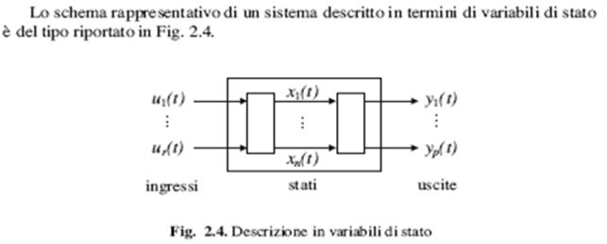
Dynamic Models: input-state-output representation
MATHEMATICAL MODEL
Input state output
vectorial scalar
 Giua & Seatzu, “Analisi dei sistemi dinamici”, 2006
Intuitively, the state of a system describes enough about the system to determine its future behavior.
     Behavioral models
    ☞ “internal” model of the process
     Roffel & Betlem, 2006

Slide 88
Definition of State
  The state of a dynamic system is defined through the smallest set of variables (called the state variables) such that the knowledge of these variables at t=t₀, together with the knowledge of the input for t≥t₀, completely determines the behavior of the system for any time.
State variable ➔ x(t)
Introduction to Process Control Romagnoli & Palazoglu
Notes:
new

Slide 89
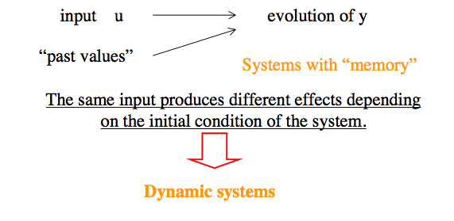
Input-state-output model
 Such a “memory”, required to define the present-time condition of the system, is called the state of the system at the time instant when the input is applied.
Basic Automatic Control prof. Guariso

Slide 90
Example No.5 of input-state-output dynamic model:
WATER OPEN TANK
h(t)
IN :
VARIABLES:
STATE: h(t)
OUT :
State equation:
Initial Condition:
h(0) = h₀
Output transformation:
Notes:
new

Slide 91

VARIABLES
Variables are things that
vary and change

Slide 92
VARIABLES
Classification in dynamic models
INPUT:
time-varying quantities that change according to a known or prefixed law.
The user (e.g., manipulated variables) or the outside environment (e.g., disturbances) decides how they change with time
OUTPUT:
quantities representing the observed or calculated time-varying results that the model yields to outside.
They are originally unknown, but provide (typically as functions) results to outside once the input variables have been specified and the state variables have been calculated.

Slide 93
State Variables
Quantities describing the present state of a system enough well to determine its future behavior.
They provide a means to keep memory of the consequences of the past inputs to the system.
They may be partly coincident with output variables.
The minimum number of state variables required to represent a given system, n, is usually equal to the order of the system's defining differential equation.
The choices for variables to include in the state is highly dependent on the fidelity of the model and the type of system.
One can see immediately that the choice of variables to be included in the state is not unique.
 HINT: The state variables are often given by the same variables appearing within the initial conditions of the system’s ODEs
http://www.cds.caltech.edu/~murray/amwiki/index.php/FAQ:_What_is_a_state%3F_How_does_one_determine_what_is_a_state_and_what_is_not%3F
Basic Automatic Control prof. Guariso

Slide 94
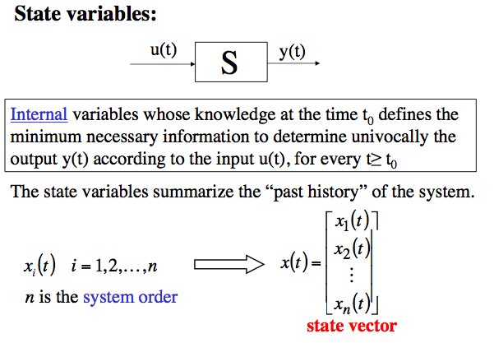
State Variables
Basic Automatic Control prof. Guariso

Slide 95
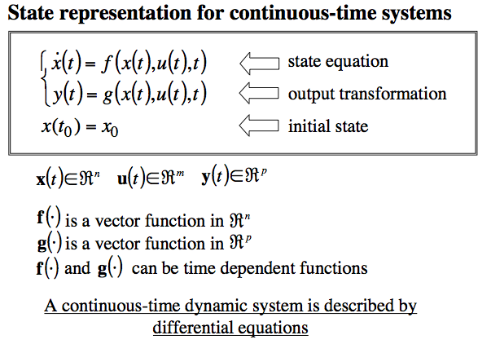
State-Space Models
Basic Automatic Control prof. Guariso

Slide 96
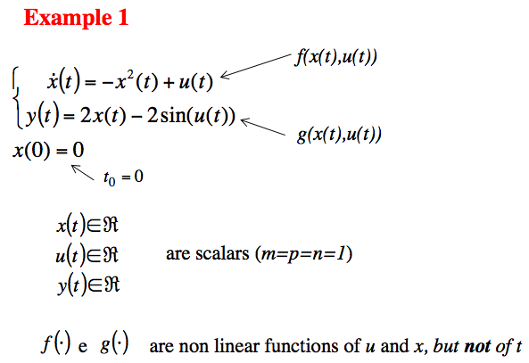
State-Space Models
6

it is a scalar model (n = 1)
Basic Automatic Control prof. Guariso
Notes:
new

Slide 97
Example No.7:
Pasteurized Milk Storage
(Two Non-interacting Tanks)
F₀
With a constant cross sectional
area A, the volume of a tank can be expressed as:
V = Ah
where h represents the liquid level.
Let us suppose that the control objective is to maintain a constant level in the second tank while the inlet flow rate to the first tank is varied.
The liquid level h₂(t) is the variable that we want to be the controlled variable.
F₁
F₂
Introduction to Process Control Romagnoli & Palazoglu
Notes:
new

Slide 98
Example No.7 – Two (Non-interacting) Tanks
State-space Model
mass balances constitutive eqs.
IC:
h₁(0)=h_{1s} , h₂(0)=h_{2s}
Defining:
State-space process model
Introduction to Process Control Romagnoli & Palazoglu
Notes:
NEW

Slide 99
Example No.7 – Two (Non-interacting) Tanks
State-space Model
vector field
MODEL CLASSIFICATION:
DYNAMIC, LINEAR, CONSTANT-COEFFICIENT, NON-AUTONOMOUS, TIME-INVARIANT, 2 ODE SYSTEM.
ORDER = 2
Introduction to Process Control Romagnoli & Palazoglu
Notes:
NEW

Slide 100
State-space Models
Terminology
n∈N is the order or size of the model
x(t) is the vector of the state variables
The n components of x(t) are phases
The space spanned x(t) ∈ℜ^{n} is the state-space or phase-space
u(t) is the vector of the input variables with m components
The function f:Ω∈·ℜ⁺ · ℜ^{n} ·ℜ^{m} →ℜ^{n} is the vector field

Slide 101
Linear State-space Models
Terminology
State equation:
Output
transformation:
Initial Condition:
A is the is the state matrix (n•n)
B is the is the input matrix (n•m)
Notes:
new

Slide 102
Autonomous System
(definition in Theory of Systems)
An autonomous system is a system having the state not depending on input
OR
input constant with time
in its the mathematical model.
adapted from “notecontrolli_PRATTICHIZZO.pdf”
NB:
For a dynamic model described by a system of ODEs, an autonomous system is also time invariant
Notes:
new

Slide 103
Autonomous System
(in Non-Linear Dynamics )
A dynamic system is autonomous if its vector field depends on the state x(t), but does not explicitly depend on time.
with x(t)∈ℜ^{n}
t ∈ℜ⁺
Examples of 2nd order systems:
Autonomous system Non-autonomous system

Slide 104
Example No.7 – Two (Non-interacting) Tanks
State-space Model
State-space (linear)
process model
State matrix
Input matrix
State variables
Output variable
MODEL CLASSIFICATION:
DYNAMIC, LINEAR, NON-AUTONOMOUS, TIME-INVARIANT, 2 ODE SYSTEM.
ORDER = 2
Introduction to Process Control Romagnoli & Palazoglu
Notes:
104
new

Slide 105
Orbits or Trajectories of a dynamic system
The forward orbit or trajectory of a state x is the time-ordered collection of states that x follow from an initial state x₀ using the system evolution rule.
When both state space and time are continuous, the forward orbit is a curve x(t) parametric in t ≥ 0
Different initial states result in different trajectories
Example of an orbit (order n=2)
x₂
x₁

Slide 106
Phase portrait
The set of of all trajectories forms the phase portrait of a dynamical system.
in practice, only representative trajectories are considered
the phase portrait is usually built by numerical methods for nonlinear systems
The analysis of phase portraits provides an extremely useful way for visualizing and understanding qualitative features of solutions.
The phase portrait is particolarly useful for scalar (1st order) and planar systems (2nd order)
x₂
x₁
Notes:
NEW

Slide 107
Transients and regimes
The orbits may have a bounded or unbounded asymptotic behavior (for t → ± ∞).
If an orbit has a bounded asymptotic behavior for t → + ∞, the part of the orbit describing such an asymptotic behavior is referred to as regime and the remaining part is referred to as transient.
The simplest and most well known regime (bounded) is the equilibrium point (steady-state point), which is possible for every system order n
Notes:
NEW

Slide 108
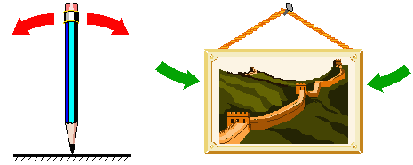
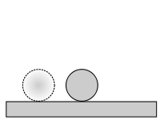
Stability of an equilibrium point
Adapted fromOn-Line Lectures ©Alexei Sharov, Department of Entomology, Virginia Tech, Blacksburg, VA
http://www.ento.vt.edu/~sharov/PopEcol/
An equilibrium may be stable or unstable or indifferent.
For example,
the equilibrium of a pencil standing on its tip is unstable;
the equilibrium of a picture on the wall is (usually) stable;
the equilibrium of a ball on a flat plane is (usually) indifferent.
 More formal definitions of stability do exist …

Slide 109
Example No.7 – Two (Non-interacting) Tanks
Input-Output Model
differenziating
substituting
substituting
Finally,
m(t)
y(t)
A single equation describing the effect of the input on the output.
Introduction to Process Control Romagnoli & Palazoglu

Slide 110
Mathematical Models
4th classification
(based on the type of description adopted for time
as the independent variable)
☞ VALID for DYNAMICAL SYSTEMS only
continuous time models
discrete time models

Slide 111
CONTINUOUS-TIME SYSTEMS
The time changes continuously. It is not possible to define a minimum time interval: it is always possible to consider a smaller time interval.
Accordingly, the theory of continuous-time systems has been defined and studied, where the variables of the system are continuous-time functions, that is, at every time instant t, it is possible to define and assign the variable value.
Continuous-time systems: t ∈ ℜ

Slide 112
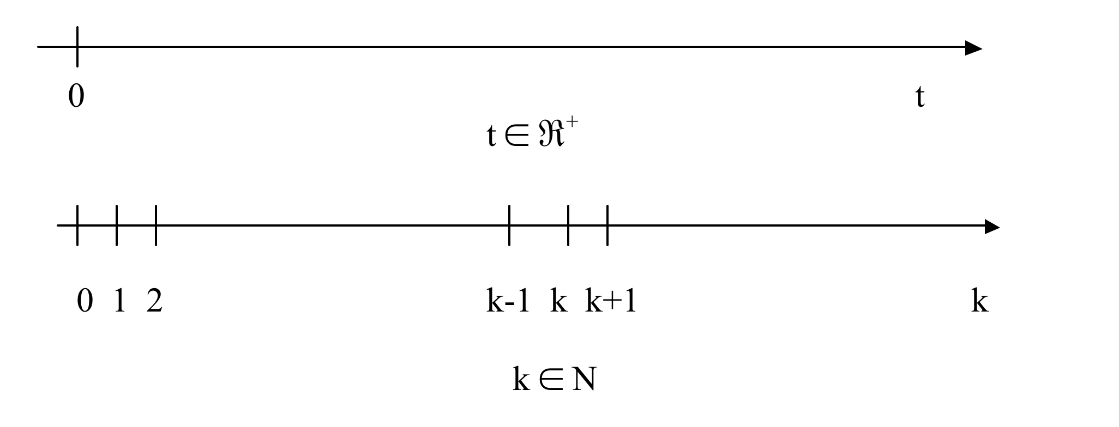
DISCRETE-TIME SYSTEMS
input – output representation
MATHEMATICAL MODEL
Ingresso uscita
Input output
input – state – output representation
MATHEMATICAL MODEL
Ingresso stato uscita
Input state output

Slide 113
DISCRETE-TIME SYSTEMS
General representation
of input–state–output discrete-time models
EXPLICIT TYPE
“IMPLICIT” TYPE
SCALAR SYSTEMS: x(k) is a scalar variable
VECTOR SYSTEMS: x(k) is a vector variable of size n
   A deterministic system with discrete time is often defined a map.

Slide 114
Example No. 1
Malthusian Growth Model (II)
If we let x(k) denote the population size during time period k and let c denote the population growth rate per unit time, the Malthusian model can be written mathematically in the following way:
x(k+1) = (1+c) x(k)
A model in this form, where the population at the next time period is determined by the population at the previous time period, is said to be a
difference equation model or a map.
The initial condition is:
IC: x(0) = x₀
autonomous discrete-time system of order 1 (scalar model)
Notes:
NEW

Slide 115
Model Order
The order n is an integer number obtained as the product between the size of the state vector x and the time gap in the implicit model representation.
 The time gap is the max time distance in the implicit model representation
Example 1:
autonomous discrete-time system of order 1 (scalar model)
Example 2:
autonomous discrete-time system of order 2 (vectorial model)

Slide 116
Fixed Points for autonomous systems x(k+1) = f(x(k)
DEFINITION of a fixed point:
x(k+1) = x(k)
 x(k) may be a scalar or vector variable
DETERMINATION of a fixed point:
The fixed points are determined as the solutions of the algebraic eq. (scalar) or system of eqns.(vector):
x*= f (x*)
A fixed point can be stable or unstable.
A stable fixed point is an attractor for the trajectories originating in a reasonable neighborhood of it.
Notes:
NEW

Slide 117
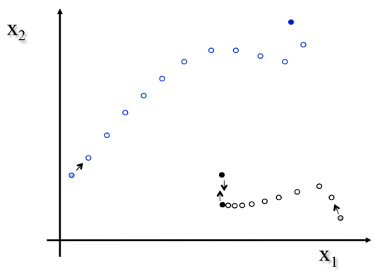
Orbits or Trajectories
Example:
autonomous non-linear, discrete-time model of order 2
fixed point
initial condition

Slide 118
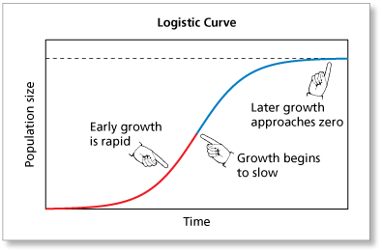
Example No. 2
Logistic Model
Differently from the Malthusian model …
developed by Belgian mathematician Pierre Verhulst (1838)
HYPOTHESES
resources are limited for growth: N(t)≤N_{sat}
CLOSED-FORM SOLUTION
N_{sat}
N₀≠0
Notes:
NEW

Slide 119
Example No. 2
Logistic Map
discreti-zation
adimen-
siona-lization

Slide 120
Mathematical Models
1st classification
(on the base of the approach
adopted for model development)
  Modelli a “principi primi” (“First principle Models”)
    Modelli basati sui “fenomeni di trasporto”
  Modelli basati sul “bilancio di popolazione”
  Modelli empirici o di “fitting”
  Dynamic models
    input-output dynamic models
    input-state-output dynamic models or state-space models
    dynamic black box models
  Serie temporali
  Modelli stocastici
120
Notes:
120

Slide 121
Black-Box Model Structures
BLACK BOX
MODEL
Input output
The model structures vary in complexity and order depending on the flexibility you need to account for the dynamics and on possible consideration of noise in your system.
The simplest black-box structures are:
Linear polynomial model, which is the simplest input-output model (e.g., ARX model)
Transfer function, with a given number of adjustable poles and zeros.
State-space model, with unknown system matrices, which you can estimate by specifying the number of model states
Non-linear parameterized functions
121
Notes:
Trovare la fonte della slide
Spostare e discutere ARX
121

Slide 122
Black-Box Modeling
Black-box modeling is usually a trial-and-error process, where you estimate the parameters of various structures and compare the results.
Typically, you start with the simple linear model structure and progress to more complex structures.
You might also choose a model structure because you are more familiar with this structure or because you have specific application needs.
Black box models are not based on physical grounds and the equations do not reflect the internal structure of the process.
Black box models usually have a linear structure, and because of this built-in linearity they have a limited validity range.
122
Notes:
122

Slide 123
    Dynamic black box.
    Linear polynomial models
Black box models may describe the system dynamics through a linear, time-invariant vector difference equation of finite dimension.
The difference equation has some model parameters.
The following difference equation represents a simple model structure:
where a and b are adjustable parameters.
Parameters are a crucial point in dynamic black box model development.
In order to parameterize a black box model, only the input-output behavior is required; detailed knowledge about the internal behavior is not necessary.
The parameters are estimated by minimizing a scalar function of the prediction error, i.e. the difference between the observed output and the model-predicted output.
123
Notes:
new
123

Slide 124

Example No.8 the ARMAX model
For a single-input/single-output system (SISO), the ARMAX (Auto-Regressive Moving-Average with eXogenous variable) model structure is:
Auto-Regression
Moving-Average
where:
y(t) represents the output at time t,
u(t) represents the input (eXogenous variable) at time t,
n_{a} is the number of poles for the dynamic model,
n_{b} is the number of zeros plus 1,
n_{c} is the number of poles for the disturbance model,
n_{k} is the dead time (in terms of the number of samples) before the input affects output of the system,
e(t) is the white-noise disturbance (gaussian)
here t≅k
the ARMAX model is NOT deterministic
124
Notes:
124

Slide 125

System Identification
Documentation center
System identification is a methodology for building mathematical models of dynamic systems using measurements of the system's input and output signals/data.
The process of system identification requires that you:
Measure the input and output signals/data from your system in time or frequency domain.
Select a model structure.
Apply an estimation method to estimate value for the adjustable parameters in the candidate model structure.
Evaluate the estimated model to see if the model is adequate for your application needs.
System identification uses the input and output signals you measure from a system to estimate the values of adjustable parameters in a given model structure.
Obtaining a good model of your system depends on how well your measured data reflect the behavior of the system.
125
Notes:
new
125

Slide 126
Mathematical Models
1st classification
(on the base of the approach
adopted for model development)
  Modelli a “principi primi” (“First principle Models”)
    Modelli basati sui “fenomeni di trasporto”
  Modelli basati sul “bilancio di popolazione”
  Modelli empirici o di “fitting”
  Dynamic models
    input-output dynamic models
    input-state-output dynamic models or state-space models
    dynamic black box models
  Serie temporali
  Modelli stocastici
126
Notes:
126

Slide 127
    Dynamical modeling
    Final Statement
A way to distinguish the techniques used when modeling dynamic processes is to picture them on a scale with two extremes at the ends:
at the one side
black box
system identification
at the other side
theoretical modeling or
first principles modeling
127
Notes:
127

Slide 128
Mathematical Models
5th classification
(based on the type of solution,
with exclusion of empirical models)
  1. ANALYTICAL SOLUTIONS
  → DIFFERENTIAL CALCULUS
      → ALGEBRA
2. NUMERICAL SOLUTIONS
→ NUMERICAL CALCULUS
      Ex.: numerical methods for PDEs
  FINITE DIFFERENCE METHODS (FDM)
  FINITE ELEMENT METHODS (FEM)
  COLLOCATION METHODS

Slide 129
Mathematical Models
1st classification
(on the base of the approach
adopted for model development)
  Modelli a “principi primi” (“First principle Models”)
    Modelli basati sui “fenomeni di trasporto”
  Modelli basati sul “bilancio di popolazione”
  Modelli empirici o di “fitting”
  Modelli dinamici
    Modelli dinamici “con rappresentazione ingresso-uscita”
    Modelli dinamici “con rappresentazione nello spazio di stato”
    Modelli dinamici a scatola nera (black box)
  Time Series
  Modelli stocastici

