Slide 1

Models based on population balance approach
UNIVERSITÁ DEGLI STUDI DI SALERNO
Dipartimento di Ingegneria Industriale
by M. Miccio
Dept. of Industrial Engineering (Università di Salerno)
Prodal Scarl (Fisciano)
Rev. 5.3 of November 3, 2014

Slide 2
Population Balance models
The population balance equation (PBE) is a statement of continuity for particulate systems, originally derived in 1964.
Population balances are of key relevance to a very diverse group of scientists, including astrophysicists, high-energy physicists, geophysicists, colloid chemists, biophysicists, materials scientists, meteorologists and chemical engineers.
Chemical engineers have put population balances to most use, with applications in the areas of crystallization; gas-liquid, liquid-liquid, and solid-liquid dispersions; liquid membrane systems; fluidized bed reactors; aerosol reactors; and microbial cultures.
Engineers encounter particles in a variety of systems. The particles are either naturally present or engineered into these systems. In either case these particles often significantly affect the behavior of such systems.
This modeling approach provides a framework for analyzing these dispersed phase systems and describes how to synthesize the behavior of the population particles and their environment from the behavior of single particles in their local environments

Slide 3

Population Balance models
Ramkrishna provides a clear and general treatment of population balances with emphasis on their wide range of applicability. New insight into population balance models incorporating random particle growth, dynamic morphological structure, and complex multivariate formulations with a clear exposition of their mathematical derivation is presented. Population Balances provides the only available treatment of the solution of inverse problems essential for identification of population balance models for breakage and aggregation processes, particle nucleation, growth processes, and more. This book is especially useful for process engineers interested in the simulation and control of particulate systems. Additionally, comprehensive treatment of the stochastic formulation of small systems provides for the modeling of stochastic systems with promising new areas of applications such as the design of sterilization systems and radiation treatment of cancerous tumors.
Doraiswami Ramkrishna,
Purdue University, West Lafayette, Indiana, U.S.A.
“Population Balances. Theory and Applications to Particulate Systems in Engineering”, Academic Press, ISBN: 0-12-576970-9, Pages: 355, Publication Date: 8 August 2000, Price: £83.99

Slide 4
Population Balances
Formulation
The Population Balance Equation was originally derived in 1964, when two groups of researchers studying crystal nucleation and growth recognized that many problems involving change in particulate systems could not be handled within the framework of the conventional conservation equations only, see Hulburt & Katz (1964) and Randolph (1964) .
They proposed the use of an equation for the continuity of particulate numbers, termed population balance equation, as a basis for describing the behavior of such systems.
This balance is developed from the general conservation equation:
Input - Output + Net Generation = Accumulation
 § 4.4 in Himmelblau D.M. and Bischoff K.B., “Process Analysis and Simulation”, John Wiley & Sons Inc., 1967 (Collocazione: 660.281 HIM 1)

Slide 5
Elements necessary for a population balance Model
Element | General description | Example
ENTITY | specific of each “particulate system”; crystallization, biochemical processes, polymerization, leaching, comminution, and aerosols are just some examples; entities are “discrete” and not continuous; entities are “countable”, but may be infinite in number | Yeast cell in a fermenter
PROPERTIES of ENTITY | in general, entities have a specified set of m properties ζ_{i} with i = 1,2...m the properties ζ_{i} will depend on the application; typical examples are the entity's size diameter, entity's chemical composition, entity's age | Cell mass, cell age, etc.
ENTITY DISTRIBU-TION | the function ψ(t, x, y, z, ζ₁, ζ₂, ..., ζ_{m}) represents the entity distribution t is time x, y, z are the spatial coordinates it is similar to a probability density function | Number of cells per unit fermenter volume, unit cell mass, unit cell age, etc.

Slide 6
Entity distribution function
Physical meaning
is the fraction (number, mass, etc.) of entities at time t that are:
contained in the infinitesimal volume dV=dxdydz
characterized by values of properties in the ranges ζ₁÷ζ₁+dζ₁, . . . , ζ_{m}÷ζ_{m}+dζ_{m}
Congruence constraint
where Ω is the (3+m)-dimensional space of the independent variables:
3 spatial or external coordinates (x, y, z)
m properties or internal coordinates (ζ_{i} with i = 1,2...m)
 time t may be one additional independent variable

Slide 7
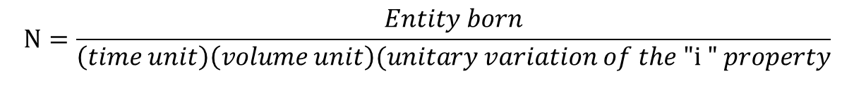
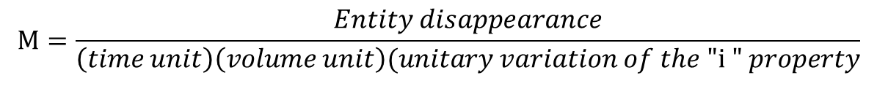
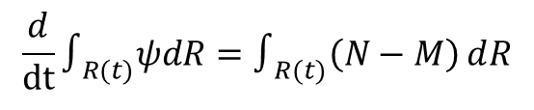

Conservation law
Generation
Positive and Negative terms are defined as:
Hypotheses:
Entities are located in a sub-space R(t) ⊆ Ω
large, arbitrary, time-varying
closed, with no input or output of entities
Balance equation
Accumulation = Net Generation
(I)

Slide 8
Leibnitz formula
a(t)
b(t)
One dimension
x
Multi-dimensional
where:
R(t) is a time-variable region of the space Ω
f(•) is a scalar function
l stands for any of the non-time variables x, y, z, ζ₁, ζ₂….,
the sum Σ is over all such variables

Slide 9
Generalized population balance model on «microscopic scale»
The total derivates with respect to time included in the Leibnitz formula can be explained in a physical way:
v_{i} is the change rate with respect to the time or kinetics of the property ζ_{i}
The Equation (I) becomes:
As the region R(t) is arbitrary, the necessary condition for that equation to be true is that the integrating term is null
This is the generalized population balance model on microscopic scale
(in x, y, z coordinates)

Slide 10
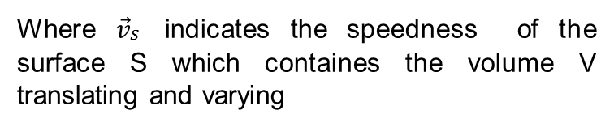
Switch to «macroscopic scale»
Often ψ spatial dependence is not known or not desired, while only averaged value on system geometric volume V is requested.
The volume-averaged entity distribution is:
V
S
Integrating over the whole volume the generalized population balance model:
I
II
III
IV
Let’s examine the various terms:
The term (I) can be obtained by an inversion of the multi-dimensional Leibnitz formula, restricted to the spatial coordinates only:
V

Slide 11
According to Gauss divergence theorem, the term V becomes:
V
S
The term II is transformed by the same Gauss theorem
The terms I and II (included V) can be combined together:
I
VI
II

Slide 12
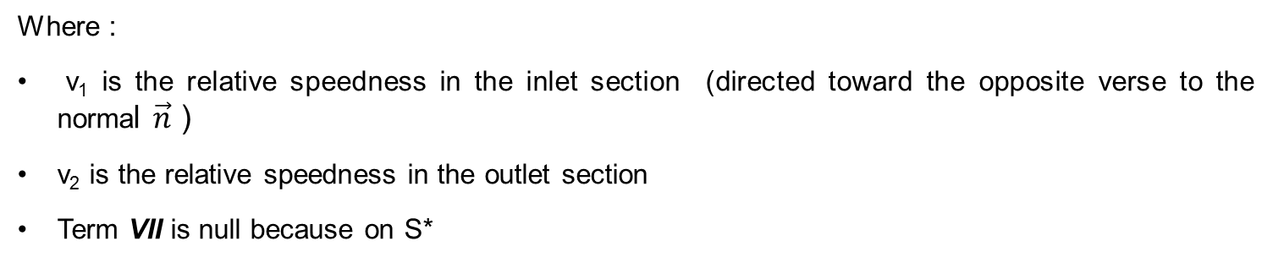
In the term VI the surface S is considered as the sum of three contributions:
S = S₁+ S₂+ S*
Where:
S₁ is inlet surface to the system volume
S₂ is the outlet surface from the system volume
S* is the remaining part of the surface (impenetrable)
S₁
S*
S₂
The term VI becomes :
VII
VIII
IX

Slide 13
Further Hypothesis:
ψ₁ and ψ₂ are averaged and, therefore, constant, respectively on S₁ and S₂
The terms VIII and IX can be simplified as follows:
where Q₁ and Q₂ are volumetric flowrates through S₁ and S₂, respectively.
The term III is integrated over the volume V and yields:
The term IV yields:

Slide 14
Population balance model on «macroscopic scale»
After replacing all the terms:
Dividing by V:
ACC
PSEUDO/CONV
GEN
IN
OUT
This is the population balance model on «macroscopic scale»
(without x, y, z coordinates)

Slide 15
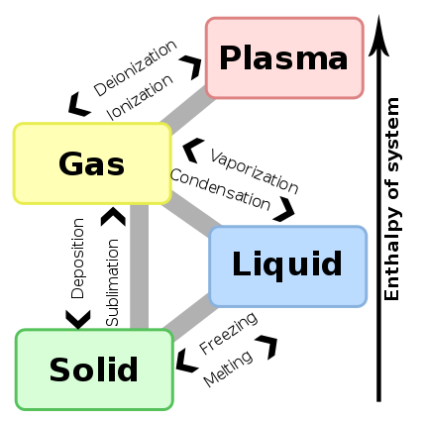
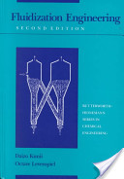
Example No. 1
Vapor Deposition in a gas-solid fluidized bed
 ch.14 pag.136, Daizo Kunii and Octave Levenspiel, Fluidization Engineering , 2nd. ed. Butterworth-Heinemann, 1991

Slide 16
Hypotheses
AIR
Steady state
Macroscopic approach
Constant inventory of particles in the fluidized bed
All particles having the same chemical composition
Particles having spherical geometry
Particles having constant density
No new particle formed directly by vapor deposition
Negligible elutriation
Negligible solid-solid and solid-wall attrition
F₀ p₀(d)
W
p(d)
T, P
F₁ p₁(d)
NOMENCLATURE
W = bed mass (inventory of particles)
F₀ = mass feed rate of fresh particles
F₁ = mass discharge rate of processed particles
AIR
+
VAPOR
scheme
of the fluidized bed
 O. Levenspiel, D. Kunii, T. Fitzgerald
The processing of solids of changing size in bubbling fluidized beds
Powder Technology, Volume 2, Issue 2, December 1968, Pages 87-96
Notes:
Eseguire borb_med.swf

Slide 17
Vapor Deposition in a gas-solid fluidized bed
Entity: solid particles
Property: particle diameter d
Entity distribution: p(d) [=] m⁻¹
p(d)dd is the mass fraction of particles with diameter between d and d+dd

p(d) is also the desired result of the model equation solution

Slide 18
Population Balance approach: the generation term
No. particles in
[d; d+dd]
rate of particle volume change
particle
density
particlesize interval
•
•
/

Slide 19
The overall generation

Slide 20
Overall Mass Balances
IN – OUT + GEN = 0
on the solid phase with ref. to the whole fluid bed:
1.
 This is NOT a Population Balance eq.
on the gas phase with ref. to the whole fluid bed:
1 bis.

Slide 21
Population Balance approach: the mass balance
Mass per unit time
and
with ref. to the size interval [d;d+dd]:
d
d+dd
control volume
in the property space
t
t+dt
IN with feed | OUT with discharge | entering the control volume [d; d+dd] from a lower size | leaving the control volume [d; d+dd] to a larger size | generation in the interval [d; d+dd]

Slide 22
Further Hypotheses
“monosize” feed: p₀(d) = δ(d-D₀)
AIR
p₀(d)
F₀ p₀(d)
W
p(d)
T, P
0
D₀
d
DIRAC DELTA FUNCTION
(UNIT IMPULSE)
δ(d)=0 for d≠D₀
δ=∞ for d=D₀
F₁ p₁(d)
AIR
+
VAPOR
back mixing: p₁(d) = p(d)

Slide 23
Population Balance approach: integration of mass balance eq.
with ref. to an infinitesimal size interval located immediately below the feed size D₀: [D₀; D₀-dd]
→ p(d)dd = 0
integration over [0, D₀] gives p(D₀):
p₀(d)
0
D₀
d
4.

Slide 24
Population Balance approach: integration of mass balance eq.
with ref. to an infinitesimal size interval [d;d+dd] located above the feed size D₀:
manipulation and integration over [D₀, d] with d>D₀ give:

Slide 25
Population Balance approach: entity distribution eq. p(d)
Taking the exponential,
replacing eq. 4
and then solving for p(d) gives:
4.
3.
where d’ is an integration variable

Slide 26
Population Balance approach: congruence condition for p(d)
2.

Slide 27
Population Balance approach:
Final equations
1.
2.
3.

Slide 28
Population Balance approach:
Integro-differential equations
More generally, size distributions are time dependent.
Ex.:
rate of change of the size distribution (s) depends on the whole distribution
x(s,t) under consideration
agglomeration of these may form a particle of size s
breakage of these may form a particle of size s
breakage of x(s,t) affects the distribution

Slide 29
Example No. 2
Sublimation in a gas-solid fluidized bed

Slide 30
Hypotheses
Macroscopic approach
Batch operation (dynamical system)
“Active” particles (i.e., sublimating particles) different from the particles constituting the fluidized bed
Perfect mixing
All “Active” particles maintain the same composition
Particles having spherical geometry
Particles having constant density
Negligible elutriation
Negligible solid-solid and solid-wall attrition
Air
+
Vapor
NOMENCLATURE
W₀ = overall mass of sublimating solid particles at time 0
W(t) = overall mass of sublimating solid particles at time t
Air
scheme
of the fluidized bed
Notes:
Eseguire borb_med.swf

Slide 31
Population Balance approach: batch sublimation in fluidized bed
Entity: mass of sublimating solid particles
Property: particle diameter d
Entity distribution: m(d,t) [=] kg/m
m(d,t)Δd is the mass of sublimating particles in the bed with diameter between d and d+Δd at the time t

m(d,t) is also the desired result of the model equation solution

Slide 32
Population Balance approach: batch sublimation in fluidized bed
Control volume in the “property space”
Mass Balance
on the size interval Δd and in the time interval Δt
IN – OUT + GEN = ACC

Slide 33
Population Balance approach: batch sublimation in fluidized bed
Let us divide by Δt
For Δt → 0
Let us divide by Δd
For Δd → 0
1.
PDE subject to:
IC: for t=0 m(d,0) = m_{o}(d)
BC: for d=0, ∀t m(0,t) = 0

Slide 34
Population Balance approach: batch sublimation in fluidized bed
Comparison with the population balance model on «macroscopic scale»
By integration over the “property space” up to the max particle size d_{max},
the total mass at time t is obtained:
2.

Slide 35
Population Balance approach: batch sublimation in fluidized bed
Particular cases for sublimation kinetics
1. Volume dependence
2. Surface dependence
 linear, non-constant coefficient, 1st order PDE

Slide 36
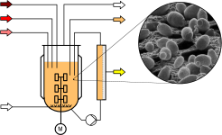
Yeast cell distribution in a fermenter

Slide 37
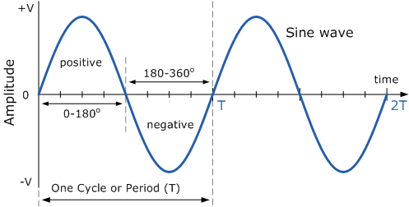
Example of sine wave
X
sin t = 0

