Slide 1
Overview on Mathematical Modeling
Prof. Ing. Michele MICCIO
Dept. of Industrial Engineering (Università di Salerno)
Prodal Scarl (Fisciano)
Rev. 7.5 of June 3, 2019
Notes:
1

Slide 2
TYPES OF MODELS
Models are used not only in the natural sciences (such as physics, biology, earth science, meteorology) and engineering/architecture disciplines, but also in the social sciences (such as economics, psychology, sociology and political science) and in public administration activities.
Here is a list:
• Physical Models
• Analogic Models
• Provisional Theories
(e.g., molecular and atomic models)
• Maps and Drawings
(e.g., PI&D, geographycal maps, etc.)
• Mathematical and symbolic models
 § 1.4 in Himmelblau D.M. e Bischoff K.B., “Process Analysis and Simulation”, Wiley & Sons Inc., 1967

Slide 3
MATHEMATICAL MODELS
Definitions
A mathematical model is a representation, in mathematical terms, of certain aspects of a non-mathematical system.
Aris, 1999
A mathematical model is a set of mathematical equations that are intended to capture the effect of certain system variables on certain other system variables.
G. C. Goodwin, St. F. Graebe, M. E. Salgado, Control System Design, Ch. 3, Prentice Hall , 2001
A model may be prescriptive or illustrative, but, above all, it must be useful !
Wilson, 1991

Slide 4

MATHEMATICAL MODELS
Definitions
A mathematical model is a description of a system using mathematical concepts and language.
. . .
A mathematical model usually describes a system by a set of variables and a set of equations that establish relationships between the variables.
. . .
Mathematical models are used not only in the natural sciences (such as physics, biology, earth science, meteorology) and engineering disciplines (e.g. computer science, artificial intelligence), but also in the social sciences (such as economics, psychology, sociology and political science); physicists, engineers, statisticians, operations research analysts and economists use mathematical models most extensively.
A model may help to explain a system and to study the effects of different components, and to make predictions about behavior.

Slide 5
MATHEMATICAL MODELING
Definition
The (human) process of developing a mathematical model is termed
mathematical modelling.

Slide 6
WHY MATH MODELING
FOR PROCESS SYSTEMS?
Is it:
  to design a controller?
  to analyze the performance of the process?
  to understand the process better?
  to simplify the complexity of a system
  etc.
Introduction to Process Control Romagnoli & Palazoglu

Slide 7
SIMULATION
The study of a system (also including a real-world process, event or phenomenon) that is performed by means of its mathematical model.
Simulation is usually carried out through a suitable software code implementing the mathematical model.
For example,
simulation may imply
search of a model solution,
value and meaning of output variables,
pattern of a dynamic response,
use of adjustable parameters,
etc.
Notes:
NEW

Slide 8
VALIDATION
In modeling and simulation,
validation is the (human) process of determining the degree to which
a model or
a simulation carried out with the model
is an accurate representation of the real world from the perspective of the intended uses.
From ✓
http://www.thefreedictionary.com
Notes:
NEW

Slide 9

THE MATHEMATICAL MODELING CYCLE
Costruzione modello
Ricerca della soluzione
Mondo Reale
Modello
        ft tt
        re 12 14
        tf 13 15
F = m × a
Interpretazione della soluzione
Donatella Sciuto, Giacomo Buonanno e Luca Mari - Introduzione ai sistemi informatici, 5a ed.
Notes:
DA AGGIUSTARE

Slide 10
MATHEMATICAL MODELS
1st CLASSIFICATION
Framework: general
Approach adopted for model development
Deterministic Models
  “First principle Models”
    Basic models
    Models involving trasport phenomena
    Models based on the “population balance approach”
  Empirical or “fitting” models
  Dynamic models
    dynamic models with “input-output rappresentation”
    state-space dynamic models
    black box dynamic models
  Time Series
  Statistical models
 rielaborated from § 1.4 in Himmelblau D.M. e Bischoff K.B., “Process Analysis and Simulation”, Wiley & Sons Inc., 1967

Slide 11
MATHEMATICAL MODELS
1st CLASSIFICATION
(on the base of
the approach adopted for model development)
  First principles Models
  or
  Fundamental Models
  ( Palazoglu & Romagnoli, 2005)
  or
  Mechanistic or White Box Models
  ( Roffel & Betlem, 2006)
  Modelli empirici o di “fitting”
  Modelli dinamici
    Modelli dinamici “con rappresentazione ingresso-uscita”
    Modelli dinamici “con rappresentazione nello spazio di stato”
    Modelli dinamici a scatola nera (black box)
  Serie temporali
  Modelli statistici

Slide 12
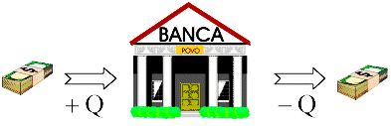

GENERAL CONSERVATION LAW
It is the most well known example of a Fundamental Principle:
Input - Output + Net Generation = Accumulation
NB: GEN > 0 → formation
GEN < 0 → disappearance
SIMPLER CASES
For a chemical element:
IN - OUT = ACC
At steady-state:
IN - OUT + GEN = 0
At steady-state and without chemical/biochemical reactions:
IN - OUT = 0
 see also
Stephanopoulos, ch. 4
Notes:
New

Slide 13
FIRST PRINCIPLES MODELS
The description of such a system and the development of such a model require the concept of:
control volume
or
system boundary
 This holds also for the case of population balance models
Notes:
new

Slide 14
MATHEMATICAL MODELS
1st CLASSIFICATION
(on the base of
the approach adopted for model development)
  “First principles Models”
    Basic models
    Models involving transport phenomena
    Models based on the “population balance approach”
  Empirical or “fitting” models
  Dynamic models
    dynamic models with “input-output representation”
    state-space dynamic models
    black box dynamic models
  Time Series
  Statistical models
 rielaborated from § 1.4 in Himmelblau D.M. e Bischoff K.B., “Process Analysis and Simulation”, Wiley & Sons Inc., 1967
Notes:
NEW

Slide 15
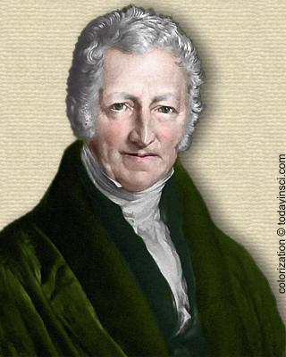
FIRST PRINCIPLES MATHEMATICAL MODELS.
Malthusian Growth Model
An Early and Very Famous Population Model
In 1798 the Englishman Thomas R. Malthus posited a mathematical model of population growth. He model, though simple, has become a basis for most future modeling of biological populations. His essay, "An Essay on the Principle of Population," contains an excellent discussion of the caveats of mathematical modeling and should be required reading for all serious students of the discipline. Malthus's observation was that, unchecked by environmental or social constraints, it appeared that human populations doubled every twenty-five years, regardless of the initial population size. Said another way, he posited that populations increased by a fixed proportion over a given period of time and that, absent constraints, this proportion was not affected by the size of the population. By way of example, according to Malthus, if a population of 100 individuals increased to a population 135 individuals over the course of, say, five years, then a population of 1000 individuals would increase to 1350 individuals over the same period of time.
Malthus's model is an example of a model with one variable and one parameter.
A variable is the quantity we are interested in observing. They usually change over time.
Parameters are quantities which are known to the modeler before the model is constructed. Often they are constants, although it is possible for a parameter to change over time. In the Malthusian model the variable is the population and the parameter is the population growth rate.

Slide 16
Example No. 1
Malthusian Growth Model
GENERAL CONSERVATION LAW
applied to No. of individuals in a “closed system”: ACC = GEN
GEN = birth - death
INITIAL CONDITION:
STATE VARIABLES
PARAMETERS
MATHEMATICAL CLASSIFICATION
dynamic, autonomous mathematical model
made by 1 ODE (Order =1),
linear, homogeneous, constant coefficient equation

Slide 17
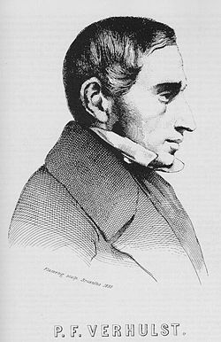
Example No. 2
Logistic Model
Differently from the Malthusian model …
developed by Belgian mathematician Pierre Verhulst (1838)
HYPOTHESES
resources are limited for growth: N(t)≤N_{sat}
GENERAL CONSERVATION LAW
applied to No. of individuals in a “closed system”: ACC = GEN GEN = birth - death
STATE VARIABLES
PARAMETERS
MATHEMATICAL CLASSIFICATION
Dynamic, autonomous mathematical model
made by 1 ODE (Order =1) ,
non linear, homogeneous, constant coefficient equation
Notes:
NEW

Slide 18
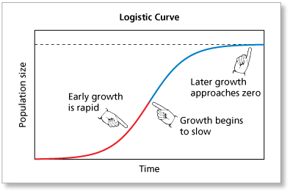
Example No. 2
Logistic Model
resources are limited for growth: N(t)≤N_{sat}
CLOSED-FORM SOLUTION
N_{sat}
N₀≠0
Notes:
NEW

Slide 19
MATHEMATICAL MODELS
1st CLASSIFICATION
(on the base of
the approach adopted for model development)
  “First principle Models”
    Basic models
    Models involving transport phenomena
    Models based on the “population balance approach”
  Empirical or “fitting” models
  Dynamic models
    dynamic models with “input-output rappresentation”
    state-space dynamic models
    black box dynamic models
  Time Series
  Statistical models
 rielaborated from § 1.4 in Himmelblau D.M. e Bischoff K.B., “Process Analysis and Simulation”, Wiley & Sons Inc., 1967

Slide 20
TRANSPORT PHENOMENA
General Law
(flux) = (transfer coefficient)・(spacial gradient)
Examples:
Newton law of viscosity
Fourier law of heat conduction
1st Fick law of diffusion

Slide 21
TRANSPORT
AND KINETIC RATE EQUATIONS
Momentum, Heat and Mass transfers
 | Heat | Mass | Momentum
Flux | q | n_{A} | τ_{xy}
Diffusion transfer (microscopic scale)
Law | Fourier’s law | 1st Fick’s law | Newton’s law
Driving force (gradient) | dT/dx | dC_{A}/dx | dv_{y}/dx
Key parameter (transfer coefficient) | k_{T} (Thermal conductivity) | D_{AB} (Binary Diffusivity) | µ (Viscosity)
Convection transfer (macroscopic scale)
Driving force | ∆T | ∆C_{A} | ∆P

Slide 22
Example No. 3
The Tubular Reactor
dx
u
0
L
x
An example of a first principles model involving transport phenomena.
HYPOTHESES
Isothermal reactor
2nd order homogeneous chemical reaction
A → P
Flat velocity profile
Axial diffusion only
VARIABILI
x: ascissa, m
t: tempo, s
u: velocità, m/s
C: concentrazione del reagente, mol/m³
D: diffusività assiale del gas, m²/s
k: cost. reazione 2° ordine, m³/moli/s
Notes:
NEW

Slide 23
Example No. 3
The Tubular Reactor
(DIFFERENTIAL) MASS BALANCE
ACC = IN – OUT + GEN
E' un'equazione differenziale alle derivate parziali (PDE) quasi-lineare, parabolica del secondo ordine,
integrabile per assegnate condizioni iniziali e condizioni al contorno
Notes:
NEW

Slide 24
Example No. 3
The Tubular Reactor
Boundary and initial conditions
initial condition
boundary conditions
x = 0
x = L

Slide 25
MATHEMATICAL MODELS
1st CLASSIFICATION
(on the base of
the approach adopted for model development)
  “First principle Models”
    Basic models
    Models involving transport phenomena
    Models based on the “population balance approach”
  Empirical or “fitting” models
  Dynamic models
    dynamic models with “input-output rappresentation”
    state-space dynamic models
    black box dynamic models
  Time Series
  Statistical models
 rielaborated from § 1.4 in Himmelblau D.M. e Bischoff K.B., “Process Analysis and Simulation”, Wiley & Sons Inc., 1967

Slide 26
MODELS BASED ON A “POPULATION BALANCE APPROACH”
Formulation
The Population Balance Equation was originally derived in 1964, when two groups of researchers studying crystal nucleation and growth recognized that many problems involving change in particulate systems could not be handled within the framework of the conventional conservation equations only, see Hulburt & Katz (1964) and Randolph (1964).
They proposed the use of an equation for the continuity of particulate numbers, termed population balance equation, as a basis for describing the behavior of such systems.
This balance is developed from the general conservation law:
Input - Output + Net Generation = Accumulation
 § 4.4 in Himmelblau D.M. and Bischoff K.B., “Process Analysis and Simulation”, John Wiley & Sons Inc., 1967 (Collocazione: 660.281 HIM 1)

Slide 27
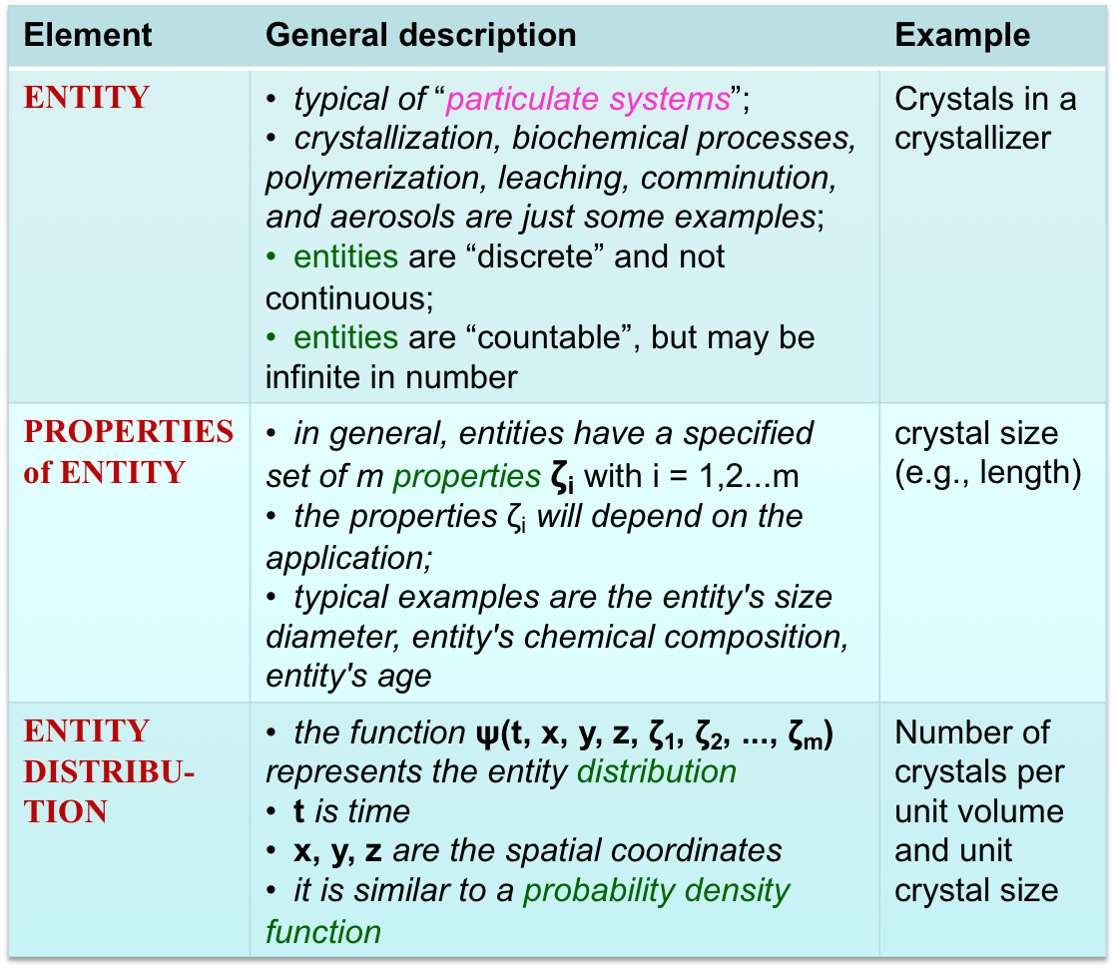
ELEMENTS NECESSARY
FOR A POPULATION BALANCE MODEL

Slide 28
ENTITY DISTRIBUTION FUNCTION
Physical meaning
is the fraction of entities at time t that are:
contained in the infinitesimal volume dV=dxdydz
characterized by values of properties in the ranges ζ₁÷ζ₁+dζ₁, . . . , ζ_{m}÷ζ_{m}+dζ_{m}

Slide 29
MATHEMATICAL MODELS
2nd CLASSIFICATION
Framework: process systems
Approach of process engineering
 Ogunnaike B.A. and Ray W.H., “Process Dynamics, Modeling and Control”, Oxford Univ. Press, 1994
 Romagnoli & Palazoglu, "Introduction to Process Control"
Structured Models (or Theoretical or White Box Models)
Unstructured Models (or Empirical or Black Box Models)
Hybrid Models (or Gray Box Models)

Slide 30
STRUCTURED MODELS
Characteristics:
Mathematical equations describing the process system can be:
a) Conservation equations e.g. total mass, mass of individual chemical species, total energy, momentum and number of particles.
b) Rate equations e.g. transport rate and reaction rate equation.
c) Equilibrium equation e.g. reaction and phase equilibrium.
Equations of state e.g. ideal gas law
Other constitutive relationships, e.g., control valve flow equation, PID control law, etc.
☺ Advantages:
They provide fundamental and general knowledge of the process
☹ Disadvantages:
They require a good and reliable understanding of the physical and chemical phenomena that underlie the process
Accuracy of models depends on the assumptions and mathematical ability of the person constructing the model.
y
i
white box
Model

Slide 31
UNSTRUCTURED MODELS
Characteristics:
They rely on measured or observed data availability:
  a) Vary input variables and then measure the value of the output variables.
  b) Perform enough measurements or observations (experiments)
The equations describing a process system in this way consist in mathematical relationships among the variables representing the available data (fitting).
Such models that rely solely on empirical information are termed as black-box models.
Example: A black-box model simulating the internal combustion engine operation and implemented into the control box of a modern car
☺ Advantages:
a) No or very limited assumptions required.
b) Just focus on the range of process operating conditions.
☹ Disadvantages:
a) They require an actual operating process and may become very time-consuming and costly
b) They don’t allow extrapolation, generally
c) They never give the engineer a fundamental understanding of the process.
y
i
black box
Model

Slide 32

Example 4
FOPDT model
An example of Black-Box Dynamic Model
Modeling means fitting a first order plus dead time (FOPDT) dynamic process model to the data set:
where:
y(t) is the measured process variable
u(t) is the controller output signal
The important parameters that result are:
      Steady State Process Gain, K_{P}
      Overall Process Time Constant, τ_{P}
      Apparent Dead Time, θ_{P} or t_{d}
 The FOPDT model is low order and linear:
so it can only approximate the behavior of real processes
adapted from:
D. Cooper, "Practical Process Control using Loop-Pro Software", PDF textbook

Slide 33
STRUCTURED AND UNSTRUCTURED MODELS: a comparison
Structured Models
theory-rich and data-poor
Unstructured Models
data-rich and theory-poor

Slide 34
“HYBRID” MODELS
Hybrid Model is developed by incorporating empirical knowledge into the fundamental understanding of the process.
Such models blending fundamental and empirical knowledge are referred to as gray-box models.
  Example
  An example can be the use of mass and energy balances to develop a reactor model and the rate of the reaction will be based on an empirical expression obtained from laboratory experiments.
y
i
gray box
Model
Introduction to Process Control Romagnoli & Palazoglu

Slide 35
MATHEMATICAL MODELS
1st CLASSIFICATION
(on the base of
the approach adopted for model development)
  “First principle Models”
    Basic models
    Models involving transport phenomena
    Models based on the “population balance approach”
  Empirical or “fitting” models
  Dynamic models
    dynamic models with “input-output rappresentation”
    state-space dynamic models
    black box dynamic models
  Time Series
  Statistical models
 rielaborated from § 1.4 in Himmelblau D.M. e Bischoff K.B., “Process Analysis and Simulation”, Wiley & Sons Inc., 1967
Notes:
NEW

Slide 36

EMPIRICAL OR “FITTING” MODELS
Mathematical models obtained by curve fitting
Curve fitting is the process of constructing a curve, or mathematical function, that has the best fit to a series of data points, possibly subject to constraints.
Curve fitting can involve:
  either interpolation, where an exact fit to the data is required,
  or smoothing, in which a "smooth" function is constructed that approximately fits the data.
A related topic is regression analysis, which focuses more on questions of statistical inference such as how much uncertainty is present in a curve that is fit to data observed with random errors.
Fitted curves can be used as an aid for
  to visualize data, e.g., to infer values of a function where no data are available,
  and to summarize the relationships among two or more variables.
Extrapolation refers to the use of a fitted curve beyond the range of the observed data, and is subject to a greater degree of uncertainty since it may reflect the method used to construct the curve as much as it reflects the observed data.

Slide 37
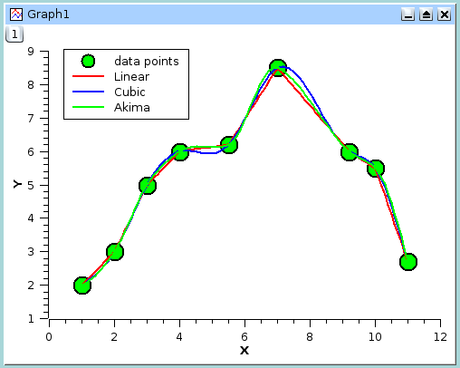
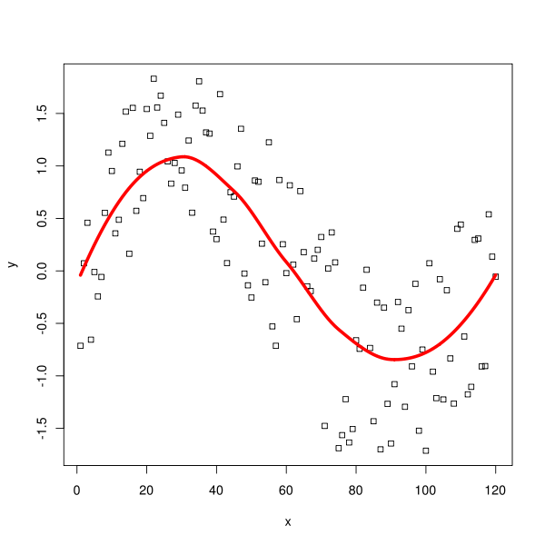
EMPIRICAL OR “FITTING” MODELS
The interpolation problem
The smoothing or
regression problem

Slide 38
MATHEMATICAL MODELS
3rd CLASSIFICATION
on the base of
mathematical features of equations and variables,
also affecting type or easiness of solution
Model attribute | Contrasting attribute | Asserts whether or not ...
Deterministic | Stochastic | ...the model equations have no stochastic variables or at least one
Lumped parameter | Distributed parameter | ...the model-predicted variables are a function of the spatial variables or not
Single input single output | Multiple input multiple output | ...the model equations have one input and one output only
One dimension | Several dimensions | ...the model equations have one or more independent spatial variables
Linear | Nonlinear | ... the model equations are linear in the system variables
Steady state | Time dependent OR dynamic | … time is one of the independent variables
Time invariant | Time varying | ... model parameters or coefficients in equations do not change with time
Continuous | Sampled | ...model equations describe the behavior at every instant of time, or only in discrete samples of time
  with ref. to Dynamical Models

Ch.3 of Himmelblau D.M. and Bischoff K.B., “Process Analysis and Simulation”, Wiley, 1967
http://www.csd.newcastle.edu.au//chapters/chapter3.html
Notes:
Da completare!

Slide 39
MATHEMATICAL MODELS
3rd CLASSIFICATION
Linear system
any function or term in the model equations must satisfy two basic properties:
additivity
homogeneity
Viewpoint of process engineering
Nonlinear
Linear
Distributed
Deterministic
Lumped
Simple!!
But not necessarily the best…
Stochastic
The theory of control is well developed for linear, deterministic, lumped-parameter models
(see Transfer Functions).
 Romagnoli & Palazoglu, “Introduction to Process Control”

Slide 40
MATHEMATICAL MODELS
1st CLASSIFICATION
(on the base of
the approach adopted for model development)
  “First principle Models”
    Basic models
    Models involving transport phenomena
    Models based on the “population balance approach”
  Empirical or “fitting” models
  Dynamic models
    input-output dynamic models
    input-state-output dynamic models or state-space models
    dynamic black box models
  Time Series
  Statistical models
 rielaborated from § 1.4 in Himmelblau D.M. e Bischoff K.B., “Process Analysis and Simulation”, Wiley & Sons Inc., 1967

Slide 41

    DYNAMIC MODELS: definitions
A dynamical system is a state space S , a set of times T and a rule R for evolution, R:S×T→S that gives the consequent(s) to a state s∈S .
  A dynamical system consists of an abstract phase space or state space, whose coordinates describe the state at any instant, and a dynamical rule that specifies the immediate future of all state variables, given only the present values of those same state variables.
  For example the state of a pendulum is its angle and angular velocity, and the evolution rule is Newton's equation F = ma.
A dynamical mathematical model can be considered to be a tool describing the temporal evolution of an actual dynamical system.
  Dynamical systems are deterministic if there is a unique consequent to every state, or stochastic or random if there is a probability distribution of possible consequents (the idealized coin toss has two consequents with equal probability for each initial state).
  A dynamical system can have discrete or continuous time.
Notes:
NEW

Slide 42
DYNAMIC MODELS: definitions
Order of a dynamical system
  It is defined as the order of the dynamical mathematical model representing the system
Order of a single differential equation
  It is defined as the order of the highest derivative in the differential eq.
  Ex.: n-th order ODE:
Order of a system of differential equations
  It is defined as the sum of the orders of the individual differential eqs.
Notes:
NEW

Slide 43
MATHEMATICAL MODELS
1st CLASSIFICATION
(on the base of
the approach adopted for model development)
  “First principle Models”
    Basic models
    Models involving transport phenomena
    Models based on the “population balance approach”
  Empirical or “fitting” models
  Dynamic models
    input-output dynamic models
    input-state-output dynamic models or state-space models
    dynamic black box models
  Time Series
  Statistical models
 rielaborated from § 1.4 in Himmelblau D.M. e Bischoff K.B., “Process Analysis and Simulation”, Wiley & Sons Inc., 1967

Slide 44
    DYNAMIC MODELS: input-output representation
MATHEMATICAL MODEL
Input output
An input-output equation reveals the direct relationship between the output variable desired, and the input variable.
This relationship often includes the derivatives of one or both variables.
Even with a higher order equation, the advantage is that the output variable is independent of (uncoupled from) any other variables except the inputs.
 Giua & Seatzu, “Analisi dei sistemi dinamici”, 2006
 typical of automatic process control
 Stephanopoulos, §5.1
 Roffel & Betlem, 2006
Notes:
new

Slide 45
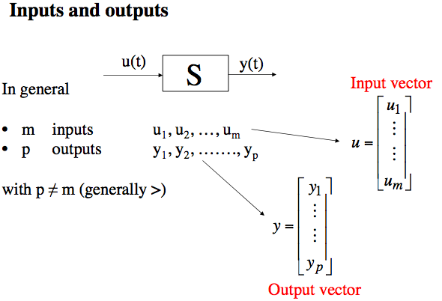
INPUT-OUTPUT REPRESENTATION
Variables
Basic Automatic Control prof. Guariso
Notes:
new

Slide 46
MATHEMATICAL MODELS
1st CLASSIFICATION
(on the base of
the approach adopted for model development)
  “First principle Models”
    Basic models
    Models involving transport phenomena
    Models based on the “population balance approach”
  Empirical or “fitting” models
  Dynamic models
    input-output dynamic models
    input-state-output dynamic models or state-space models
    dynamic black box models
  Time Series
  Statistical models
 rielaborated from § 1.4 in Himmelblau D.M. e Bischoff K.B., “Process Analysis and Simulation”, Wiley & Sons Inc., 1967

Slide 47
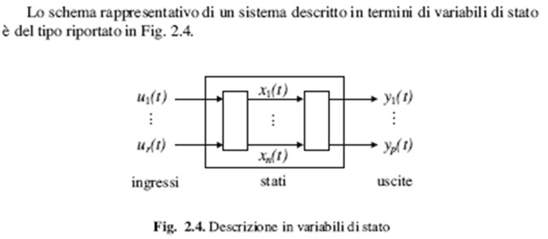
DYNAMIC MODELS: input-state-output representation
MATHEMATICAL MODEL
Input state output
 Giua & Seatzu, “Analisi dei sistemi dinamici”, 2006
Intuitively, the state of a system describes enough about the system to determine its future behavior.
     Behavioral models
    ☞ “internal” model of the process
     Roffel & Betlem, 2006

Slide 48
Example 5
WATER OPEN TANK
 see also
Ex. 6.1 pag. 118 and Ex. 6101 pag. 175
in Stephanopoulos
h(t)
IN :
VARIABLES
STATE: h(t)
OUT :
ACC = IN – OUT
State equation:
Output transformation:
Initial Condition: h(0) = h₀
 An example of:
first principles model
input-state-output dynamic model

Slide 49
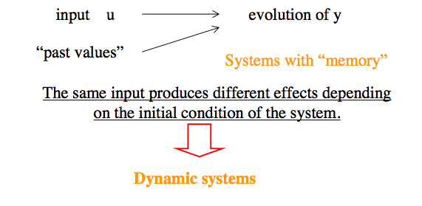
INPUT-STATE-OUTPUT MODEL
 Such a “memory”, required to define the present-time condition of the system, is called the state of the system at the time instant when the input is applied.
The variables x(t) defining the state are called state variables.
  The state of a dynamic system is such that the knowledge of the state variables at t = t₀, together with the knowledge of the input variables for t ≥ t₀, completely determines the behavior of the system for any time t ≥ t₀.
Basic Automatic Control prof. Guariso
Notes:
Semplificare ed unificare

Slide 50
STATE VARIABLES
Quantities describing the present state of a system enough well to determine its future behavior.
They provide a means to keep memory of the consequences of the past inputs to the system.
They may be partly coincident with output variables.
The minimum number of state variables required to represent a given system, n, is usually equal to the order of the system's defining differential equation.
The choices for variables to include in the state:
  is highly dependent on the fidelity of the model and the type of system
  is not unique
  as a HINT, the state variables are often given by the same variables appearing within the initial conditions of the system’s ODEs
http://www.cds.caltech.edu/~murray/amwiki/index.php/FAQ:_What_is_a_state%3F_How_does_one_determine_what_is_a_state_and_what_is_not%3F
Basic Automatic Control prof. Guariso
Notes:
Semplificare ed unificare
Semplificare ed unificare

Slide 51
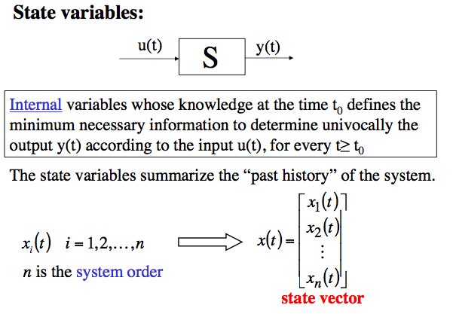
STATE VARIABLES
Basic Automatic Control prof. Guariso
Notes:
Semplificare ed unificare

Slide 52
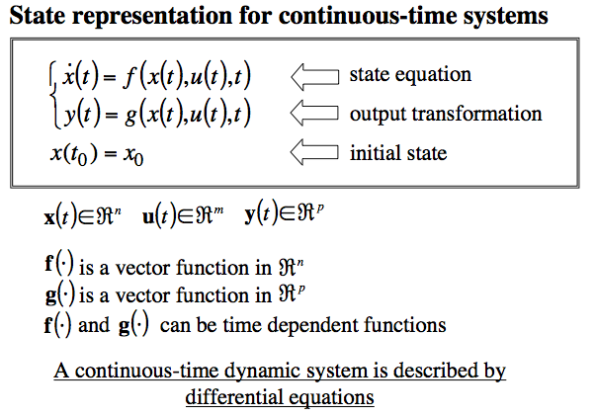
STATE-SPACE MODELS
where:
The space spanned x(t) ∈ℜ^{n} is the state-space or phase-space
n∈N is the order or size of the model
The n components of x(t) are termed phases
The function f:Ω∈ℜ⁺ ·ℜ^{n} ·ℜ^{m} →ℜ^{n} is termed vector field
Basic Automatic Control prof. Guariso

Slide 53
LINEAR STATE-SPACE MODELS.
Terminology
State equation:
Output
transformation:
Initial Condition:
A·x(t)
[n·n][n·1] = [n·1]
B·u(t)
[n·m][m·1] = [n·1]
v·t
[n·1][1·1] = [n·1]
A is the state (or system) matrix [n·n]
B is the input matrix [n·m]
C is the output matrix [p·n]
D is the feedthrough matrix [p·m]
v is the time vector [n·1]

Slide 54
MATHEMATICAL MODELS
1st CLASSIFICATION
(on the base of
the approach adopted for model development)
  “First principle Models”
    Basic models
    Models involving transport phenomena
    Models based on the “population balance approach”
  Empirical or “fitting” models
  Dynamic models
    input-output dynamic models
    state-space autonomous dynamic models
    dynamic black box models
  Time Series
  Statistical models
 rielaborated from § 1.4 in Himmelblau D.M. e Bischoff K.B., “Process Analysis and Simulation”, Wiley & Sons Inc., 1967

Slide 55
AUTONOMOUS SYSTEM
(definition based on the input-state-output representation)
DYNAMICAL SYSTEM
A dynamical system is autonomous if the state is not depending on input
OR
the input is constant with time.
adapted from “notecontrolli_PRATTICHIZZO.pdf”
NB:
For a dynamic model described by a system of ODEs, an autonomous system is also time invariant
Notes:
NEW

Slide 56
AUTONOMOUS SYSTEM
(definition based on the shape of the vector field)
A dynamical system is autonomous if its vector field depends on the state x(t), but does not explicitly depend on time.
with x(t)∈ℜ^{n}
t ∈ℜ⁺
Examples of 2nd order systems:
Autonomous system Non-autonomous system
Notes:
Da integrare con la prec.

Slide 57
ORBITS OR TRAJECTORIES
OF A DYNAMIC SYSTEM
The (forward) orbit or trajectory of a state variable x is the time-ordered collection of states that x follow from an initial state x₀ using the system evolution rule (vector field).
When both state space and time are continuous, the forward orbit is a curve x(t) parametric in t≥0
Different initial states result in different trajectories
Example for a system of order n=2
x₂
x₀^{T} = [x₁₀, x₂₀]
x₁
Notes:
NEW

Slide 58
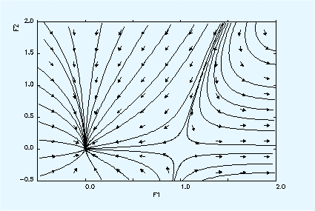
PHASE PORTRAIT
The set of all trajectories plotted in the state space forms the phase portrait of a dynamical system.
it is parametric in time
in practice, only representative trajectories are considered, indicating the forward time-orientation by an arrow
the phase portrait is usually built by numerical methods for nonlinear systems
The analysis of phase portraits provides an extremely useful way for visualizing and understanding qualitative features of solutions.
The phase portrait is particolarly useful for scalar (1st order) and planar systems (2nd order)
Example for a planar system
Notes:
Cambiare il grafico

Slide 59
TRANSIENTS AND REGIMES
The orbits may have a bounded or unbounded asymptotic behavior (for t → ± ∞).
If an orbit has a bounded asymptotic behavior for t → + ∞, the part of the orbit describing such an asymptotic behavior is referred to as regime and the remaining part is referred to as transient.
The regimes (bounded) can be constant or dynamic
Notes:
NEW

Slide 60
CONSTANT REGIMES
The simplest and most well known constant regime (bounded) is the equilibrium point (steady-state point), which is possible for every system order n
Example for a system of order n=2
x₂
x_{s}^{T} = [x_{1s}, x_{2s}]
x₀^{T} = [x₁₀, x₂₀]
x₁
Notes:
NEW

Slide 61
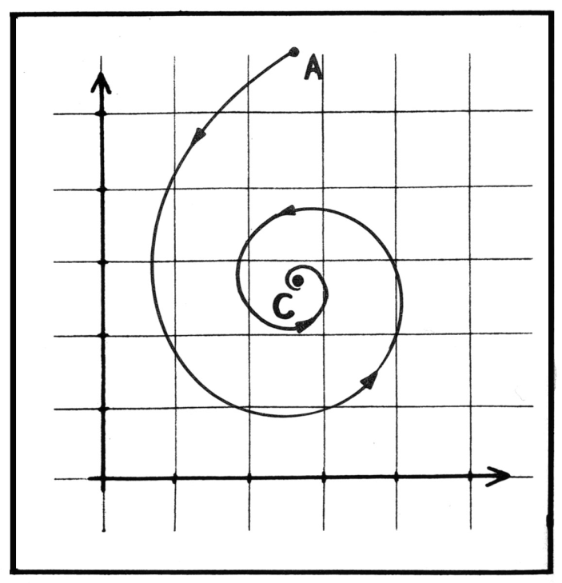
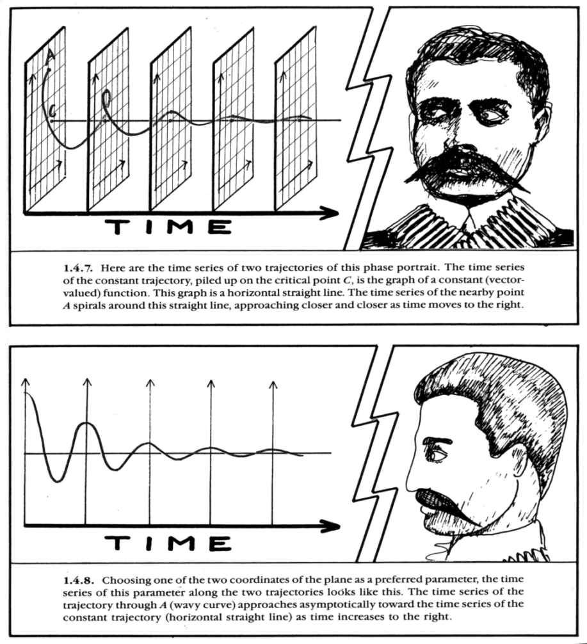
EQUILIBRIUM POINT
Example for a 2nd order dynamical system:
Stable equilibrium point (STEADY STATE)
Phase plane
Initial condition
Equilibrium point
Orbit
Time chart
or
Time trajectory
2D
1D

Slide 62
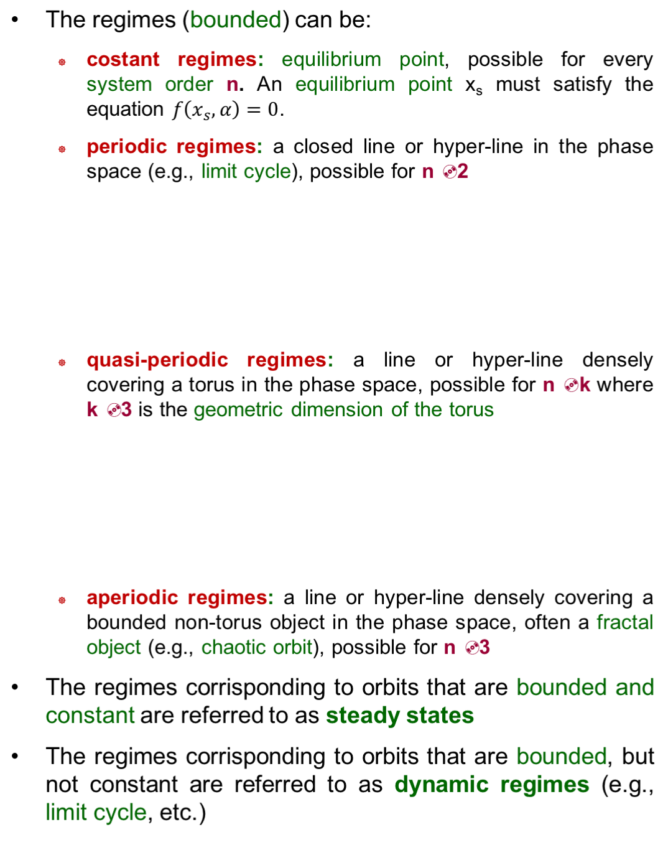
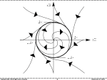
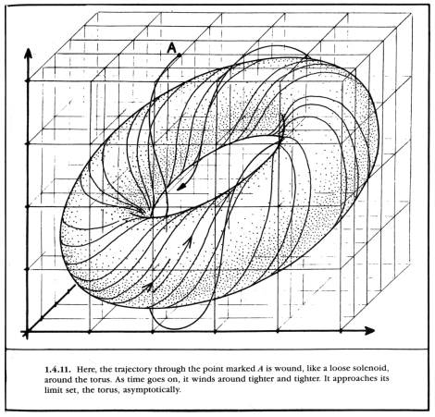
REGIMES
≥
≥
≥
≥
Notes:
NEW

Slide 63
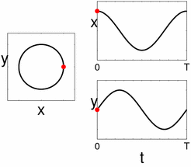
PERIODIC REGIME
Example:
Stable LIMIT CYCLE for a 2nd order dynamical system
Limit cycle
Phase portrait
2D
Time chart
1D

Slide 64

LIMIT CYCLE
Definition:
A closed asymptotic orbit in the phase space that results in a periodic oscillation of the state variables (phases), with amplitude and frequency depending on the properties of the non-linear dynamic system only and not on the chosen initial conditions.
 in order to have a Limit Cycle as an asymptotic orbit, the non-linear dynamic (continuous time) system must be of order 2 at least.
 the Limit Cycle cannot exist as an asymptotic orbit for linear dynamic system.
Notes:
Trascrivere la nota !

Slide 65
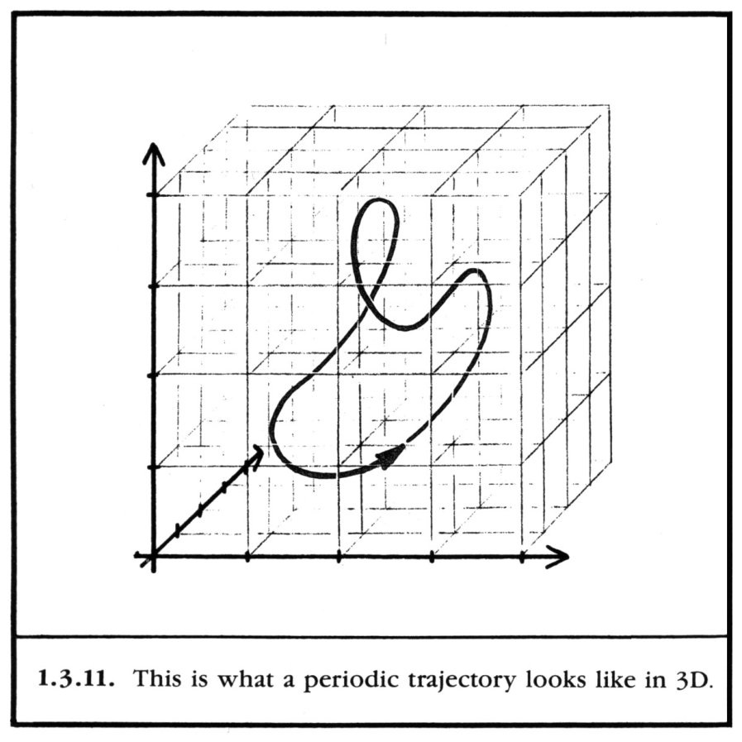
LIMIT CYCLE
Examples:
n = 2
Phase plane
Time chart
n = 3

Slide 66
2nd ORDER, NON-LINEAR, AUTONOMOUS SYSTEM
dx₁/dt = f₁(x₁(t), x₂(t))
dx₂/dt = f₂(x₁(t), x₂(t))
1st IC: x₁(t₀)=x₁₀; x₂(t₀)=x₂₀
2nd IC: x₁(t₀)=x₁₁; x₂(t₀)=x₂₁
Example of Phase Portrait
x₂
x₀=[x₁₀, x₂₀]
x₀₀=[x₁₁, x₂₁]
x₁

Slide 67
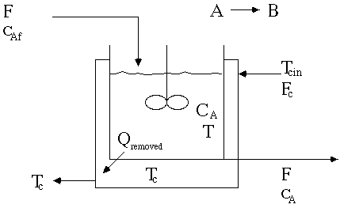
THE DIABATIC CSTR
Example No. 6
An example of
2nd order, non-linear, autonomous system
T_{f}
control volume
T_{j}
T
☞ Diabatic CSTR by Prof. B.W. Bequette:
http://www.rpi.edu/dept/chem-eng/WWW/faculty/bequette/education/links_mods/cstr/

Slide 68
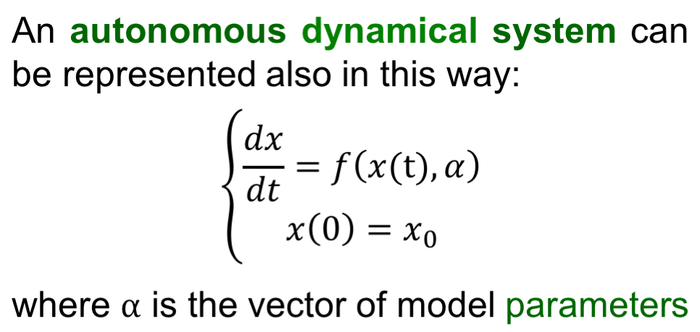
AUTONOMOUS SYSTEM
(alternative formulation)
Notes:
Immagine !

Slide 69
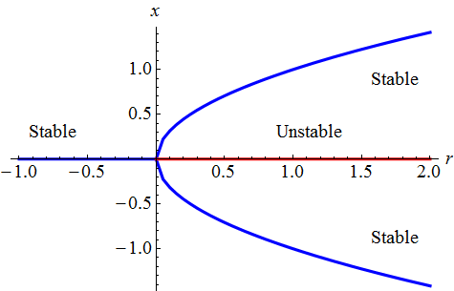
SOLUTION OR BIFURCATION DIAGRAM
A solution diagram is a diagram in which the asymptotic regimes (at least the simplest of them) of a single state variable are reported as a function of a single model parameter.
Therefore this diagram allows to represent the possible regimes for each parameter value.
Furthermore, it also shows the (possible) bifurcation values of the parameter: in fact, they correspond to a change in type, number or stability of the asymptotic solutions.
Example of the 1st order system dx/dt = r x(t) - x (t)³
asymptotic
solution
model
parameter

Slide 70
MATHEMATICAL MODELS
4th CLASSIFICATION
(based on the type of description adopted for time as the independent variable)
☞ VALID for DYNAMICAL SYSTEMS only
continuous time models
discrete time models

Slide 71
CONTINUOUS-TIME SYSTEMS
The time changes continuously:
  it is not possible to define a minimum time interval
  it is always possible to consider a smaller time interval.
Accordingly, the theory of continuous-time systems has been defined and studied, where the variables of the system are continuous-time functions, that is, at every time instant t, it is possible to define and assign the variable value.
Continuous-time systems: t ∈ ℜ

Slide 72
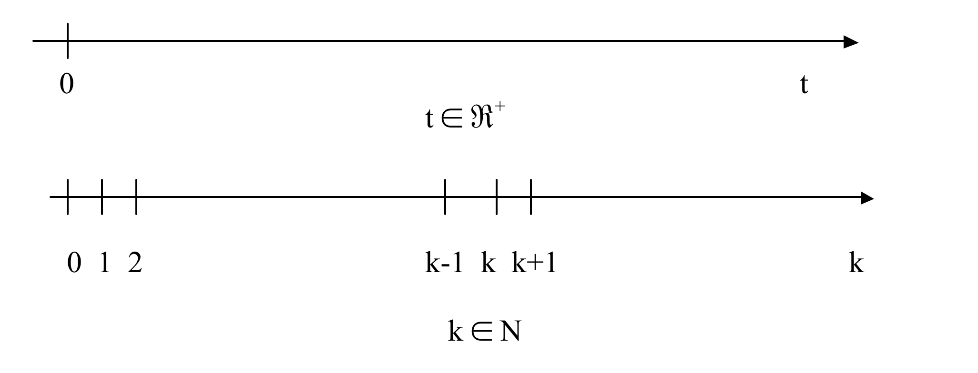
DISCRETE-TIME SYSTEMS
input – output representation
MATHEMATICAL MODEL
Ingresso uscita
Input output
input – state – output representation
MATHEMATICAL MODEL
Ingresso stato uscita
Input state output

Slide 73
INPUT–STATE–OUTPUT DISCRETE-TIME SYSTEMS
General representation of models
EXPLICIT TYPE
State equation
Output transformation
“IMPLICIT” TYPE
State equation
Output transformation
SCALAR SYSTEMS: x(k) is a scalar variable
VECTOR SYSTEMS: x(k) is a vectorial variable of size n
   A deterministic system with discrete time is often defined a map.

Slide 74
MODEL ORDER
The order n is an integer number obtained as the product between the size of the space vector x and the time gap in the implicit model representation.
 The time gap is the max time distance in the implicit model representation
Example 1:
autonomous discrete-time model of order 1 (scalar model)
Example 2:
autonomous discrete-time model of order 2 (vectorial model)

Slide 75
FIXED POINT
DEFINITION of a fixed point:
x(k+1) = x(k)
x(k) may be a scalar or vector variable
A fixed point can be stable or unstable.
A stable fixed point is an attractor for the trajectories originating in a reasonable neighborhood of it.
AUTONOMOUS SYSTEMS
The fixed points are determined for autonomous systems x(k+1) = f(x(k)) as the solutions of the algebraic eq. (scalar) or system of eqns. (vector):
x*= f (x*)

Slide 76
PERIODIC REGIMES
k₀ … … … k k+1 … k+q … k+j … … … k+2j …
periodical regimes with period “j”
in an autonomous discrete-time model
x(k+1) = f (x(k))
x(k+j)=x(k)
x(k+q)≠x(k)
with q ∈ N and q < j
 The fixed point can be viewed as a periodical regime with period “1”
x(k) =x(k+1) = f (x(k))

Slide 77
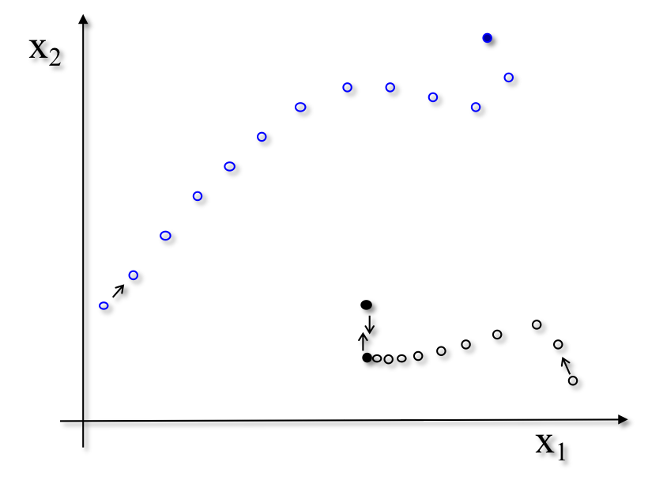
ORBITS OR TRAJECTORIES
Example:
discrete-time, non-linear, autonomous model of order 2
fixed point
Phase Portrait
periodic regime

Slide 78
LOGISTIC MODEL
a natural saturation level N_{sat} exists for the population at which the growth rate becomes zero
Search for Equilibrium Points

Slide 79
LOGISTIC MAP
discreti-zation
adimen-
siona-lization

Slide 80
LOGISTIC MAP WITH 1 PARAMETER
x(k+1) = r [1 - x(k)] x(k)
x(k₀) = x₀
0 ≤ x(k) ≤ 1
x(k+1)→y x(k)→x
Diagram of Generalized Eq. y = f(x)
Parabola that is
passing through the origin
having a vertical axis
having a downward concavity
having vertex coordinates: (-b/2a; -Δ/4a)
r = growth rate parameter

Slide 81
LOGISTIC MAP:
Analytical determination of fixed points
x* = r x* (1 - x*)
 
1st solution 2nd solution
x* = 0 x* ≠ 0
1 = r (1 - x*)
x* = 1 – 1/r
∃ x* only for r>1
81
Notes:
81

Slide 82
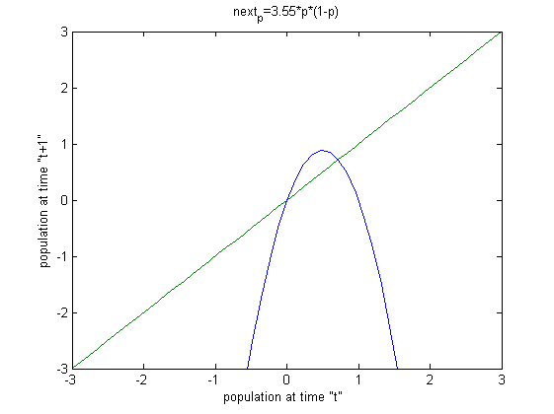
LOGISTIC MAP:
Graphical determination of fixed points Example
Logistic map.: x(k+1)=3.55 x(k)(1-x(k))
Bisector of 1st quadrant: x(k+1) = x(k) locus of fixed points
x(k+1)
← vertex r/4
fixed points x*= f (x*) by intersection
x(k)
82
Notes:
82

Slide 83
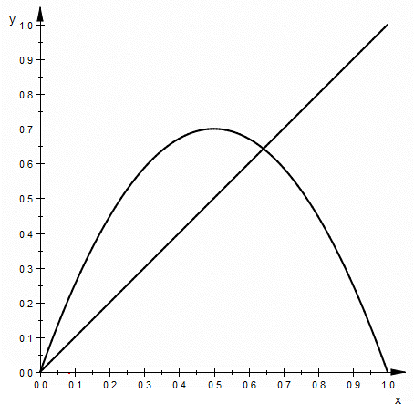

COBWEB or
STAIRCASE CONSTRUCTION
Example
logistic map: x(k+1)= r x(k)(1-x(k))
bisector of 1st quadrant: x(k+1) = x(k)
initial condition: x₀ = 0.08
r ≈ 2.6 (estimated)
← vertex r/4
From Wikipedia, the free encyclopedia: http://en.wikipedia.org/wiki/Cobweb_plot

Slide 84

THE LOGISTIC MAP IN MATLAB
Useful scripts:
cobweb.m
logistic_time_trajectory.m
logistic_solution_diagram.m
☑ try the script cobweb.m
with the following values for r:
r=0.75;
r=1.5;
r=2.5;
r=3.2;
r=3.5;
r=3.55;
r=3.8;
r=3.83;
r=3.9
84
Notes:
84
riferimento

Slide 85
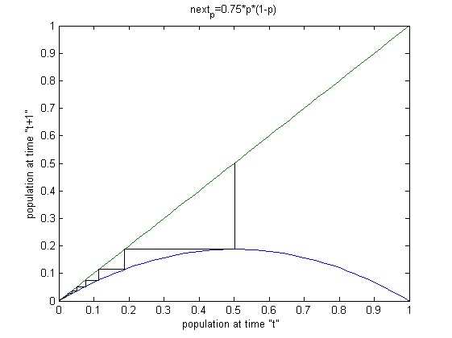
LOGISTIC MAP
r=0.75 x₀=0.5
Cobweb
← vertex r/4
stable fixed point: x* = 0 (“trivial solution”)

Slide 86
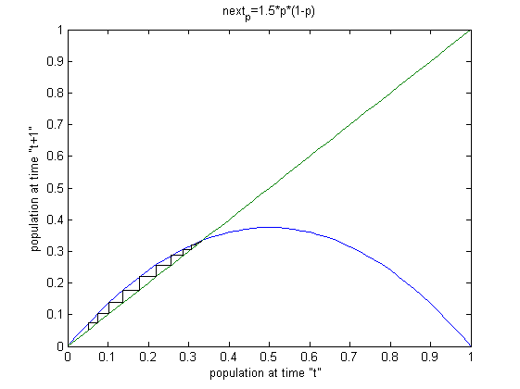
LOGISTIC MAP
r=1.5 x₀=0.05
Cobweb
← vertex r/4
stable fixed point x* = (1 – 1/r)

Slide 87
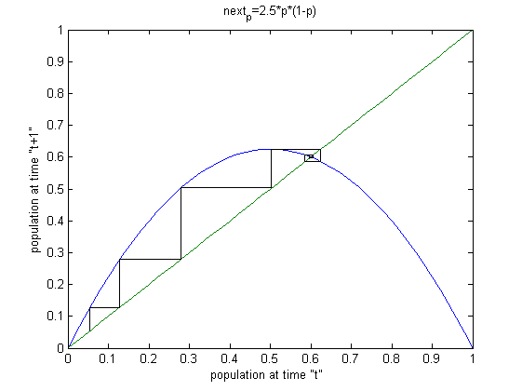
LOGISTIC MAP
r=2.5 x₀=0.05
Cobweb
← vertex r/4
stable fixed point x* = (1 – 1/r)

Slide 88
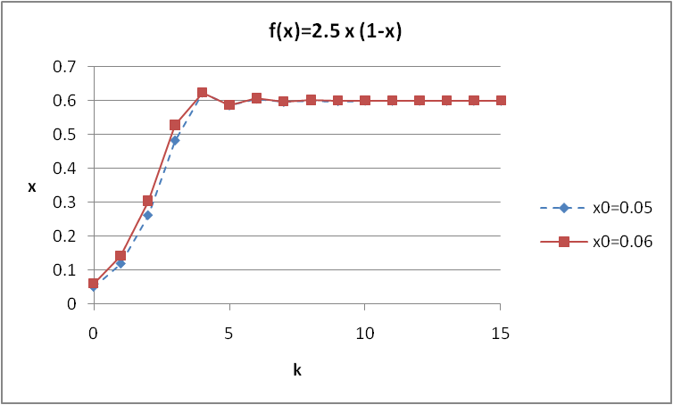
LOGISTIC MAP
Time Trajectories for r = 2.5
x₀=0.05 (in blu)
x₀=0.06 (in red)

Slide 89
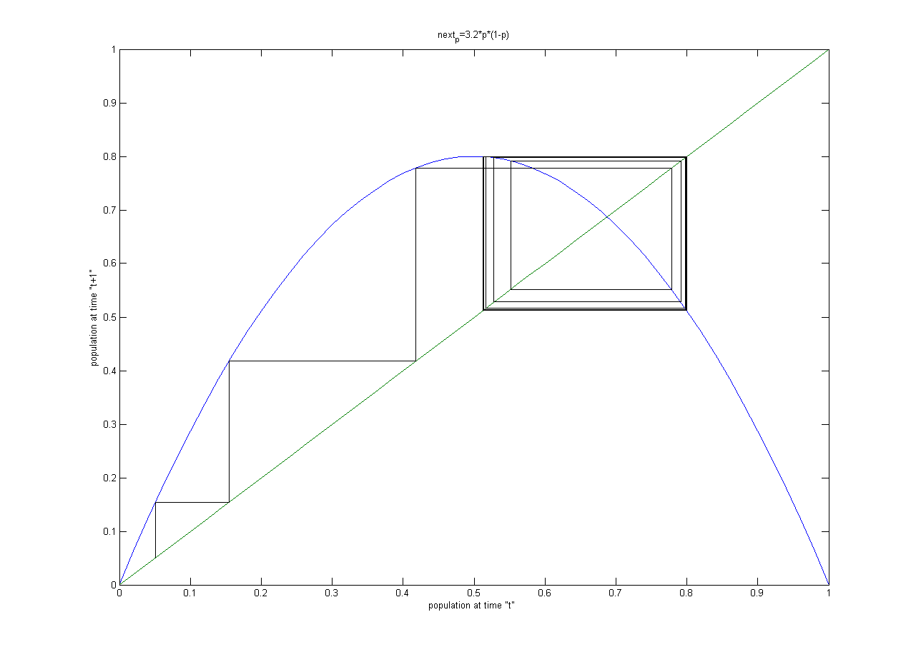
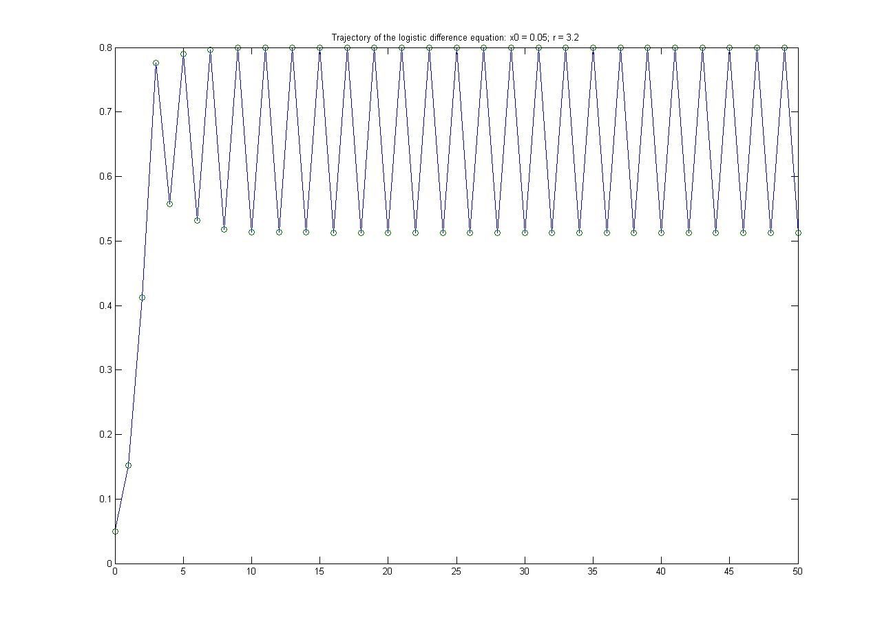
LOGISTIC MAP
r=3.2 x₀=0.05
Cobweb
← vertex r/4
Time Trajectory
unstable fixed point x* = (1 – 1/r)
period 2 dynamic regime: x∞= 0.513, 0.799

Slide 90
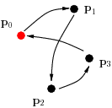
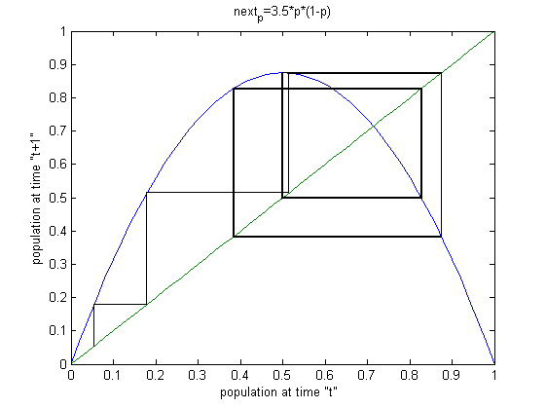
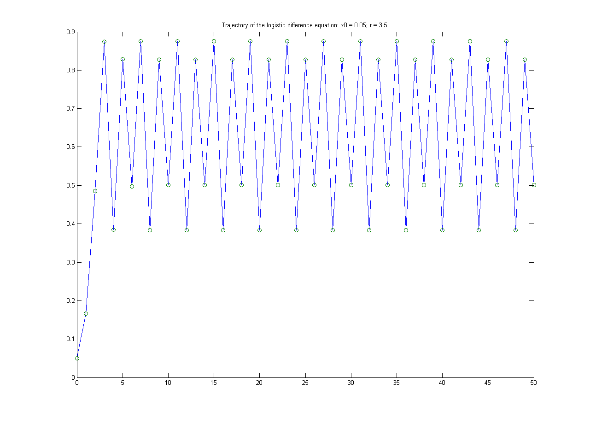
LOGISTIC MAP
r=3.5 x₀=0.05
Cobweb
← vertex r/4
Time Trajectory
unstable fixed point x* = (1 – 1/r)
period 4 dynamic regime

Slide 91
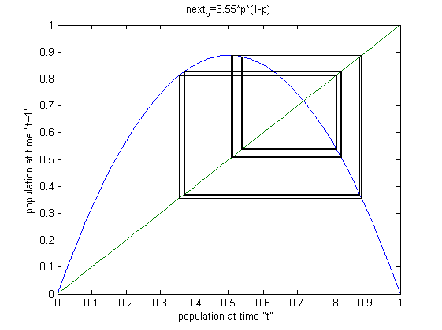
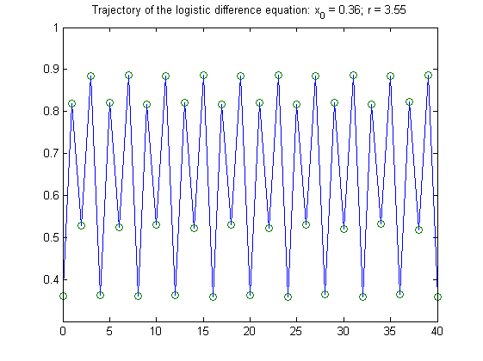
LOGISTIC MAP
r=3.55 x₀=0.36
Cobweb
← vertex r/4
Time Trajectory
unstable fixed point x* = (1 – 1/r)
period 8 dynamic regime

Slide 92
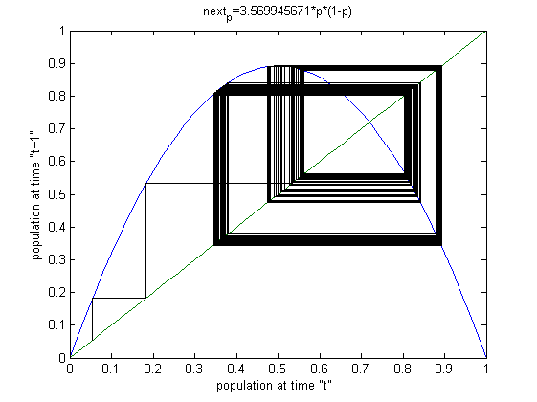
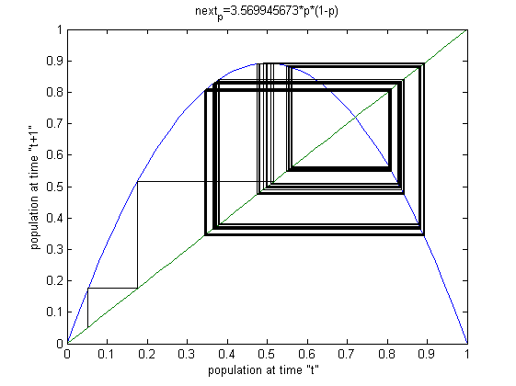
LOGISTIC MAP: switch to deterministic chaos
Cobweb: x₀=0.05 100 steps
r=3.569945671
Cobweb: x₀=0.05 100 steps
r=3.569945673
92

Slide 93
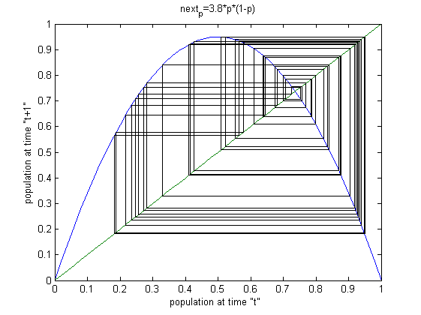
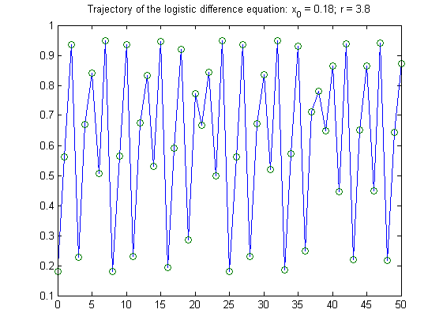
LOGISTIC MAP
r=3.8 x₀=0.17
Cobweb
← vertex r/4
Time Trajectory
chaotic solution (aperiodic dynamic regime)

Slide 94
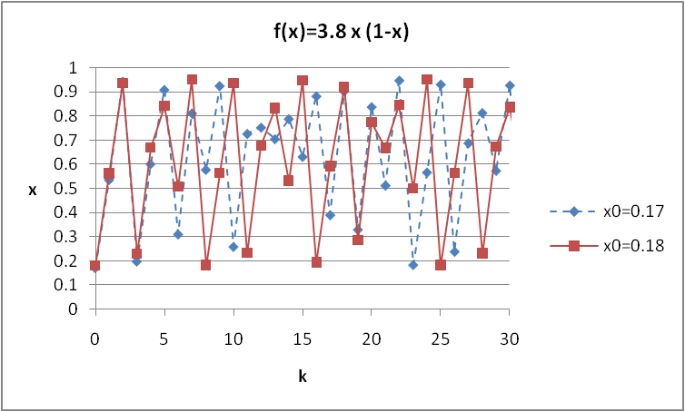
LOGISTIC MAP:
Deterministic caos
Time Trajectories for r=3.8:
x₀=0.17 (in blu)
x₀=0.18 (in red)

sensible dependence from initial conditions

Slide 95
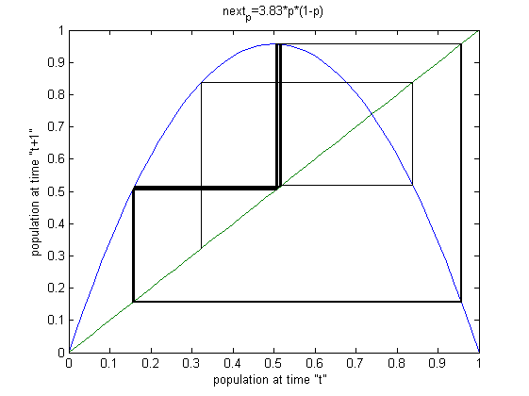
LOGISTIC MAP
r=3.83 x₀=0.33
Cobweb
← vertex r/4
period 3 dynamic regime

Slide 96
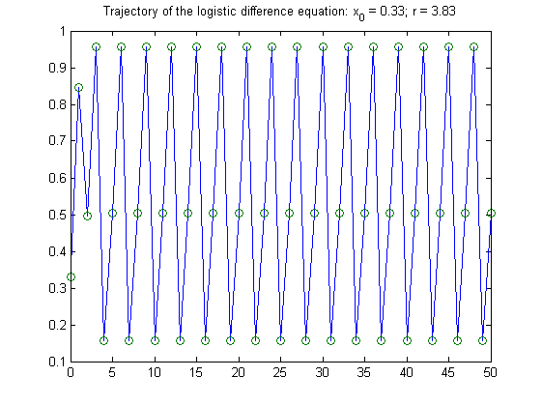
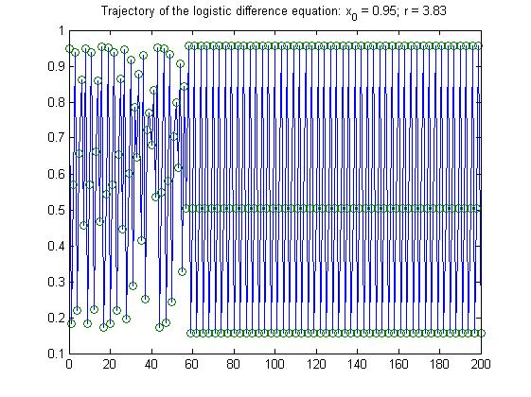
LOGISTIC MAP
Time Trajectories
r=3.83
x₀=0.33
x₀=0.95
period 3

Slide 97
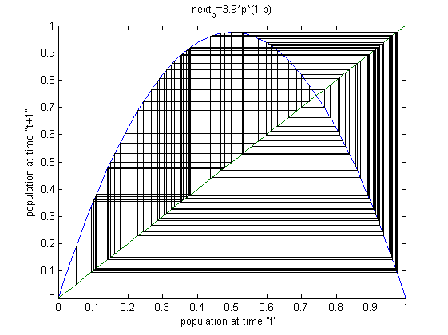
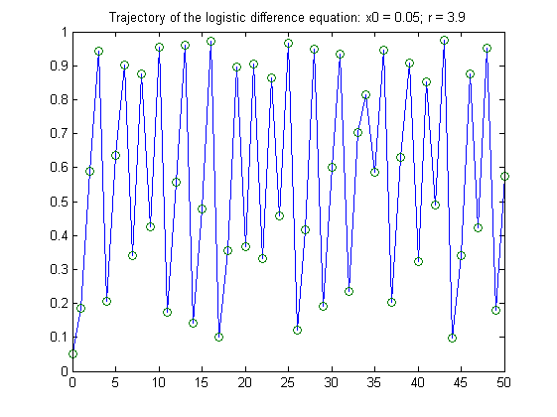
LOGISTIC MAP
r=3.9 x₀=0.05
Cobweb
← vertex r/4
Time Trajectory
aperiodic regime

Slide 98
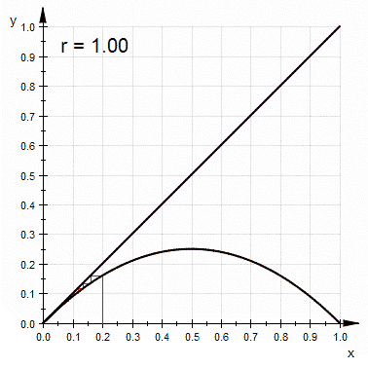
LOGISTIC MAP
Cobweb
x₀=0.2
r =1 ÷ 4
From Wikipedia, the free encyclopedia: http://en.wikipedia.org/wiki/File:LogisticCobwebChaos.gif
Notes:
98

Slide 99
LOGISTIC MAP: remarks on Fixed points
for 0 < r < 1 one fixed point x*=0 exists, i.e., the origin, and is stable
for 1 < r < 3 two fixed points exist:
one is unstable (x*=0) and the other one x*=(r-1)/r is stable
for r > 3 the fixed point becomes unstable, but a new stable periodic regime arises with a period 2^{k} and k ε N (period doubling cascade)
the periodic regime holds up to a particular value r_{c}, = 3.569945672.., beyond which the map seems to oscillate among an infinite number of points without any regular law: 
deterministic chaos
for certain values r_{c} < r < 4 there are still periodic windows

a stable fixed point is referred to as attractor
a stable periodic regime is referred to as periodic attractor

Slide 100
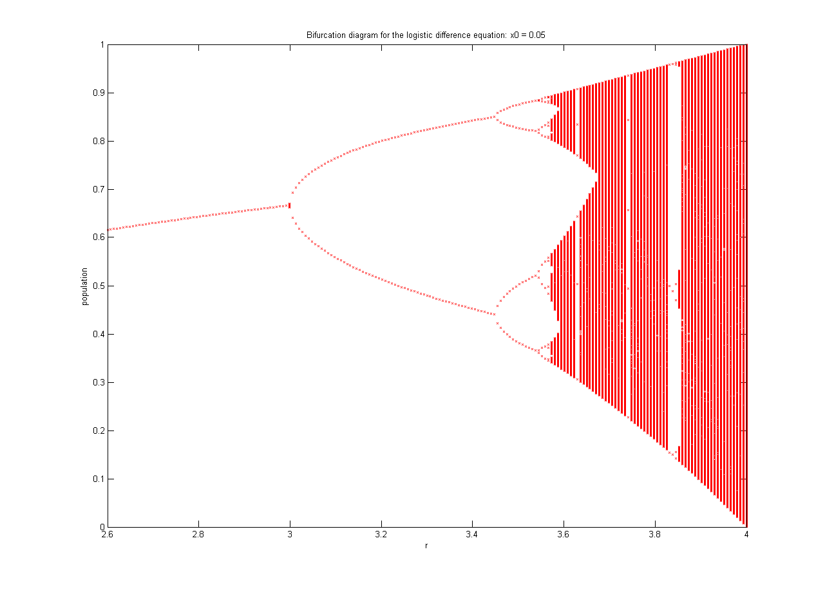

LOGISTIC MAP.
Solution diagram
x₀=0.05
x₀=0.3
100

Slide 101
LOGISTIC MAP: regime patterns
n | 2^{n} | r_{n}
1 | 2 | 3
2 | 4 | 3.449490
3 | 8 | 3.544090
4 | 16 | 3.564407
5 | 32 | 3.568750
6 | 64 | 3.56969
7 | 128 | 3.56989
8 | 256 | 3.569934
9 | 512 | 3.569943
10 | 1024 | 3.5699451
11 | 2048 | 3.569945557
infinity | accumulation point | 3.569945672
The table shows the type of cycles that can be observed and the value of the growth parameter r for which that cycle appears:
Notice that the period doubling happens faster and faster (8, 16, 32, ...) and then suddenly ends after the so-called accumulation point and chaos appears.
If we call r_{n+1} the value of r for which the 2^{n} period becomes unstable and if we determine the limit, as n goes to infinity, of ( r_{n+1} - r_{n} ) / ( r_{n+2} - r_{n+1} ) we obtain a value of 4.66920160...
Surprisingly, that limit value is the same for all functions of this type ( 1D maps with only one quadratic maximum) which approach chaos by period doubling.
In fact, that value is one of the universal constants - the Feigenbaum constant - approximately equal to 4.669. It was discovered by Feigenbaum in 1975 and it characterizes the transition to chaos.
from http://to-campos.planetaclix.pt/fractal/caose.html

Slide 102
MATHEMATICAL MODELS
1st CLASSIFICATION
(on the base of
the approach adopted for model development)
  Modelli a “principi primi” (“First principle Models”)
  Modelli basati sul “bilancio di popolazione”
  Modelli empirici o di “fitting”
  Dynamic models
    input-output dynamic models
    input-state-output dynamic models or state-space models
    dynamic black box models
  Serie temporali
  Modelli statistici

Slide 103
Black-Box Model Structures
BLACK BOX
MODEL
u(t) OR u(k) y(t) OR y(k)
Input Output
The model structures vary in complexity and order depending on the flexibility you need to account for the dynamics and on possible consideration of noise in your system.
The simplest black-box structures are:
Linear polynomial model, which is the simplest input-output model (e.g., ARX model)
Transfer function, with a given number of adjustable poles and zeroes.
State-space model, with unknown system matrices, which you can estimate by specifying the number of model states
Non-linear parameterized functions
103
Notes:
Vero ANCHE tempo continuo?
103

Slide 104

SYSTEM IDENTIFICATION
Documentation center
System identification is a methodology for building mathematical models of dynamic systems using measurements of the system's input and output signals/data.
The system identification methodology requires that you:
Measure the input and output signals/data from your system in time or frequency domain.
Select a model structure.
Apply an estimation method to estimate value for the adjustable parameters in the candidate model structure.
Evaluate the estimated model to see if the model is adequate for your application needs.
System identification uses the input and output signals you measure from a system to estimate the values of adjustable parameters in a given model structure.
Obtaining a good model of your system depends on how well your measured data reflect the behavior of the system.

Slide 105
    Dynamical modeling
    Final Statement
A way to distinguish the techniques used when modeling dynamic processes is to picture them on a scale with two extremes at the ends:
at the one side
black box
system identification
at the other side
theoretical modeling or
first principles modeling
105
Notes:
105

Slide 106
MATHEMATICAL MODELS
5th CLASSIFICATION
(based on the type of mathematical solution,
with exclusion of empirical models)
  1. ANALYTICAL SOLUTIONS
  → DIFFERENTIAL CALCULUS
      → ALGEBRA
2. NUMERICAL SOLUTIONS
→ NUMERICAL CALCULUS
      Ex.: numerical methods for PDEs
  FINITE DIFFERENCE METHODS (FDM)
  FINITE ELEMENT METHODS (FEM)
  COLLOCATION METHODS

Slide 107
MATHEMATICAL MODELS
1st CLASSIFICATION
(on the base of
the approach adopted for model development)
  Modelli a “principi primi” (“First principle Models”)
  Modelli basati sul “bilancio di popolazione”
  Modelli empirici o di “fitting”
  Modelli dinamici
    Modelli dinamici “con rappresentazione ingresso-uscita”
    Modelli dinamici “con rappresentazione nello spazio di stato”
    Modelli dinamici a scatola nera (black box)
  Time Series
  Modelli statistici

Slide 108
TIME SERIES:
Definitions
A time series is a sequence of data points, measured typically at successive times spaced at uniform time intervals.
Y₁, Y₂,…, a series of values measured or observed for a variable Y at successive times t₁, t₂,… which may be reported as a sequence of integers k = 0, 1, 2, . . .
Anonymous
Values taken by a variable over time (such as daily sales revenue, weekly orders, monthly overheads, yearly income) and tabulated or plotted as chronologically ordered numbers or data points.
http://www.businessdictionary.com/
 time series are NOT just data …

Slide 109

TIME SERIES:
Examples
the retail garment market sellings
the daily closing value of the Dow Jones index
the annual flow volume of the Nile River at Aswan
the sampled pressure measurements in a gas-phase chemical reactor
. . .

