Slide 1

Padé Approximation
Prof. Ing. Michele MICCIO
Dip. Ingegneria Industriale (Università di Salerno)
Prodal Scarl (Fisciano)
Revision 6.21 of March 12, 2019
 see §12.2 at pag.214

Slide 2
Processes with Time Delay
K
(
s
+
z
)(
s
+
z
)…
(
s
+
z
)
GH
(
s
)
=
1
2
m
(
s
+
p
)(
s
+
p
)…
(
s
+
p
)
1
2
n

Slide 3
Limits of the Root Locus Method
When time delays are part of the model, we can no longer represent the transfer function as a ratio of two polynomials in s, since the exponential term is not rational.
There is an incentive to find rational approximations to the exponential delay term.
 This allows us to factor the process transfer function in terms of simple poles and zeroes, and use analytical techniques to analyze the system responses.
Introduction to Process Control Romagnoli & Palazoglu

Slide 4


Padé Approximation
http://en.wikipedia.org/wiki/Pad%C3%A9_approximant#DLog_Pad.C3.A9_method
Padé approximant is the "best" approximation of a function by a rational function of given order – under this technique, the approximant's power series agrees with the power series of the function it is approximating.
The technique was developed by Henri Padé.
The Padé approximant often gives better approximation of the function than truncating its Taylor series.
Definition:
Given a function f(x) and two integers m ≥ 0 and n ≥ 0, the Padé approximant of order [m/n] is the rational function R(x):

Slide 5
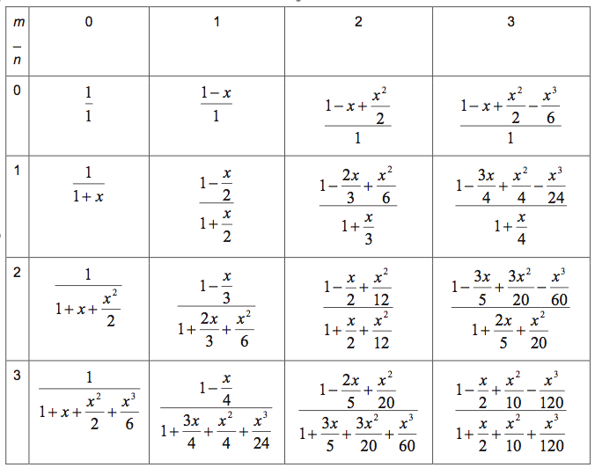
Padé Table

Slide 6
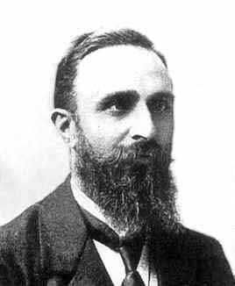
Padé Approximation of Dead Time
First-order (1/1) Padé Expansion
Second-order (2/2) Padé Expansion

The First-order Padé Expansion introduces a stable pole at p=−1/(t_{D}/2)
and an RHP zero at z=+1/(t_{D}/2)
These expressions should serve as a reasonable approximation to the delay term, especially for small delays.
Introduction to Process Control Romagnoli & Palazoglu

Slide 7
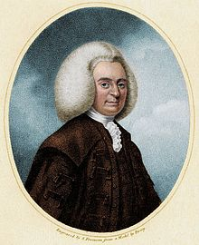
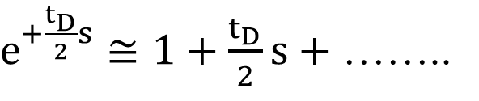
Padé Approximation of Dead Time
Let’s rewrite the time delay TF as follows:
Let’s expand both the numerator and the denominator into a McLaurin series arrested at the 1st order term:
$e^{+\frac{t_{D}}{2}s}≅1+\frac{t_{D}}{2}s+$ ……..
 The 1st order Padé approximation is coincident with the result of an expansion into a McLaurin series arrested at the 1st order term
Introduction to Process Control adapted from Romagnoli & Palazoglu

Slide 8
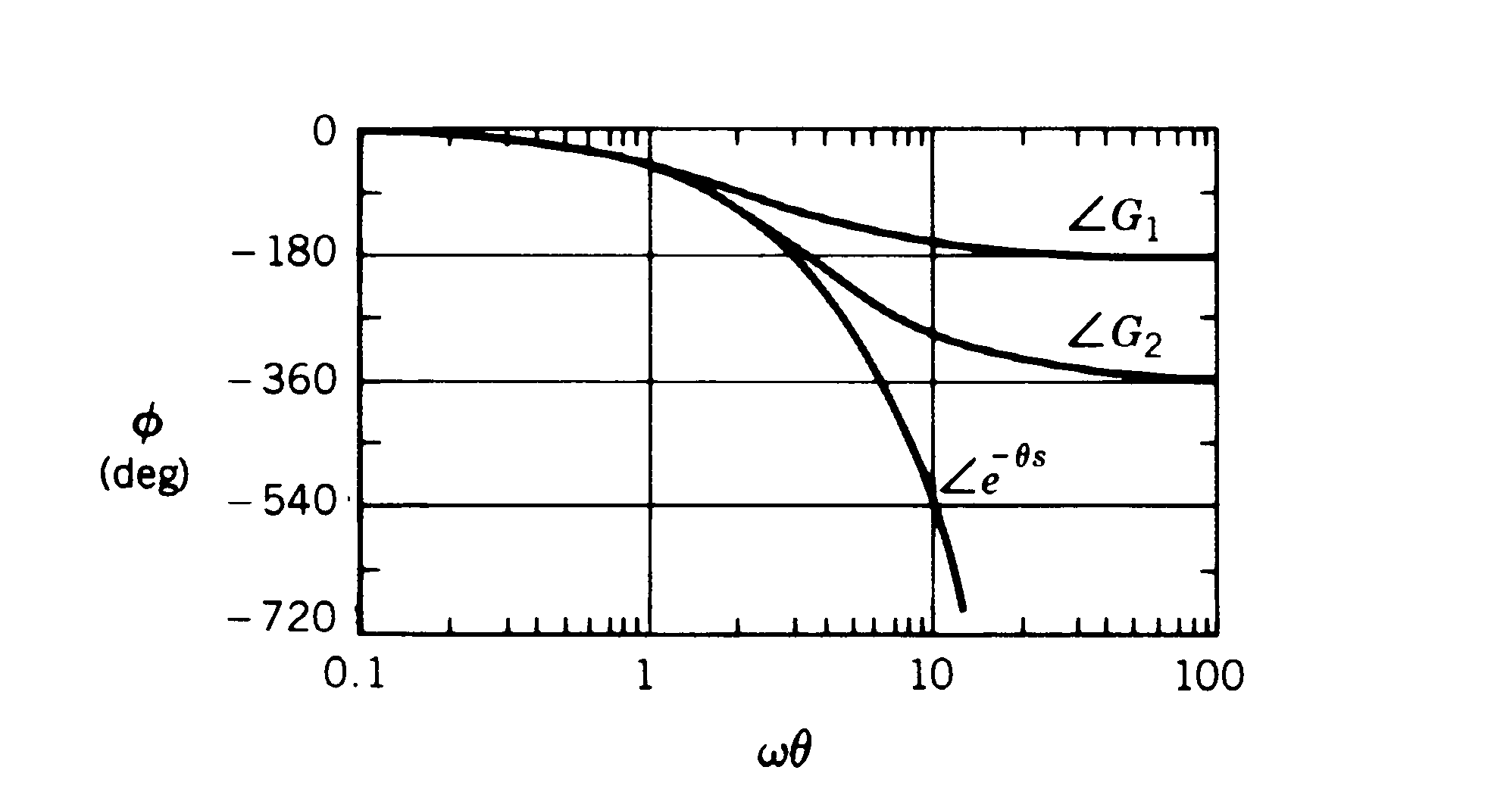
Approximation introduced by Padé
1/1 approximation
☺ In this range, approximation gives accurate results 
2/2 approximation
Figure 14.6.
Phase angle plot (Bode) for time delay ʘ
and for 1/1 (G1)
and 2/2 (G2) Padé approximations
the phase Bode diagram
by 박흥일
-> For each ω, the Phase angle plot (Bode) never exceeds the 1/1 (G1) and 2/2 (G2) Padé approximations

Slide 9

Padé implementation in Matlab
(command line implementation)
>> [NUM,DEN] = pade(D,N)
% PADE provides Padé approximation of time delays:
% [NUM,DEN] = pade(D,N) returns the Nth-order Padé approximation
% of the continuous time delay exp(-D*s) in TF form.
% The row vectors NUM and DEN contain
% the polynomial coefficients in descending powers of s.
>> pade(D,N)
% When we use pade(D,N) without the left-hand argument [q,p],
the function automatically plots:
% the step responses as a function of time
% and the phase Bode diagram
% and compares them with the exact responses of the time delay (dashed red lines).

Slide 10
Padé implementation in Matlab
(command line implementation)
Dead time:
D = 3
Order:
N = 1
UNIT STEP RESPONSE
▬▬▬▬▬ 1st order approximation
▬▬ ▬▬ actual dead time
PHASE PLOT
▬▬▬▬▬ 1st order approximation
▬▬ ▬▬ actual dead time

Slide 11
Padé implementation in Matlab
(demo script file implementation)
>> pade1
% File: pade1.m
% from the book by P.C. Chau © 2001
% *** revision 1.2 by M.Miccio on May 3, 2017 ***
% Very simple macro demonstrating the MATLAB command
% [q,p]=pade(td,n)
% to do a Padé approximation
>> padeshow ???
% File: pade2.m (CENG 120)
% very simple macro
% for Pade deadtime approximation using textbook formulas.
%
% Must have defined the order, named order
% and the deadtime, named td

Slide 12
Example 1
(a FOPDT process model)
Consider a FOPDT process model
First-order Padé Approximation:
Introduction to Process Control Romagnoli & Palazoglu

Slide 13
Example 1
(a FOPDT process model)
Comparison of unit step responses:
Exact vs 1st order Approximation
Inverse response
HINT:
Try plotting time responses with Matlab®, e.g.,
>> step(G_dt)
Introduction to Process Control Romagnoli & Palazoglu

Slide 14
Processes with Time Delay
In the previous FOPDT example the original system was first-order. After the approximation, the system appears to be second-order.
The effect of the approximation is to increase the order of the system.
The final order will depend on the order of the approximation
Introduction to Process Control Romagnoli & Palazoglu

Slide 15
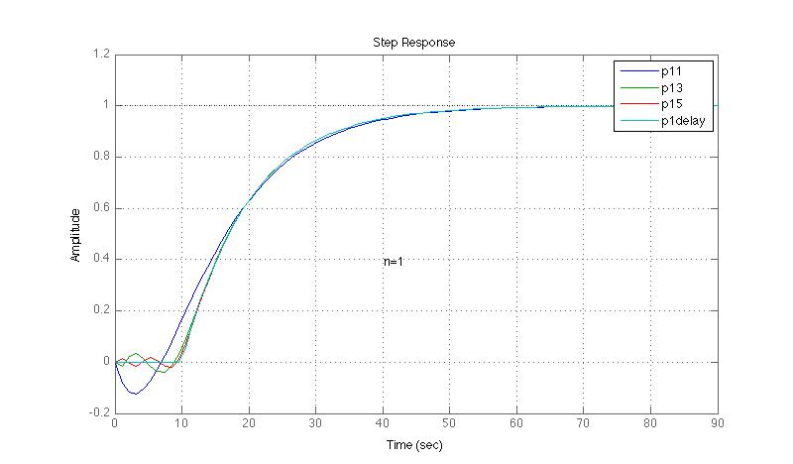
Padé implementation in Matlab
(demo script file implementation)
>> pade_show
% SCPC - Matlab Es#1 (file UniPISA mat-Es1_UniPI_2007-08.pdf)
% *** revision 2.01 by M.Miccio on Apr 22, 2015 ***
%
% FOPTD with Kp=1; tauP=tD=10
% and its Padé approximations
% with order n=1,3,5
%
% plots dynamic responses to unit step for comparison

