Slide 1

NOTES
ON STABILITY
FOR NON-LINEAR SYSTEMS
Michele MICCIO
and
Andrea CAMMAROTA
Dept. of Industrial Engineering (Università di Salerno)
Prodal Scarl (Fisciano)
Rev. 3.8 of May 23, 2019

Slide 2
Different behaviors between linear and nonlinear systems
There are phenomena that can take place only in the presence of nonlinearity in the dynamical model; hence they cannot be described or predicted by linear models.
The following are examples of nonlinear phenomena:
Finite escape time: The state of an unstable linear system can go to infinity as time approaches infinity. A nonlinear system’s state, however, can go to infinity in finite time.
Multiple isolated equilibrium points: A linear system can have only one equilibrium point, and thus only one steady-state operating point that attracts or repels the state of the system irrespective of the initial state. A nonlinear system can have more than one equilibrium point.
Limit cycles: A linear system can have a stable oscillation if it has a pair of eigenvalues on the imaginary axis. The amplitude of the oscillation will then depend on the initial conditions. A nonlinear system can exhibit an oscillation of fixed amplitude and frequency, which appears independently of the initial conditions.
Chaos: A nonlinear system can have a more complicated steady-state behavior that is not equilibrium or periodic oscillation. Some of these chaotic motions exhibit randomness, despite the deterministic nature of the system.
Multiple modes of behavior: A nonlinear system may exhibit very different forms of behavior depending on external parameter val- ues, or may jump from one form of behaviour to another autonomously. These behaviors cannot be observed in linear systems, where the complete system behaviour is characterized by the eigenvalues of the system matrix A.
 NLSC_lecture_notes_2017 (ETH, P. Al Hokayem & E. Gallestey)

Slide 3

Introduction
For clarity and simplicity, we concentrate on stability of
☞ constant regimes (equilibrium points in the continuous time domain)
QUESTIONS
How many steady-state regimes does a dynamical system have?
What are the stability properties of a given steady-state regime?
http://www.scholarpedia.org/article/Equilibria

Slide 4
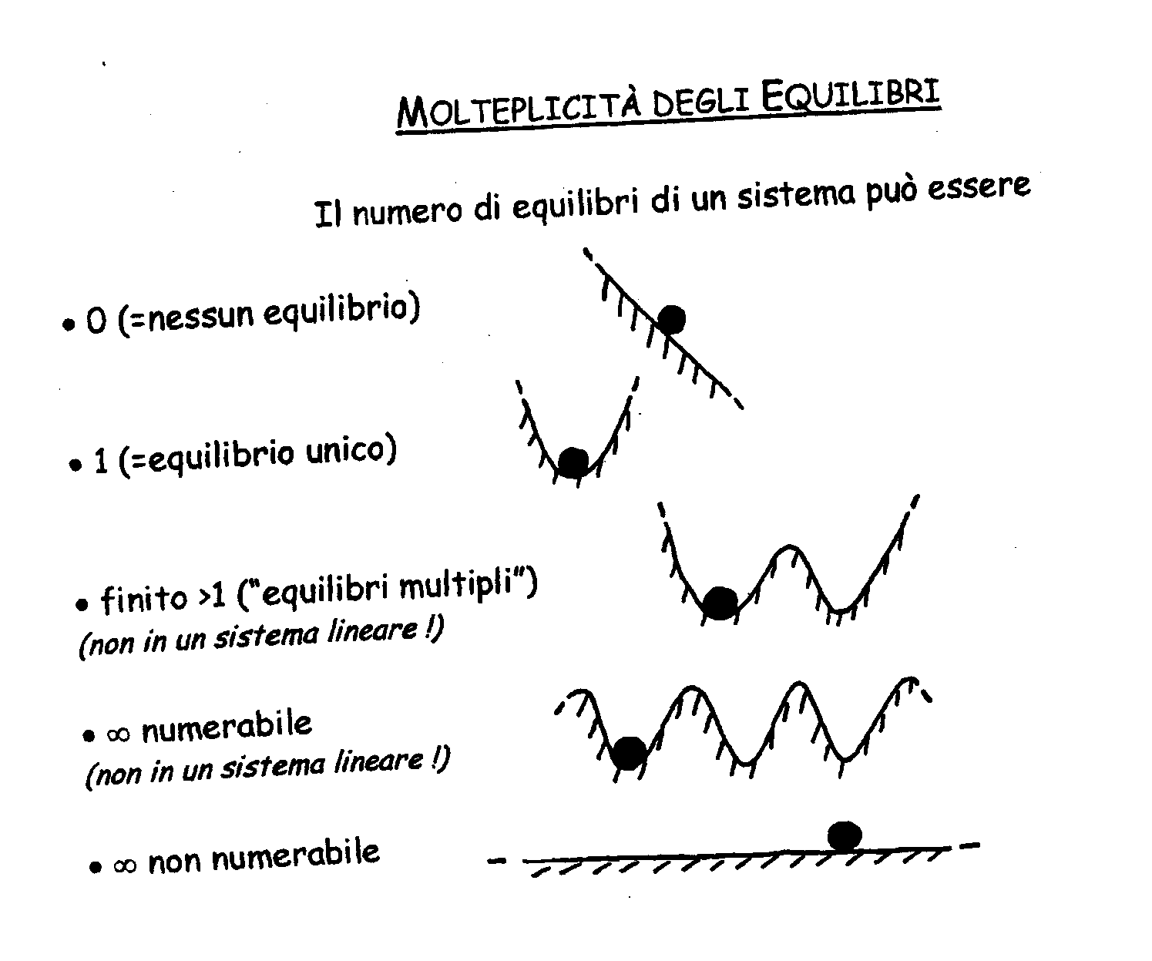
Constant Regimes:
How many ?
Multiplicity of Equilibrium Points

Slide 5

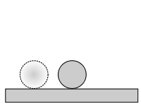
What are the stability properties ?
A qualitative concept
An equilibrium may be stable or unstable or indifferent.
For example:
the equilibrium of a pencil standing on its tip is unstable;
the equilibrium of a picture on the wall is (usually) stable;
the equilibrium of a ball on a flat plane is (usually) indifferent.
Adapted from On-Line Lectures ©Alexei Sharov, Department of Entomology, Virginia Tech, Blacksburg, VA
http://www.ento.vt.edu/~sharov/PopEcol/

Slide 6
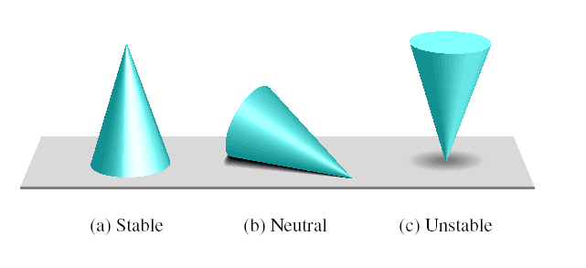
What are the stability properties ?
A qualitative concept (2)
The concept of stability can be illustrated by a cone placed on a plane horizontal surface.

Slide 7
Stability: general properties
Linear Systems | Non-Linear Systems
stability is an intrinsic property of the system itself and not of its equilibrium points | stability is a property of each asymptotic regime and not of the system itself; e.g., the same dynamic system may exhibit stable and unstable equilibrium points in parallel

Slide 8
Stability for INPUT-OUTPUT DYNAMICAL systems

Slide 9
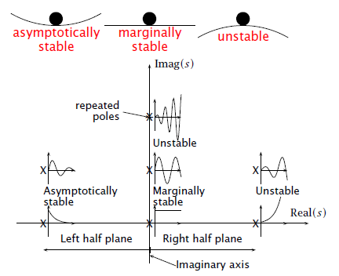

Stability for linear input-output systems
A necessary and sufficient condition for a linear dynamic system to be stable is that all the poles of the system transfer function have negative real parts (BIBO Stability Theorem).
 Part IB Paper 6: Information Engineering from Glenn Vinnicombe
A marginally stable input-output system has only certain bounded inputs resulting in a bounded output.
http://en.wikipedia.org/wiki/Marginal_stability

Slide 10
Stability for AUTONOMOUS DYNAMICAL systems

Slide 11
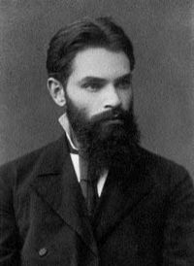
Lyapunov Stability definition
(for a point of equilibrium x_{s})
Consider an autonomous nonlinear dynamical system
A point of equilibrium x_{s} of the above system is said to be Lyapunov stable if, for every region U of radius ε >0, there exists a neighborhood V of radius δ > 0 such that, for each initial condition x₀∈V, the corresponding trajectory x(t) remains included in U for every t>t₀
that is:
ε
x₀
δ
x(t)
x_{s}
Conceptually, the meaning is the following:
Trajectories (e.g., perturbations from equilibrium) starting "close enough" to x_{s} (within a distance δ from it) remain "close enough" forever (within a distance ε from it). Note that this must be true for any ε that one may want to choose, otherwise the system is unstable!
Notes:
v. Formalismo matem. Di M.T. D’Agosto

Slide 12
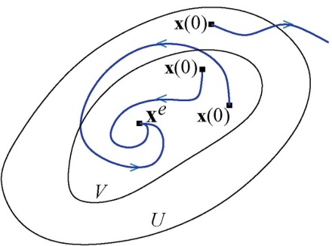

Lyapunov Asymptotic Stability definition
(for a point of equilibrium x_{s})
Consider the same autonomous nonlinear dynamical system
A point of equilibrium x_{s} of the above system is said to be asymptotically stable if it is Lyapunov stable and if a neighborhood V of radius δ > 0 exists such that, for each initial condition x₀∈V and for t → ∞
ε
x₀
δ
x(t)
x_{s}
1st example 2nd example
Conceptually, the meaning is the following:
Trajectories (e.g., perturbations from equilibrium) that start "close enough" to x_{s} (within a distance δ from it) not only remain close enough, but also eventually converge to the equilibrium.
Notes:
v. Formalismo matem. Di M.T. D’Agosto

Slide 13
Instability
A point of equilibrium x_{s} is said to be unstable if it is not Lyapunov stable
http://www.scholarpedia.org/article/Stability

Slide 14
Example:
2nd order dynamical system
 The origin is an equilibrium point
phase portrait
 retrieved from Dr. Victor M. Becerra, University of Reading (UK)

Slide 15
Qualitative concept of stability vs.
Lyapunov Stability
stable equilibrium | unstable equilibrium | indifferent or neutral equilibrium
Lyapunov’s Asymptotic Stability | Lyapunov Instability | Lyapunov Stability
 Adapted from Economia dei Sistemi Complessi dei proff.ri Silvio Giove e Christina Mosele

Slide 16
Linear autonomous dynamical systems

Slide 17
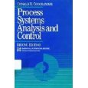
Study of linear autonomous dynamical systems
… understanding linear systems and their solutions is a crucial first step to understanding the more complex nonlinear systems.
n-ORDER, LINEAR AUTONOMOUS DYNAMICAL SYSTEM
x is state:
A is a non singular state matrix [n · n]
EQUILIBRIUM POINTS
If A is non singular , x = 0 is the only steady state.
For this part see ch. 27 of:
 D.R. Coughanowr, L.B. Koppel, Process systems analysis and control
UniSA library 660.281 5 COU

Slide 18
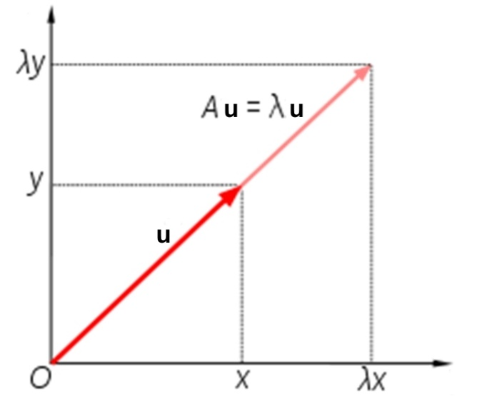
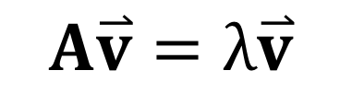
Linear autonomous dynamical systems: definitions
EIGENVALUES and EIGENVECTORS
The eigenvectors v of a square matrix are the non-zero vectors which, after being multiplied by the matrix, remain proportional each one to the original vector (i.e., change only in magnitude, not in direction).
For each eigenvector, the corresponding eigenvalue λ is the factor by which the eigenvector magnitude changes when multiplied by the matrix.
$$A\overset{⃑}{v}=λ\overset{⃑}{v}$$
EIGENVALUES
Solutions of the eq.:

Slide 19
Linear autonomous dynamical systems: definitions
HYPERBOLICITY
A linear autonomous dynamical system is said to be hyperbolic if all eigenvalues have nonzero real part.
A linear autonomous dynamical system is said to be non-hyperbolic if at least one eigenvalue has a real part equal to zero.
ORBITS
Assumptions:
1) n distinct Eigenvalues and Eigenvectors, (i.e., each eigenvalue λ_{i} has a unit algebraic multiplicity)
2) at least λ_{i} is complex
INVARIANT
A subset A of the state space X is said to be invariant if the orbits starting at each of its points (x₀∈A) are totally included in A (x(t)∈A).
If an eigenvalue λi has a unit algebraic multiplicity, the corresponding (real) eigenvector v_{i} forms a uni-dimensional invariant subspace (autospace of the matrix A relative to the eigenvalue λi).
Notes:
"invariant".
Se v è reale e la condizione iniziale appartiene alla retta passante per l’origine e parallela a v, l’evoluzione del sistema è contenuta in tale retta per ogni t∈ℜ. A causa di tale comportamento le direzioni individuate dagli autovettori reali (autospazi) si dicono invarianti. La stabilità su tali rette può essere determinata con le regole date per i sistemi lineari del primo ordine.

Slide 20
Linear autonomous dynamical systems:
Stability
ORBITS
x(t) is bounded if the terms
do not diverge.
Therefore:
SYSTEM STABILITY
Asymptotically Stable if Re(λ_{i})<0 ∀ i
Unstable if at least one eigenvalue λ_{i} exists with a positive real part

Slide 21
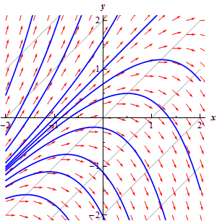
Autonomous dynamical systems: an example in the planar case
order n = 2
phase portrait
orbit
or
trajectory

Slide 22
Linear autonomous dynamical systems: the planar case
Assumptions:
A is invertible,
The eigenvalues λ₁ and λ₂ are non-zero.
v₁ and v₂ are the corresponding eigenvectors
c₁ and c₂ are constants
The origin (0,0) is the only steady-state point
The general solution is:

Slide 23
Planar linear dynamical systems: the hyperbolic case
Real Complex and conjugate
1)
1bis)
2)
2bis)
3)

Slide 24
Planar linear dynamical systems:
the non-hyperbolic case
Real Imaginary and conjugate
4)
8)
5)
6)
With 2 indipendent eigenvectors
7)
With only 1 indipendent eigenvector

Slide 25

PPlane
MATLAB and JAVA software for simulation and stability analysis of 2nd order (planar) systems,
either linear or non-linear
http://math.rice.edu/~dfield/

Slide 26
Phase Portrait:
1) λ₁ and λ₂ are real, distinct and negative
Eigenvalues λ₁= -1 λ₂= -4
Eigenvectors
(coincident with axis versors)
(NODO STABILE)
Knot or Nodal Sink

Slide 27
Phase Portrait:
1) λ₁ and λ₂ are real, distinct and negative
Eigenvalues λ₁= -1 λ₂= -4
Eigenvectors (not orthogonal !)
invariant
(NODO STABILE)
Knot or Nodal Sink

Slide 28
Phase Portrait:
2) λ₁ and λ₂ are real, distinct and positive
Eigenvalues λ₁=4 λ₂=1
Eigenvectors (not orthogonal !)
(NODO INSTABILE)
Unstable Knot or Nodal Source

Slide 29
Phase Portrait:
3) λ₁ and λ₂ are real, distinct and opposite
Eigenvalues λ₁= -1 λ₂= 3
Eigenvectors (not orthogonal !)
invariant
(SELLA)
Saddle

Slide 30
Phase Portrait:
1_{bis}) λ₁ and λ₂ complex with a negative real part
Eigenvalues λ₁= -1+3j λ₂= -1-3j
Eigenvectors
(complex !)
(FUOCO STABILE o POZZO A SPIRALE)
Stable Focus or Spiral Sink

Slide 31
Phase Portrait:
2_{bis}) λ₁ and λ₂ complex with a positive real part
Eigenvalues λ₁=1-2j λ₂=1+2j
Eigenvectors
(complex !)
(FUOCO INSTABILE)
Spiral Source

Slide 32
Phase Portrait:
8) λ₁ and λ₂ imaginary (non hyperbolic)
Eigenvalues λ₁= -2j λ₂= 2j
Eigenvectors
(complex !)
(CENTRO)
Center

The amplitude of the oscillation will depend on the initial condition.
NOT an asymptotically stable equil. point !

Slide 33
Planar linear dynamical systems:
Eigenvalues

Slide 34
Planar linear dynamical systems: real and distinct Eigenvalues
The eigenvalues are real and distinct when the discriminant Δ is positive
The sign of eigenvalues is from Carthesius rule:
Possible Cases
Unstable Knot | λ₁,λ₂∈R λ₁>0, λ₂>0 | Det(A)<[Tr(A)]²/4 Tr(A)>0 Det(A)>0
Stable Knot | λ₁,λ₂∈R λ₁<0, λ₂<0 | Det(A)<[Tr(A)]²/4 Tr(A)<0 Det(A)>0
Saddle | λ₁,λ₂∈R λ₁<0, λ₂>0 | Det(A)<[Tr(A)]²/4 Det(A)<0 ∀Tr(A)∈ℜ− ⎨0⎬  there are always a variation and a permanence in sign, whatever Tr(A)=0  there are two eigenvalues, real and opposed in sign

Slide 35
Planar linear dynamical systems: real and coincident Eigenvalues
The eigenvalues are real and coincident when the discriminant Δ is null
This can be viewed as the eq. for a parabola passing through the origin, having its vertical axis (Det A) coincident with the y-axis
Possible Cases
Unstable Knot | λ₁,λ₂∈R λ₁ = λ₂ = Tr(A)/2 > 0 | Det(A) = [Tr(A)]²/4 Tr(A)>0
Stable Knot | λ₁,λ₂∈R λ₁ = λ₂ = Tr(A)/2 < 0 | Det(A) = [Tr(A)]²/4 Tr(A)<0

Slide 36
Planar linear dynamical systems: complex and coniugate Eigenvalues
The eigenvalues are complex and coniugate when the discriminant Δ is negative
Possible Cases
Unstable Focus | λ₁,λ₂∈C-R Re(λ₁)=Re(λ₂)>0 | Det(A)>[Tr(A)]²/4 Tr(A)>0
Stable Focus | λ₁,λ₂∈C-R Re(λ₁)=Re(λ₂)<0 | Det(A)>[Tr(A)]²/4 Tr(A)<0
Center | λ₁,λ₂∈C-R Re(λ₁)=Re(λ₂)=0 | Det(A)>[Tr(A)]²/4 Tr(A) = 0

Slide 37
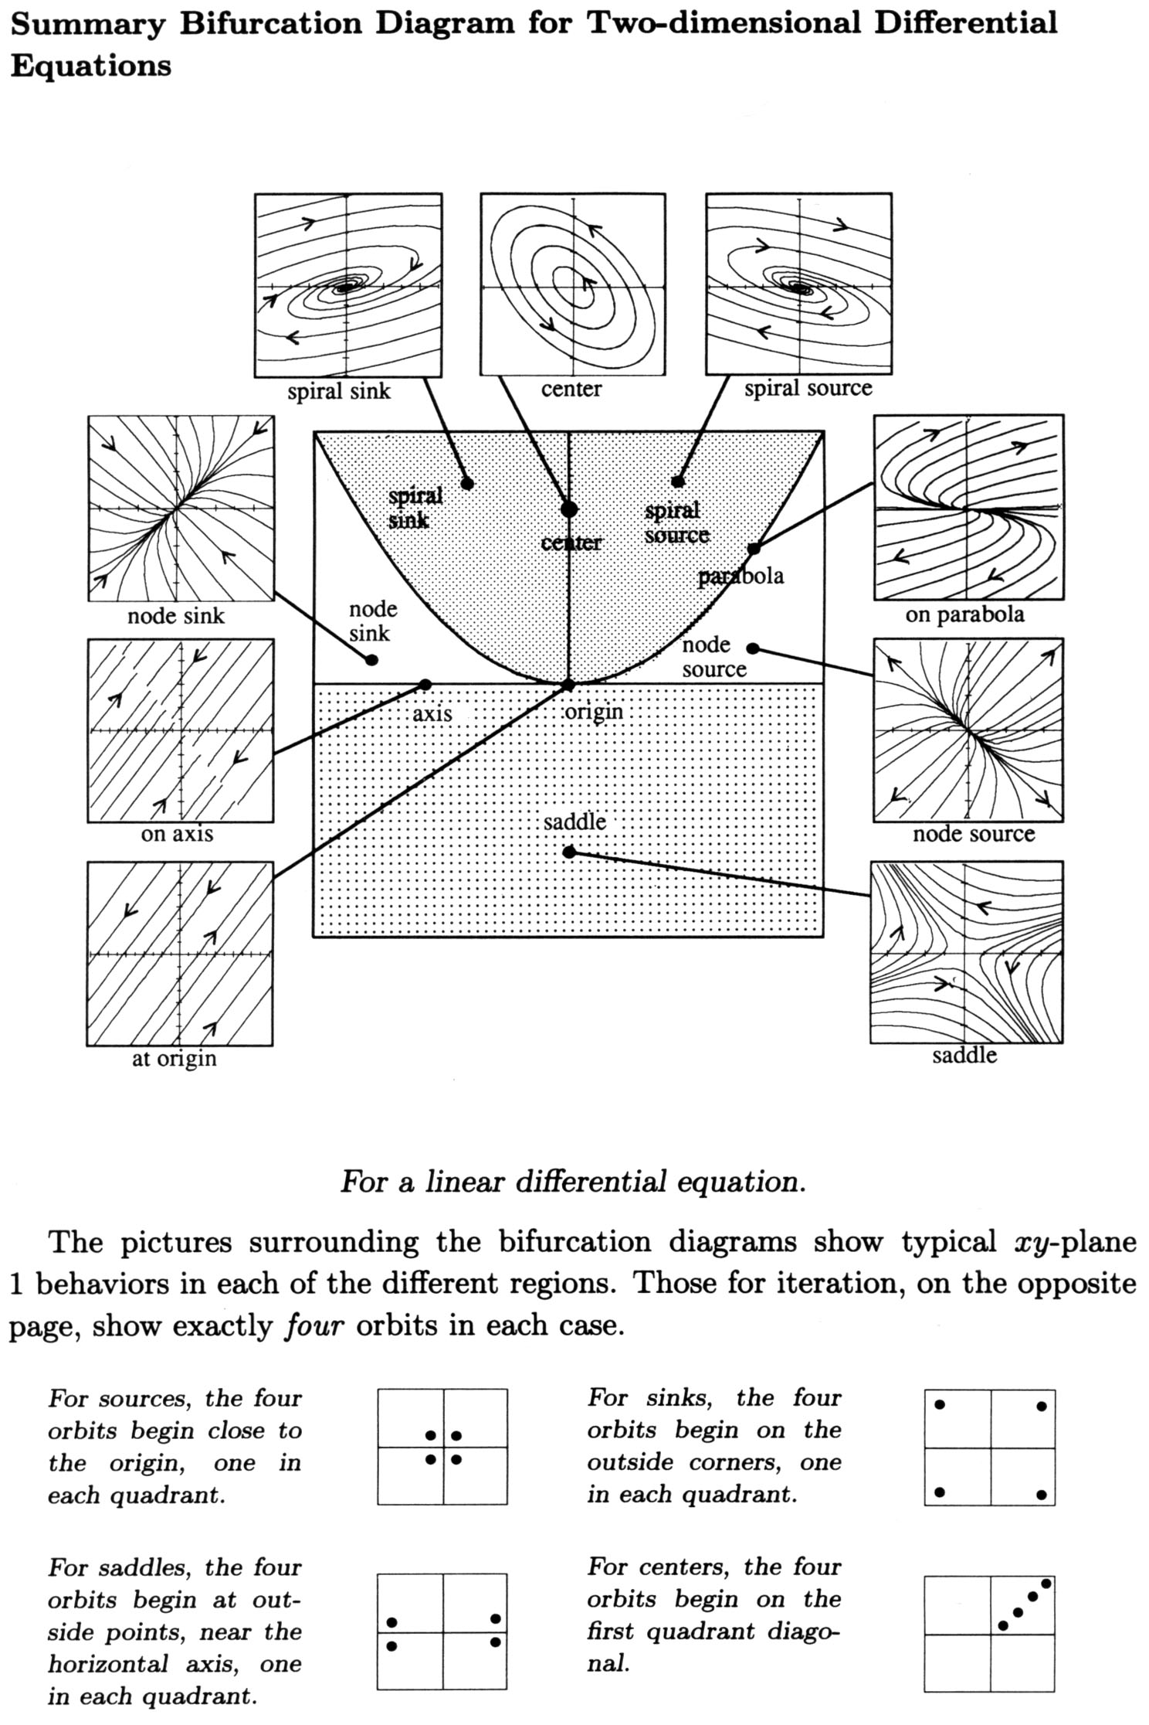
Planar linear dynamical systems:
General Diagram
det(A)
Tr(A)

Slide 38
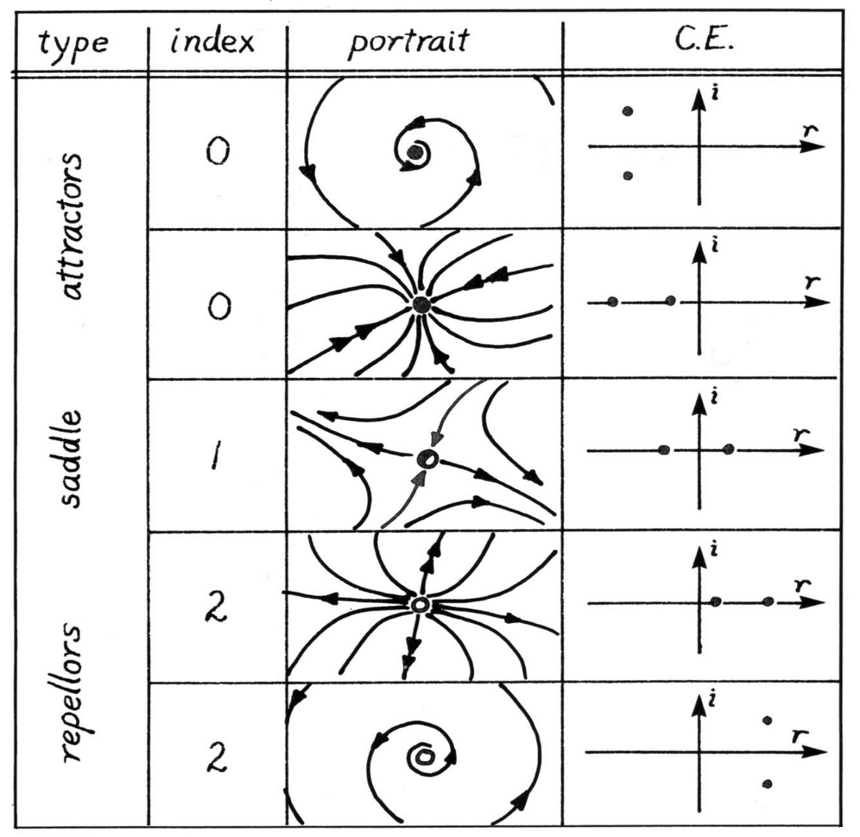
Planar linear dynamical systems: attractors and repellors
n = 2
eigenvalues

Slide 39
Non-linear autonomous dynamical systems

Slide 40
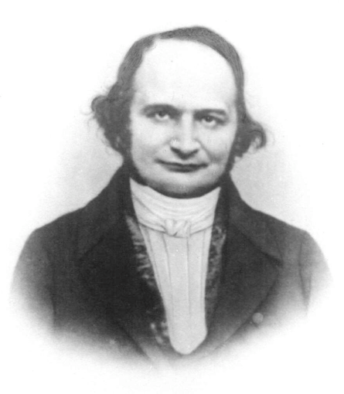
Linearization around a steady-state point
Let x_{s} be a steady-state point, which can be stable or unstable.
Let’s use Taylor expansion:
f(x)= f(x_{s})+ J(x_{s}) (x- x_{s})+ O(| x- x_{s}|²)
f(x_{s}) = 0 as it’s a steady-state;
The linear term is the product between the Jacobian matrix J and the vector (x – x_{s}).
The term O(| x- x_{s}|²) is an infinitesimal of order of | x- x_{s}|² and is negligible when x→ x_{s}.
Notes:
MANCA Taylor !

Slide 41
Stability of non-linear systems:
Linearization Method
The non-linear system is linearized with a 1st order Taylor expansion around x_{s};
y(t) = x(t) - x_{s} is set (deviation variables)
the new linearized system is analized according to the theory of stability for linear systems
dy/dt = J(x_{s}) y(t)
Lyapunov Theorem
(Lyapunov's indirect method)
If the new linearized system has all eigenvalues with a negative real part (asymptotically stable steady-state) then the steady-state is asymptotically stable even for the original non linear system
If the new linearized system has at least one eigenvalue with a positive real part (unstable steady-state) then the steady-state is unstable even for the original non linear system
Nothing can be concluded in other cases

Slide 42
Summary
1. Linearizazion Method
(Lyapunov's indirect method)
2. Lyapunov's 2nd method for stability (1892)
is more general
makes use of a Lyapunov function V(x) which has an analogy to the potential function of classical dynamics.
3. Direct Simulation Methods

Slide 43
The diabatic CSTR as the prototype of non-linear autonomous dynamical systems

Slide 44
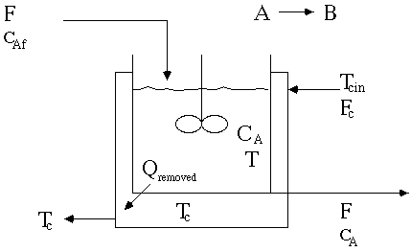
THE DIABATIC CSTR
Example No. 6
An example of
2nd order, non-linear, autonomous system
T_{f}
control volume
T_{j}
T
☞ Diabatic CSTR by Prof. B.W. Bequette:
http://www.rpi.edu/dept/chem-eng/WWW/faculty/bequette/education/links_mods/cstr/

Slide 45





THE DIABATIC CSTR
Example No. 6
Overall mass balance
Mass balance on A species
Energy balance balance
☞ Diabatic CSTR by Prof. B.W. Bequette:
http://www.rpi.edu/dept/chem-eng/WWW/faculty/bequette/education/links_mods/cstr/

Slide 46


THE DIABATIC CSTR
Example No. 6
IC: x₀ = (C_{A0} T₀)^{T}
Classifications
“first principles” math model (1st classification)
structured model (2nd classification)
non-linear because of Arrhenius (3rd classification)
continuous time (4th classification)
2nd order
autonomous
state variables C_{A}, T  x = (C_{A} T)^{T}
☞ Diabatic CSTR by Prof. B.W. Bequette:
http://www.rpi.edu/dept/chem-eng/WWW/faculty/bequette/education/links_mods/cstr/

Slide 47
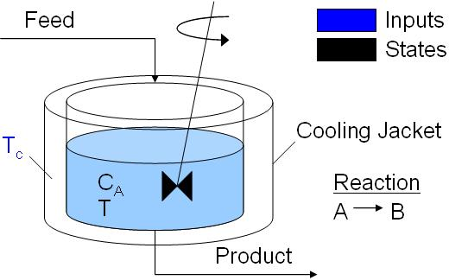
The Diabatic CSTR: a Matlab code
% CSTR model from Michael A. Henson and Dale E. Seborg. Nonlinear Process Control.
% Prentice Hall PTR, Upper Saddle River, New Jersey, 1997.
% Description:
% Continuously Stirred Tank Reactor with energy balance and reaction A->B.
% The temperature of the cooling jacket Tc is the input variable.
% The concentration of A and temperature are the state variables.
% The code calculates and plots the Time Chart.
Reference:
https://it.mathworks.com/matlabcentral/fileexchange/13556-continuously-stirred-tank-reactor-cstr

Slide 48
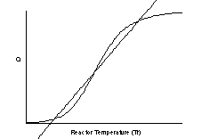
The Diabatic CSTR: multiple steady-states from the entalpy balance
Q_{R}
case C)
Q_{E}
Van Herden stability analysis
The energy removal rate is linear and has two terms (1) the energy needed to change the feed temperature to the reactor temperature, and (2) the energy removed or added by heat transfer to a cooling/heating fluid, which is at a constant temperature.
At steady state:
Van Herden stability analysis:
arbitrarily extends the steady-state entalpy balance to unsteady conditions;
is effective in determining unstable regimes, but not the stable ones.
Reference:
[1] Multiple Steady States in a Continuously Stirred Tank Reactor. http://www.rpi.edu/dept/chem-eng/WWW/faculty/bequette/education/links_mods/cstr/

Slide 49
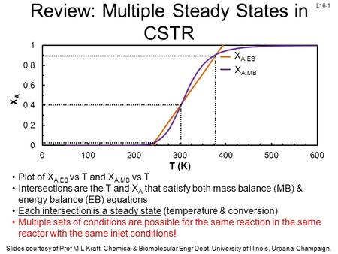
The Diabatic CSTR: multiple steady-states from the mass balance
case C)
Van Herden stability analysis
The non-dimensional conversion has two terms (1) from the energy balance (EB), and (2) from the mass balance (MB)
At steady state:
X_{A,EB} = X_{A,MB}
Reference:
See Ch. 8 in Levenspiel O., Chemical Reaction Engineering, 1972

Slide 50

The Diabatic CSTR: multiple steady-states from the mass balance
Reference:
http://demonstrations.wolfram.com/MultipleSteadyStatesInAContinuouslyStirredTankReactor/
www.colorado.edu/learncheme/kinetics/MultipleSteadyStatesCSTRnoHeat.html

Slide 51
The Diabatic CSTR: non-dimensional model
Non-dimensional variables:
                t’=t/t_{R}
Non-dimensional parameters:
Model:
Notes:
Da e Beta da verif.

Slide 52
Diabatic CSTR: multiple steady-state
(Da=0.04; beta=1.5)
phase portrait
Notes:
Introdurre I par. Adimensionali
Ed adim. Le eq. !!!

Slide 53
Diabatic CSTR: stable steady-states
low conversion
Stable Knot
Coordinates (0.043,0.388)
Eigenvalues -1.14, -1.48
Eigenvectors
(0.400, -0.916)
(-0.09, 0.995)
high conversion
Stable Focus
Coordinates (0.921, 8.11)
Eigenvalues -2.14+4.01j
-2.14-4.01j
Eigenvectors
(0.041+0.016j, -0.999)
0.041-0.016j, -0.999)

Slide 54
Diabatic CSTR: unstable steady-state
phase portrait
nullcline
Saddle
Coordinates (0.412,3.64)
Eigenvalues -0.751, 3.23
Corresponding Eigenvectors: (-0.304, -0.952)
(-0.061, 0.998)

Slide 55
Diabatic CSTR: dynamical (periodic) regime
(Da=0.07; beta=2.3)
phase portrait
Stable limit cycle
unstable steady-state

Slide 56
Diabatic CSTR: limit cycle
(Da=0.07; beta=2.3)
phase portrait
time trajectories (corresponding)
t’

Slide 57
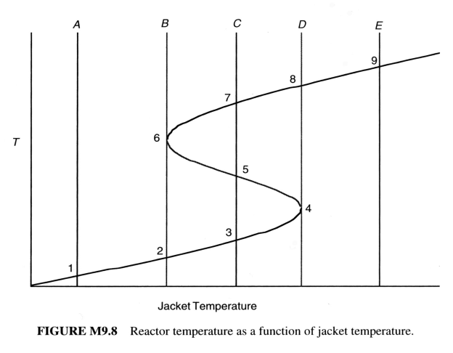
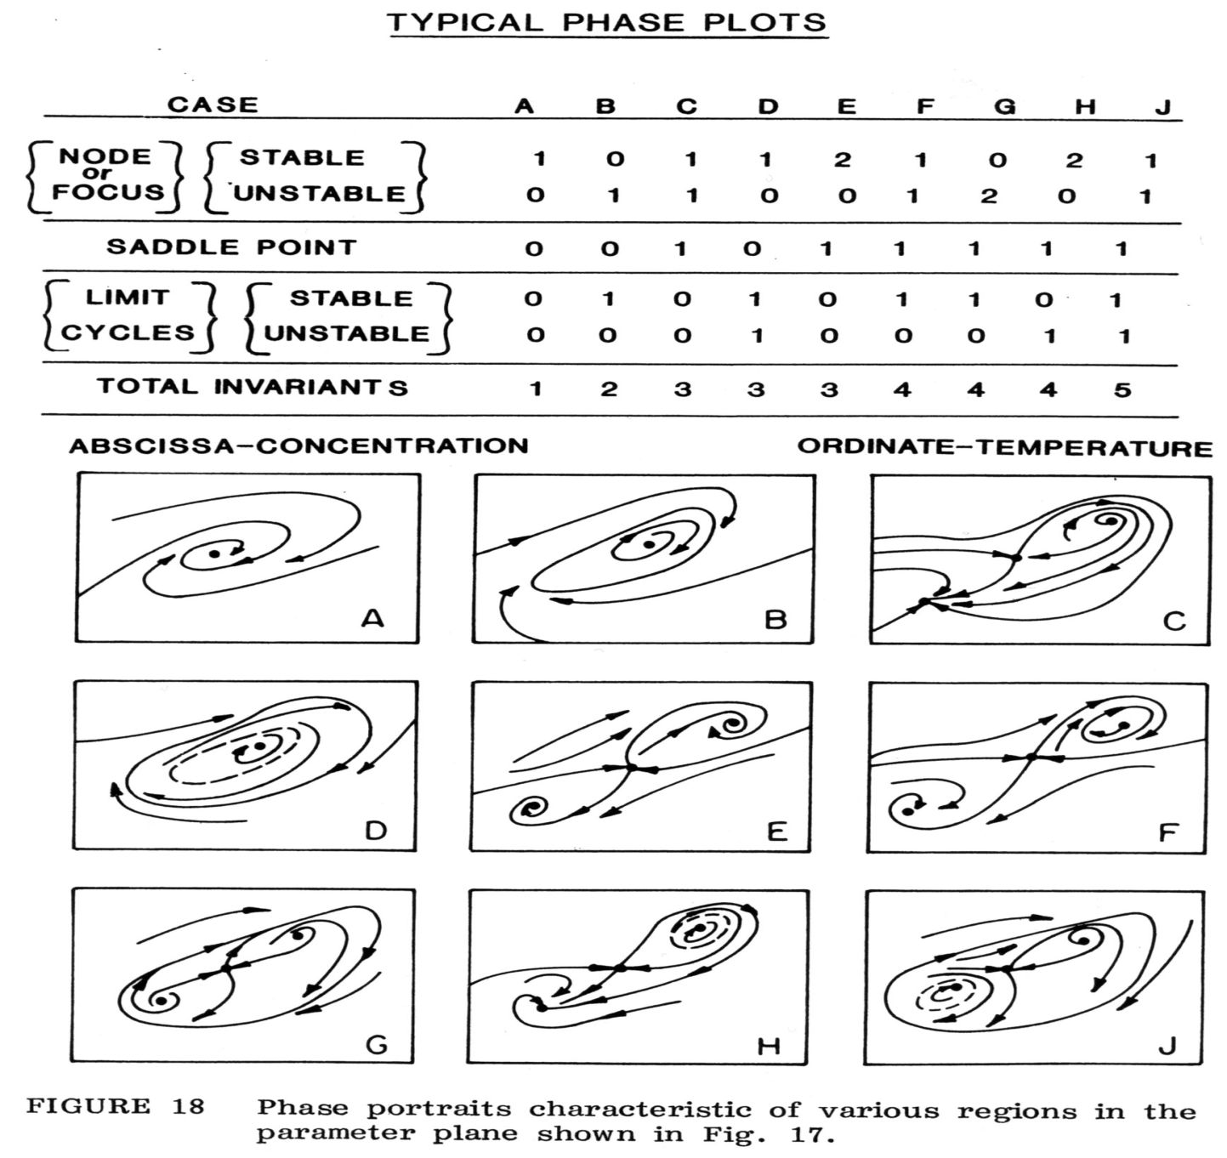
Diabatic CSTR
the solution diagram

Slide 58
Concept of bifurcation
A nonlinear dynamic system differs from a linear dynamic system in that its qualitative properties can change under small perturbations of the model parameters.
These properties include the number of equilibria, stability of the equilibria, existence of limit cycles, multiple modes of behavior, and chaos.
 Zhang, Y. and Henson, M. A. (2001), “Bifurcation analysis of continuous biochemical reactor models”, Biotechnology Progress, 17, p. 647-660
Bifurcation is a sudden and drastic change in important properties of a nonlinear system (e.g., type of asymptotic regimes or their stability), following a smooth gradual change in one or more model parameters (“bifurcation parameters”) deviating from their design or predetermined values.
 Cosenza and Miccio (2015)
Notes:
In generale, si dice che un parametro attraversa un valore di biforcazione quando determina il passaggio fra due situazioni dinamiche qualitativamente diverse, dovuto ad esempio alla creazione o scomparsa di punti di equilibrio o altri tipi di regimi asintotici, oppure cambiamenti di stabilità.
Gian-Italo Bischi, Rosa Carini, Laura Gardini e Paolo Tenti pubblicato sul n. 47 di Lettera matematica pristem

