Slide 1

The Nyquist stability criterion
Example problem
from Exam_2013-07-22
(imaginary coniugate poles with double multiplicity)
rev. 1 of July 13, 2015 by Michele MICCIO

Slide 2
Use your brain and be smart!

Slide 3
Open Loop transfer function
G_{c} = K_{c}
G_{f} = 1
>> n=1
>> G_OL = 1/n/(s+n)/(s^2+n^2)^2
Transfer function:
1
---------------------------------
s^5 + s^4 + 2 s^3 + 2 s^2 + s + 1

Slide 4
Nyquist Plot
Positive frequency

Slide 5
Extended Nyquist
(Originally plotted)

Slide 6
The critical point
("zoom on -1,0" right click command)

Slide 7
Region near the critical point
(zoomed)

Slide 8
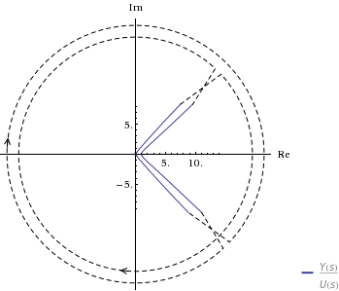

Closure at infinity
http://www.wolframalpha.com/examples/ControlSystems.html

Slide 9
Conclusions
N = 2
P = 0
Z = N + P = 2
Closed loop Unstable system

