Slide 1
TSPC_Exam_2015-11-06 Nyquist diagram Matlab construction with tricks, doubts and alternatives
Solution with n = 22
Rev. June 10, 2022 by M. Miccio

Slide 2
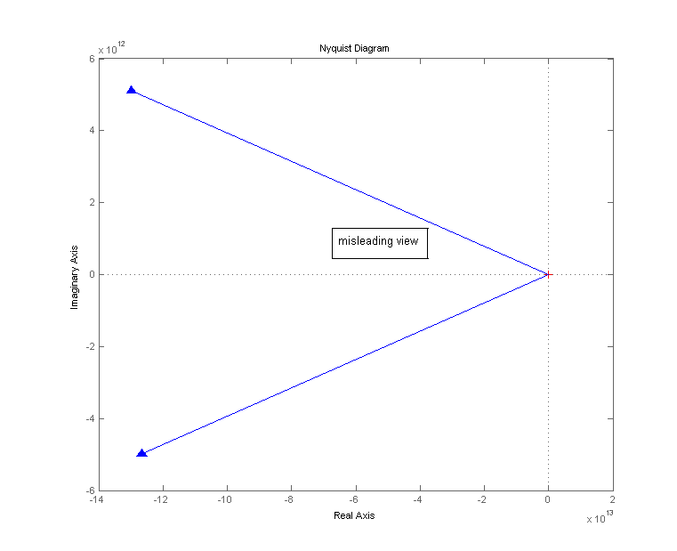
TSPC_Exam_2015-11-06 Nyquist by default
As plotted by the command nyquist at the prompt
☹
n = 22

Slide 3
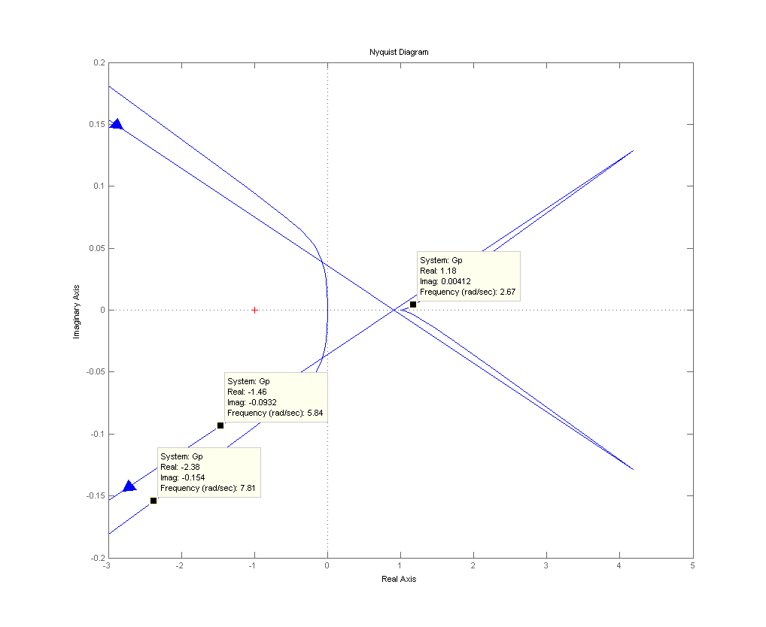
TSPC_Exam_2015-11-06 extended Nyquist zoomed
Zoomed, after plotting by the command nyquist at the prompt
🤔
Straight lines drawn by Matlab to connect the Nyquist points at infinity.
 They are NOT the "closure at infinity"
☹
The frequency does not change when dragging the cursor over here !
Notes:
n = 22

Slide 4
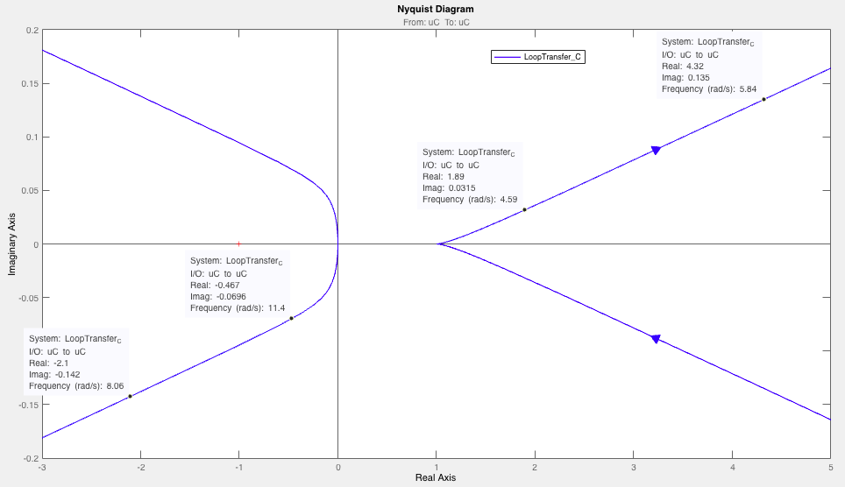
TSPC_Exam_2015-11-06 extended Nyquist zoomed
Zoomed, after plotting by Sisotool
☺
Notes:
n = 22

Slide 5
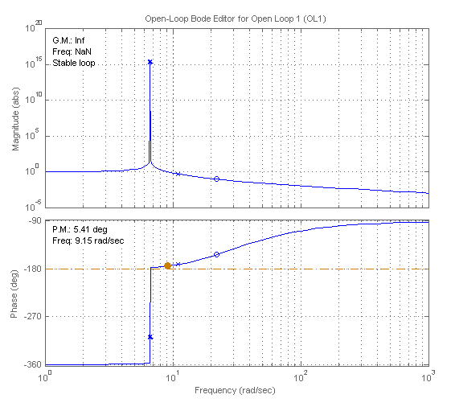
TSPC_Exam_2015-11-06 Bode diagrams
n = 22
180° discontinuity jump in phase at resonance frequency
The phase can/must be read “modulo 360° ”
Notes:
n = 22

Slide 6
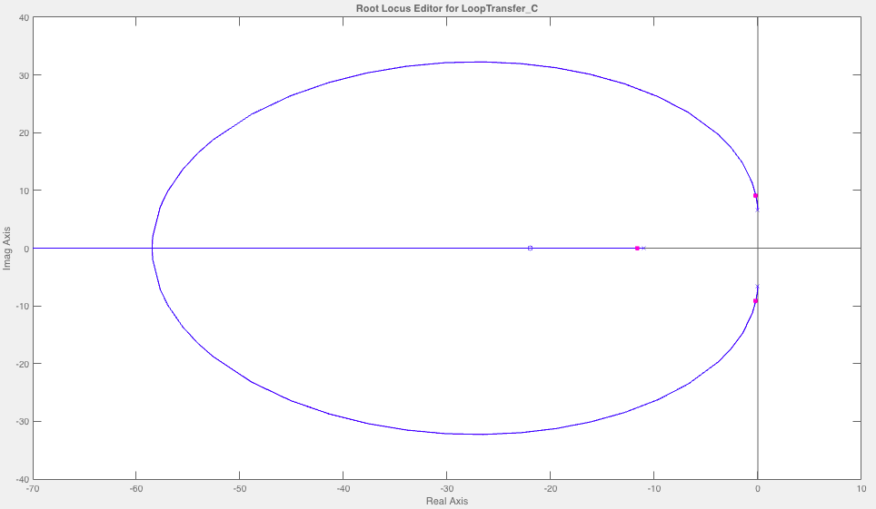
TSPC_Exam_2015-11-06 root locus
☺ Actually plotted by Sisotool
stable loop
Notes:
n = 22

Slide 7
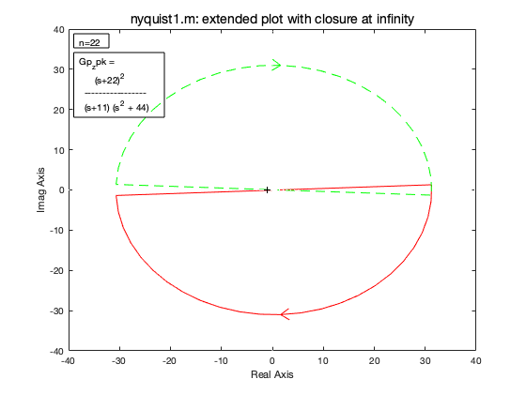
TSPC_Exam_2015-11-06 extended Nyquist with closure at infinity
Actually plotted by the script nyquist1.m
n = 22
>> nyquist1(Gp)
p =
-11.0000 + 0.0000i
0.0000 + 6.6332i
0.0000 - 6.6332i
Open loop poles
P =
0
P=number of Open loop poles in rhp
N =
1
N=number of clockwise encirclements
Z =
1
Z = P + N = number of closed loop poles in rhp
😐
☹

Slide 8
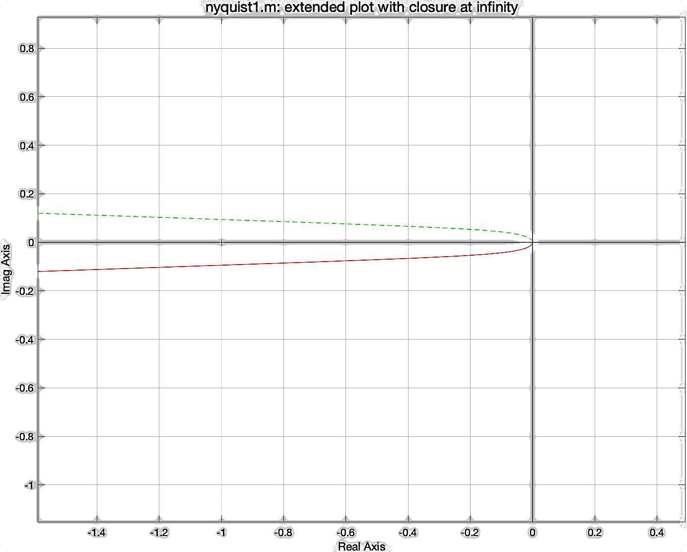
TSPC_Exam_2015-11-06 extended Nyquist with closure at infinity
Zoomed, after plotting by nyquist1.m
default
zoomed directly on the figure
☺
add +1 to N
add −1 to N

Slide 9
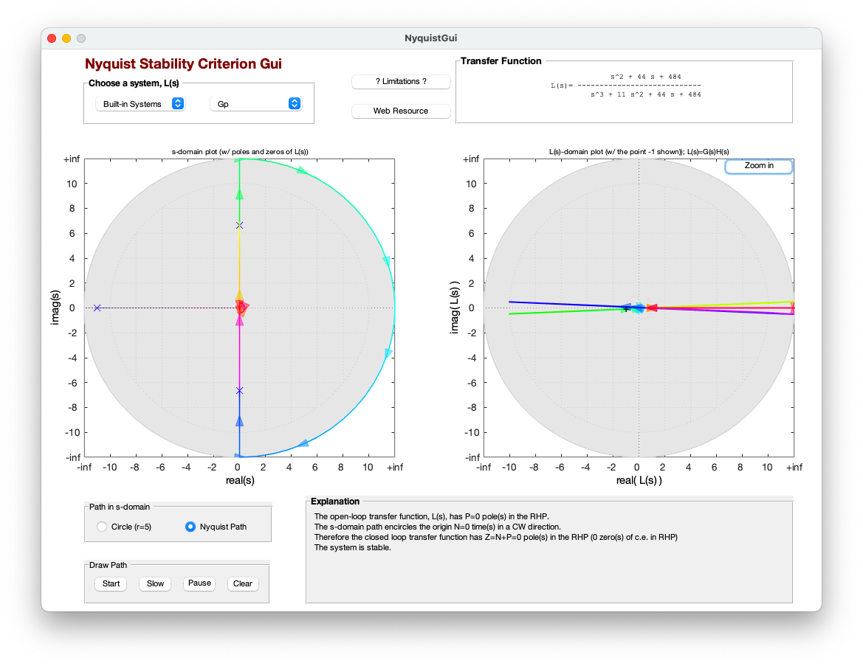
TSPC_Exam_2015-11-06 extended Nyquist with closure at infinity
☺ Actually plotted by the script nyquistGUI.m
stable loop

Slide 10
TSPC_Exam_2015-11-06 extended Nyquist with closure at infinity
Actually plotted by www.wolframalpha.com
n = 22
☺
Number of times that the extended polar plot of G_{OL}(jω) encircles the (–1,0) point in the clockwise direction:
N = -1 +1 = 0

